Slide 1
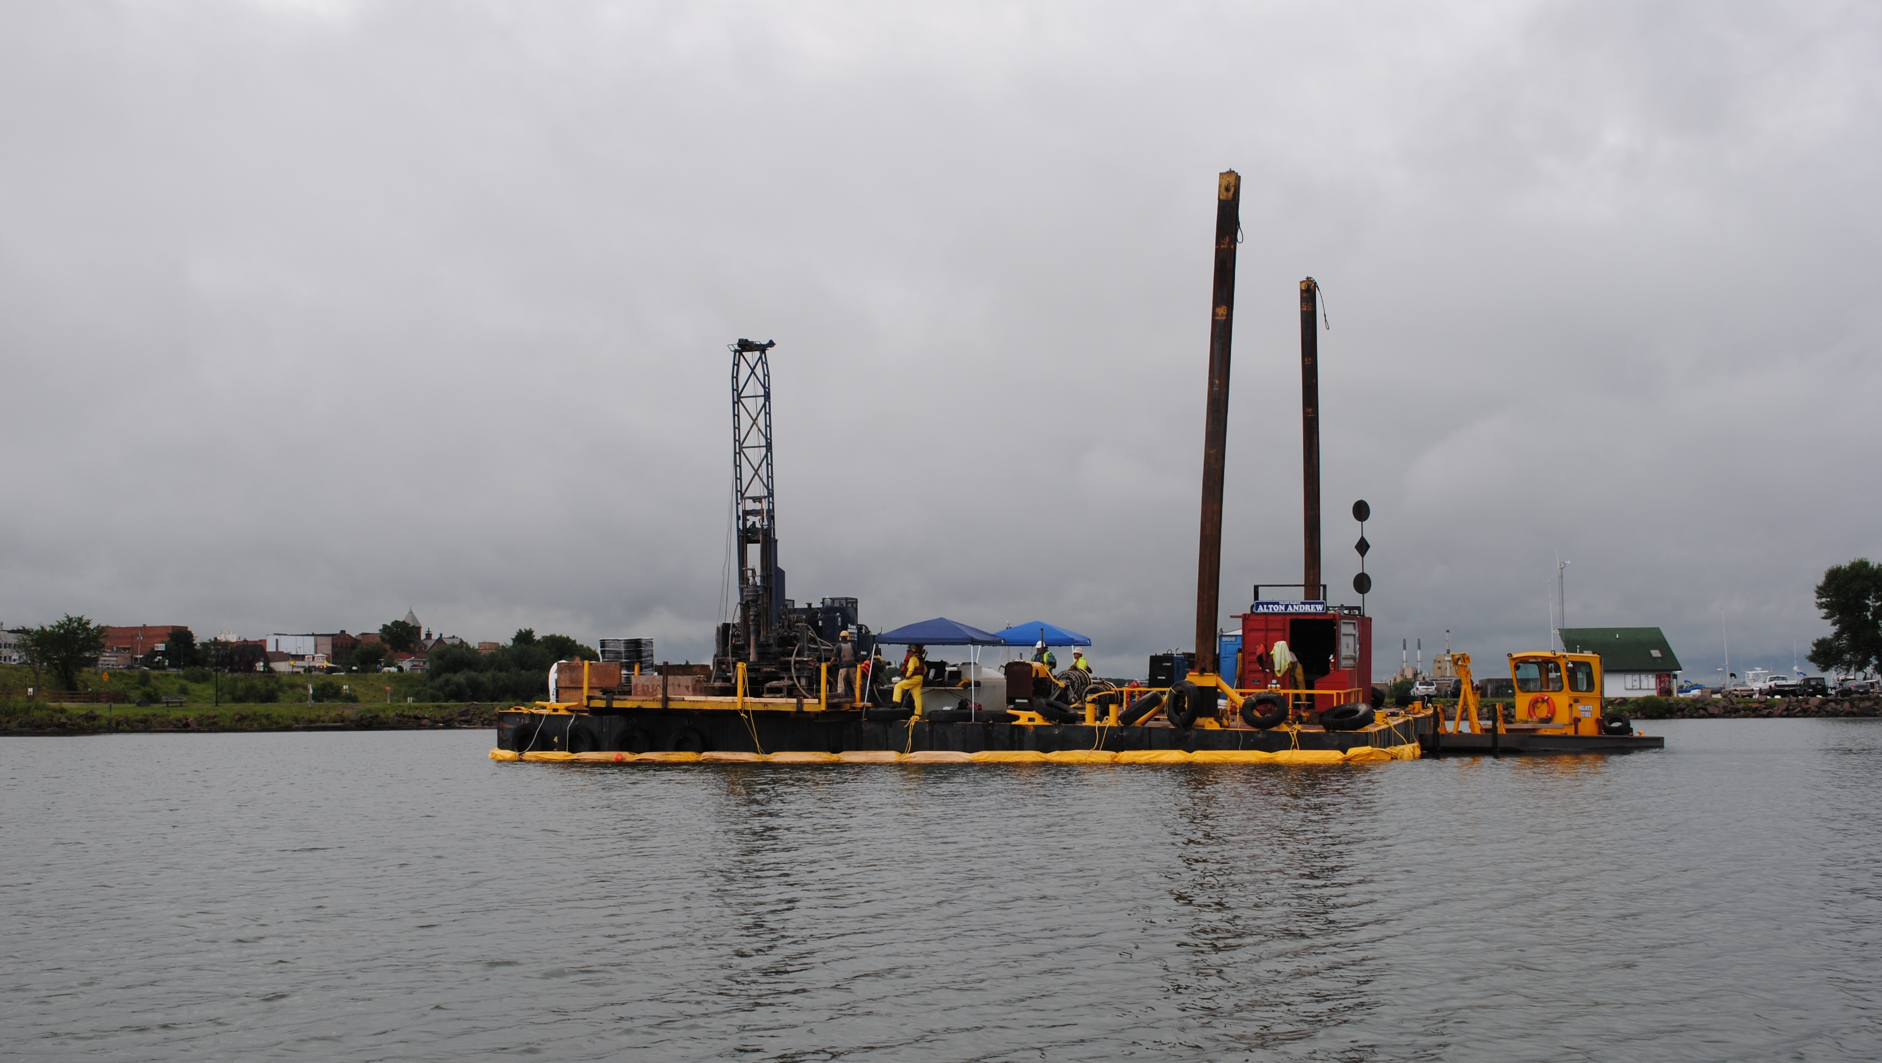
Ashland/NSP Lakefront Superfund Site
Project Update
September 2013

Slide 2
Overview of Site History
1989
Contamination (tars/oils) first documented near the former City of Ashland wastewater treatment plant.
1993
WDNR starts the State Funded investigation.
1995
Conclusion that contamination source is a former manufactured gas plant.

Slide 3
Overview of Site History
2002
Site added to the National Priorities List.
2003
NSPW signed an Administrative Order of Consent with EPA to conduct a remedial investigation and feasibility study for the site.
2008
NSPW completes the RI/FS as approved by EPA.

Slide 4
Overview of Site History
Record of Decision (ROD) was issued on September 30, 2010.
The ROD is a document that explains which cleanup alternatives will be used to clean up a Superfund site.
On October 18, 2012, Consent Decree was entered by the court for the Phase I remedial design/remedial action (RD/RA) of the selected remedy for the on land portion of the site.

Slide 5
What the Remedial Investigation Found
Types of the Contamination
  VOCs
  PAHs
  Metals
Degree and Extent
Nature of Contaminants
  Free Product
  Dissolved Phase

Slide 6
Sediment
16 acres impacted above the preliminary remediation goal of 9.5 ppm total PAHs.
Significant free product oil/tars in the near shore zone.
Some areas covered with wood waste.

Slide 7
Feasibility Study
The FS is the mechanism for the development, screening, and detailed evaluation of alternative remedial actions.

Slide 8
Remedial Action Objectives
Groundwater
Protect human health by eliminating exposure (direct contact, ingestion, inhalation) to groundwater with COCs in excess of regulatory or risk-based standards.
Restore groundwater to its beneficial use by reducing contaminant levels in groundwater to meet maximum contaminant levels (MCLs) and State of Wisconsin Drinking Water Standards.
Protect the environment by controlling the off-site migration of contaminants in groundwater to surrounding surface water bodies which would result in exceedance of applicable or relevant and appropriate requirements (ARARs) for COCs in surrounding surface waters.

Slide 9
Remedial Action Objectives
Groundwater
Conduct NAPL removal whenever it is necessary to halt or contain the discharge of a hazardous substance or to minimize the harmful effects of the discharge to the air, land, sediments or water.
• Protect the environment by minimizing/eliminating the migration of contaminants in the groundwater to soil, sediments or to surrounding surface water bodies.
No COPCs were initially identified in the HHRA for groundwater because groundwater

Slide 10
Remedial Action Objectives
Sediment
Protect human health by eliminating exposure (direct contact, ingestion, inhalation, fish ingestion) to sediment with COCs in excess of regulatory or risk-based standards;
Conduct NAPL (source) removal whenever it is necessary to halt or contain the discharge of a hazardous substance or to minimize the harmful effects of the discharge to the air. land or water; and
Protect populations of ecological receptors or individuals of protected species by eliminating exposure (direct contact with sediment or ingestion of sediment or prey) to sediment with COCs that would pose an unacceptable risk.

Slide 11
Remedial Action Objectives
Soil
Protect human health by reducing or eliminating exposure (ingestion/direct contact/inhalation) to soil having COCs representing an excess cancer risk greater than 10' as a point of departure (with cumulative excess cancer risks not exceeding 10-5) and a hazard index (HI) greater than 1 for reasonably anticipated future land use scenarios.
Ensure future beneficial commercial/industrial use of the Site and recreational use of Kreher Park.
Protect populations of ecological receptors or individuals of protected species by eliminating exposure (direct contact with or incidental ingestion of soils or prey) to soil with levels of COCs that would pose an unacceptable risk.

Slide 12
Remedial Action Objectives
Soil
Protect populations of ecological receptors or individuals of protected species by eliminating exposure (direct contact with or incidental ingestion of soils or prey) to soil with levels of COCs that would pose an unacceptable risk.
Conduct NAPL removal whenever it is necessary to halt or contain the discharge of a hazardous substance or to minimize the harmful effects of the discharge to the air, land, sediments or water (groundwater and surface water).

Slide 13
Sediment Options
Confined Disposal Facility
(landfill within the lake)
Capping
Removal (dredging)
Combination

Slide 14
Detailed Analysis
Detailed analysis is the last phase of the Remedial Investigation/Feasibility Study process. Once sufficient data are available, alternatives are evaluated in detail with respect to nine evaluation criteria that the Agency has developed to address the statutory requirements and preferences of CERCLA.

Slide 15
The nine criteria include:
Overall Protection of Human Health and the Environment;
Compliance with ARARs
Long-term Effectiveness and Permanence;
Reduction of Toxicity, Mobility, or Volume;
Short-term Effectiveness;
Implementability;
Cost;
State Acceptance; and
Community Acceptance.

Slide 16
Threshold Criteria
(Each cleanup method must satisfy this criteria)
Protecting human health and the environment
Compliance with state and federal regulations

Slide 17
Criteria Balance
(Technical criteria with detailed analysis)
Ability to implement
Long-term effectiveness
Short-term effectiveness
Reduce toxicity, mobility, and volume
Cost

Slide 18
Modifying Criteria
(Considered after threshold and balancing criteria)
State Acceptance
Community Acceptance

Slide 19
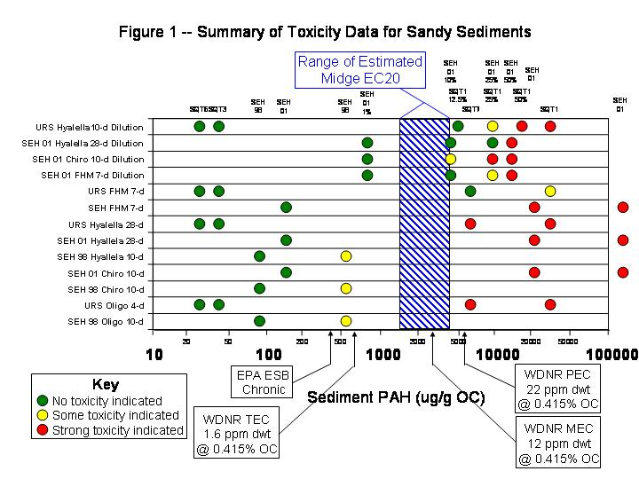

Slide 20
Sediment
Selected Remedies
Dry removal - near shore sediment and wood debris.
Wet dredging - offshore sediment and wood debris.
Sediment treated or disposed off-site.

Slide 21
Dry removal – near shore sediment and wood debris
Will reduce/eliminate re-suspension from high quantity of free product coal tar
Will eliminate slicks
Will allow the use of covers/foams to control odors
Protective of Human Health and the Environment

Slide 23
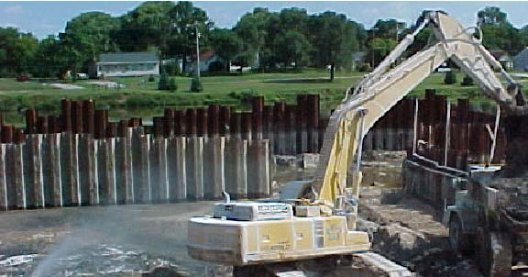

Slide 24
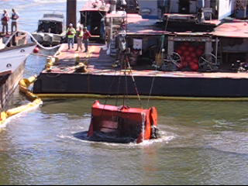

Slide 25
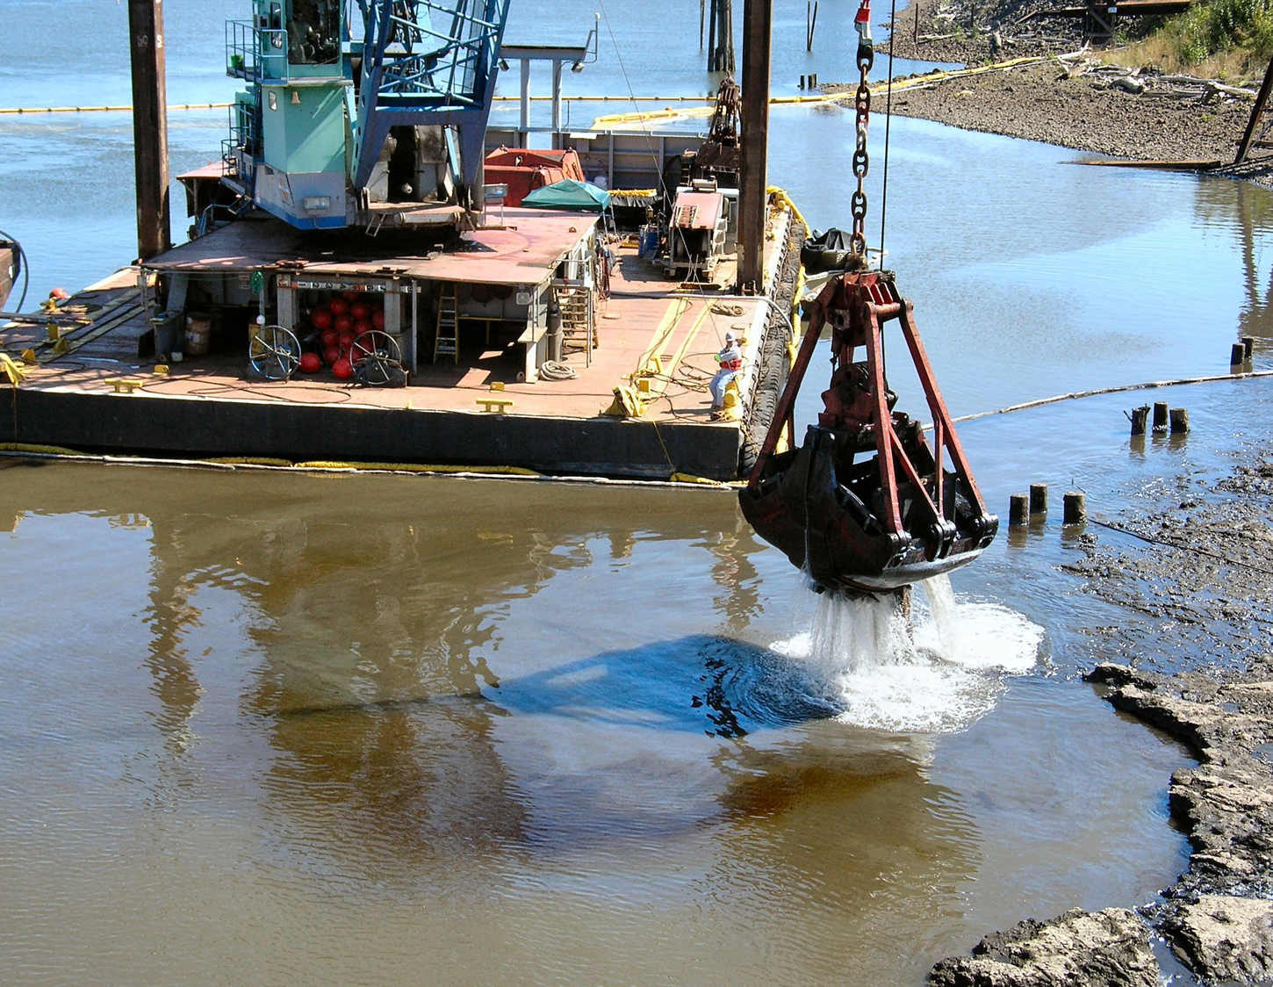

Slide 26
Wet dredging - offshore sediment and wood debris
(areas with less free product)
Remove wood debris from sediments
Mechanically or hydraulically dredge sediments
Protective of Human Health and the Environment

Slide 27
Selected Remedies
Upper Bluff/Filled Ravine and Kreher Park Soils
Limited soil removal and thermal treatment.
Contaminated soil will be treated and/or disposed off-site.

Slide 28
Selected Remedies
Upper Bluff/Filled Ravine and Kreher Park Ground Water
Engineered surface barriers, and
Vertical barriers with hydraulic containment for the shallow ground water.

Slide 29
Selected Remedies
Copper Falls Aquifer
Enhanced ground water extraction.
In-situ treatment.

Slide 30
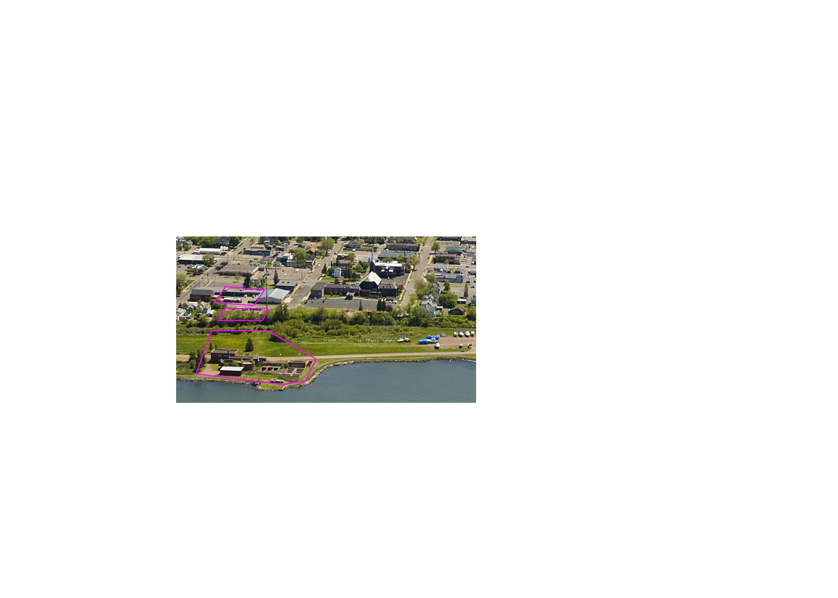

Slide 31
Status of On Land Work
Phase I addresses the on land portions of the selected remedy but does not address the sediment in the bay.
Remove soil from the most contaminated areas of Kreher Park and what is known as the Upper Bluff/Filled Ravine that overlooks the park area. The soil will be treated on-site and re-used after treatment.

Slide 32
Status of On Land Work
Use barriers to contain and stop the movement of contaminants in ground water, treat the ground water in-place and add wells to extract and treat groundwater.

Slide 33
Status of On Land Work
EPA is currently reviewing remedial designs for the on land work.
Initially, in an effort to start work this fall, the designs were separated (Soil Excavation/Thermal Treatment, Shoreline Wall, Remaining Containment Wall, and Copper Falls).
However, it was realized that the designs were integral to each other.

Slide 34
Status of On Land Work
Three of the designs will be combined into one (Soil Excavation/Thermal Treatment, Shoreline Wall, and the Remaining Containment Wall).
The plan will be to finalize the design in order to start work in spring 2014.

Slide 35
Cleanup of Contaminated Sediments in the Bay
Selected Remedies:
Dry excavation - near shore sediment and wood debris.
Wet dredging - offshore sediment and wood debris.
Sediment treated or disposed off-site.
Allowing wet dredge pilot test to be performed to see if it can meet performance standards.

Slide 36
Cleanup of Contaminated Sediments in the Bay
The ROD allows for a pre-design pilot test to determine whether wet dredging for the sediments will meet performance standards in the near shore area and can be conducted in a manner protective of human health and the environment.
To date NSPW has not submitted a Work Plan for a Pilot Test.

Slide 37
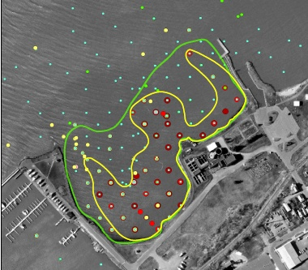

Slide 38
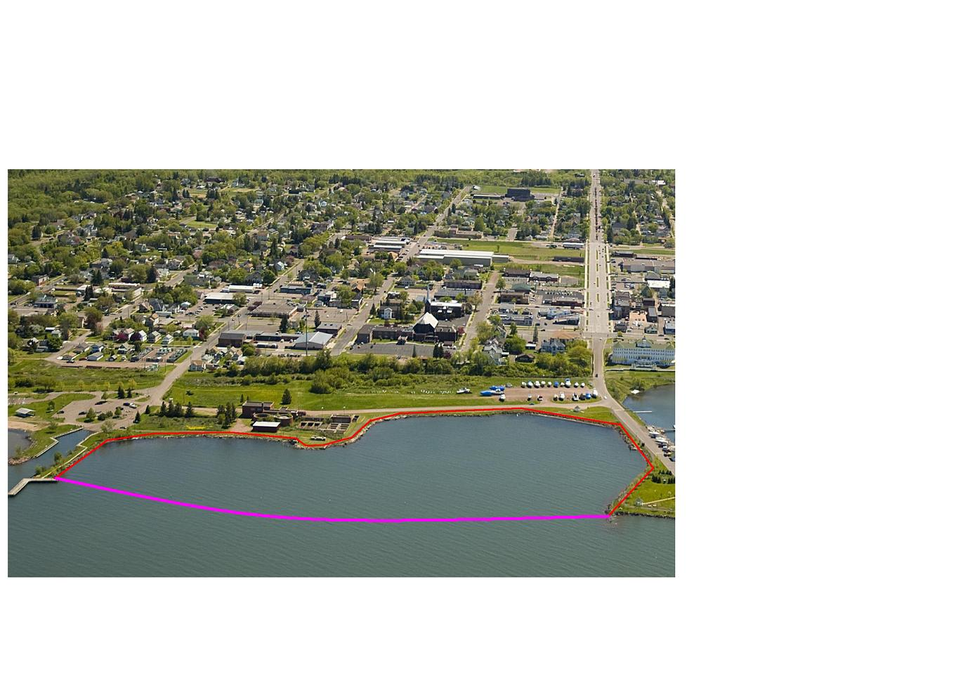

Slide 39
State and Community Acceptance
The State of Wisconsin through the Department of Natural Resources agrees with this Record of Decision via Letter of Concurrence
Public Comments collect during the Proposed Plan Process were addressed in the Record of Decision

Slide 40
Public Comments
Support
The majority of the comments support the cleanup of the site
The need to protect human health and environment
In agreement with the City’s Waterfront Development Plan including the possible harbor expansion

Slide 41
Community Comments
October 25, 2007 Community Workshop
  Comments were received and collated into categories to aid in development of the Proposed Plan.
June 7 through August 17, 2009 Public Comment Period for the Proposed Plan. Comments received were used to develop the Record of Decision.

Slide 42
Public Comments
Concerns
Exposure to air contamination during cleanup
Truck traffic and road damage
Cleanup be done right the first time
Overall cost and how it will effect the NSPW ratepayers
Worker safety issues with dry excavation of sediments

Slide 43
Public Comments
Concerns (continued)
A pilot project should be used to optimize the full scale wet dredge remedy, and
Performance standards need to be selected that are practical and implementable.

Slide 44
ROD Response
The ROD allows for a pre-design pilot test to determine whether wet dredging for the sediments will meet performance standards in the near shore area and can be conducted in a manner protective of human health and the environment.

Slide 45
ROD Response
If the pilot test results show that wet dredging can meet the established standards and EPA, in
consultation with WDNR, recommends wet dredging as the sediment remedy, then the
site-specific operations data from the pilot project will be used to help optimize a future,
full-scale wet dredge remedy.

Slide 46
Status of Cleanup
(Sediment)
Concerns were raised that the selected sediment cleanup cannot be safely implemented.
EPA requested data be collected in the bay to fully evaluate these issues.

Slide 47
Status of Cleanup
(Sediment)
An Administrative Order on Consent was signed on July 31, 2013, to conduct offshore sampling.
The offshore sampling began on August 1 and was completed on September 13.

Slide 48
Next Steps
Data Report for the offshore sampling will be submitted in November 2013.
Evaluate data to determine if the selected sediment remedy can be safely implemented or whether a remedy change is necessary.
Negotiations for sediment remedy will resume.

Slide 49
Remedial Design/
Remedial Action
Remedial Design (RD) is the phase in Superfund site cleanup where the technical specifications for cleanup remedies and technologies are designed.
Remedial Action (RA) follows the remedial design phase and involves the actual construction or implementation phase of Superfund site cleanup. The RD/RA is based on the specifications described in the ROD.

Slide 50


