Slide 1

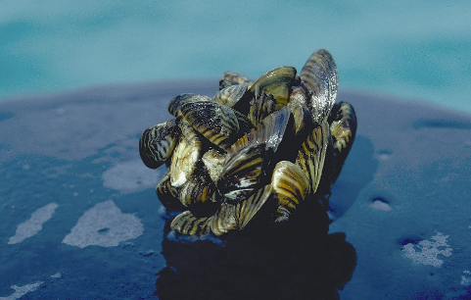
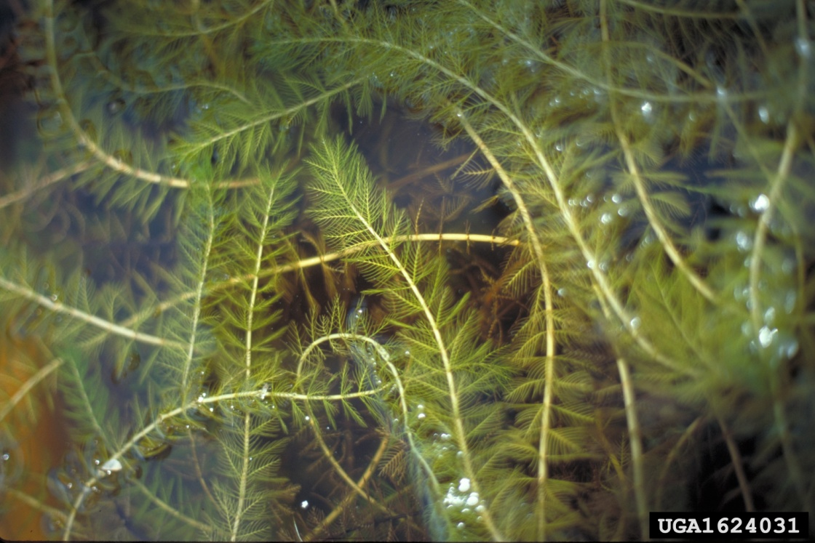
Aquatic Invasive
Species in Wisconsin
Name: Brad Morris, Mike Wampfler, Matt Wood
Location: Burnett County Government Center
Date: July 9, 2011

Slide 2




Wisconsin Lakes Partnership
Science
Citizens
Education
Notes:
Wisconsin’s AIS programs are supported by the Wisconsin Lakes Partnership.

Slide 3
Main Topics
Our problem - aquatic invasive hitchhikers
Species Profiles - more info on a few species causing the problem
What you will be doing to monitor for AIS in your area
Go through the resources provided to you
Notes:
Roadmap for presentation—main topics to cover
Background/introduction
Species examples
Wisconsin AIS programs
AIS grant program
AIS laws & regulations

Slide 4
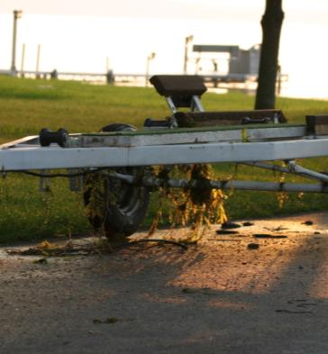
What are Invasive Species?
Non-native species that can “take over”
Not all non-native species are invasive
Successful because:
  No natural predators, parasites, etc.
  Native species can’t hide, compete, or fight back
  Often aggressive, prolific, and mature early
Notes:
Many are familiar with invasive species and the problems they cause, but want to give a little introduction to make sure that all on the same page and up to speed.
Definition: Invasive species are non-native plants, animals and pathogens that may cause economic, environmental and recreational harm, or affect human health.
Invasive because in native environments predators, parasites, pathogens, and competitors keep these species in check and create a balance, but in a new environment those checks and balances aren’t there.
These species can out-compete native species because they are aggressive, reproduce quickly and mature early.

Slide 5
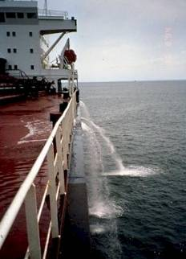
How do they get here?
Shipping - ballast water
Intentional introduction - stocking
Canals - migration from the ocean
Nursery industry
Anglers/Bait industry
Aquaculture
Aquarium trade
Common Theme????
Notes:
Invasive species can be introduced and moved around by a variety of activities such as:
-ballast water of ocean-going ships
-sport fish stocking
-accidental releases associated with bait business, aquaculture industry, aquarium trade, and horticultural practices
Common theme is that they are primarily moved by humans.

Slide 6
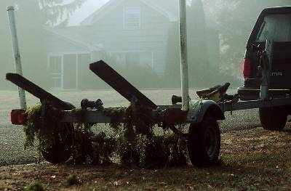
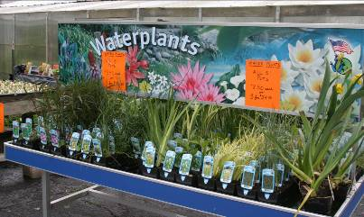
How do they spread?
Boaters
Anglers
Other water users (sea planes, SCUBA, etc)
Water garden & aquarium owners
Natural dispersal
Notes:
Once in our waters and wetlands, aquatic invasive species rely on humans to spread from one water body to another. This is often accomplished by “hitching a ride” on:
-boats, trailers equipment moved from one water to another
-bait buckets and livewells
-sea planes, SCUBA gear, personal watercraft
Accidental release from aquariums and water gardens also contributes to spread
Once introduced, some species can spread to adjacent waters without human help (plant seeds/fragments, fish via tributaries)

Slide 7
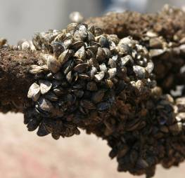
Why do we care?
Economic impacts
  Sport and commercial fishing
  Tourism
  Water users & property owners
Ecological
  Native fish, invertebrates, plants impacted
Recreational impacts
  Boating
  Angling
Notes:
Aquatic invasive species cause major economic, ecological and recreational impacts.
Economic impacts – The costs to control invasive species are extremely high.
Invasive species have the ability to harm native sport fish populations. The Great Lakes support a $4 billion fishing industry that is threatened by current and future invasives.
Tourism is one of Wisconsin’s largest industries and is dependant on Wisconsin’s lakes, streams, and natural resources that attract travelers. However, aquatic invasive species are harming these resources. Invasive plants form dense mats that make boating, fishing, and swimming difficult. Zebra mussels encrust piers, lift stations, and boats, sometimes leading to costly repairs.
Individual lake organizations spend tens of thousands of dollars per year to simply manage (not eradicate) invasive plant populations. For example, in 2003, it cost Wisconsin lake organizations over $1 million to chemically treat lakes for Eurasian water-milfoil and curly-leaf pondweed. Power plants and industries spend millions of dollars combating the zebra mussels that threaten to clog their water intakes.
Ecological impacts- Invasive species have the ability to change habitats and threaten the plants and animals that live in them.
For example, the Rusty crayfish eats small fish, insects, and fish eggs, and feeds on aquatic vegetation, depriving native fishes of food and cover. Zebra mussels encrust the shells of our native mussels, making it difficult for them to survive. These invasive mussels also consume the tiny plants and animals that young fish rely on for food. Plants like Eurasian water-milfoil form dense mats that shade out native plant species. Wetlands overrun with purple loosestrife no longer support animals that depend on native plants for food and shelter.
Recreational impacts- As mentioned previously, Invasive plants form dense mats that make boating, fishing, and swimming difficult. Zebra mussel shells that are washed up on beaches can cut the feet of unsuspecting swimmers.

Slide 8
What is expected from AIS Monitors?
Participants will attend the AIS Training
Participants will complete the required monitoring and data recording in a timely fashion
  Once in May
  Twice in June, July, August, and September (if conditions allow )
    Perhaps only do a portion of the monitoring (open water) Once in September
  Once in October
Participant will report their findings to the Lake Association at the end of the season

Slide 9
What will you be doing?
Monitoring your area for aquatic Invasive species in the shallow water (littoral zone)
Monitoring your area for purple loosestrife, Japanese knotweed, and phragmites on the shoreline and possibly in adjacent wetlands
Remove isolated curly-leaf pondweed and purple loosestrife plants if accessible by raking, pulling, or cutting ????
Record locations of all suspect AIS including purple loosestrife and phragmites with a GPS or on a lake map (GPS only if you already own one or are willing to purchase one)

Slide 10
More of what you will be doing.
Place a rusty crayfish trap in an appropriate area within your zone and monitor it for at least three days in a row
Watch for other invasive species like hydrilla, Japanese knotweed, freshwater jellyfish, etc.
Take pictures, collect suspect samples, and record where, when, and what was found
Complete all necessary AIS Monitoring Paper work and get it submitted on SWIMS

Slide 11
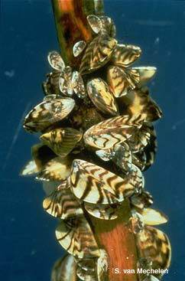
Zebra Mussels
Ballast water introduction to the Great Lakes in 1980’s
Present in 130 WI inland lakes
Attach to any hard surface - may reach tens of thousands per square meter!
Are microscopic in early life stages
Female can produce 1 million eggs/season
Notes:
Next will look at a few of the worst offenders—remember that they are only a few of the species that are causing problems in WI waters.
Zebra Mussels
-hardy, prolific mollusks that can clog water intakes, encrust piers and docks, and damage native mussel populations.
-small filter feeders (adults 1-2 inches in size) that strain plankton from water
-clarify water—seems like a good thing, but reduces food for young fish, and can lead to algae blooms
-adults and larvae can be spread in water or on equipment
-very costly to power utilities and municipalities (damage to water intakes)

Slide 12
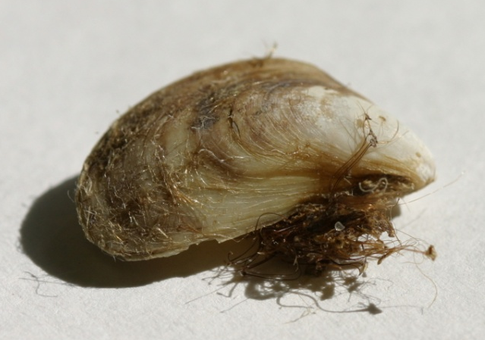
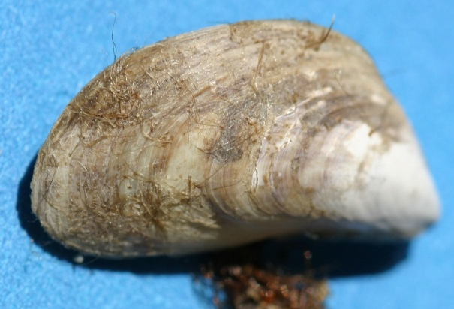
Quagga Mussels
Found in all Great Lakes but Superior
Ballast water introduction
Can survive wide range of temp. & oxygen levels
Can live directly on mud and sand
Commonly found at 100 feet and deeper
Notes:
Quagga mussels were introduced and are transported in the same ways as zebra mussels.
There is a wide range of temperatures and depths that quaggas can survive in – typically tolerate temperatures from 39 to 68 degrees. However, exceptions have been found.
They attach to soft substrates, as well as hard surfaces, and can fill in the spaces left by zebra mussels. Most commonly found at 100 feet and deeper, they have been found in depths from 3 to 541 feet…and are expected to go deeper over time.

Slide 13
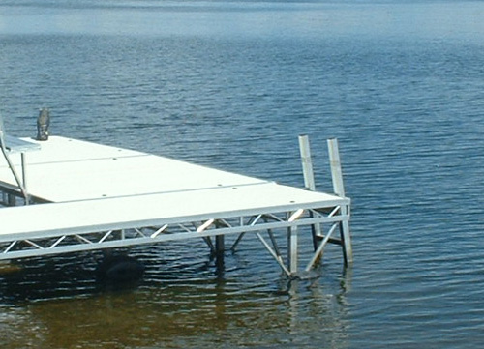
Mussels
When, Where, and How to Look?
Any hard underwater surfaces including dock structures, rocks, submerged trees, shoreline retaining structures
May through October
Run your hand over the hard surface and feel for attached critters

Slide 14
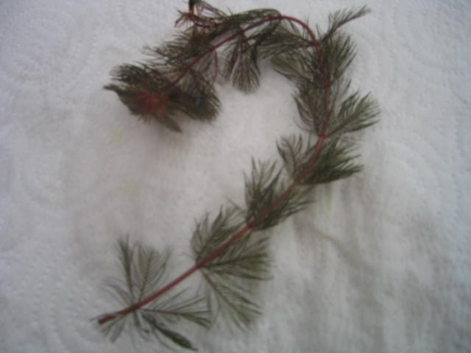
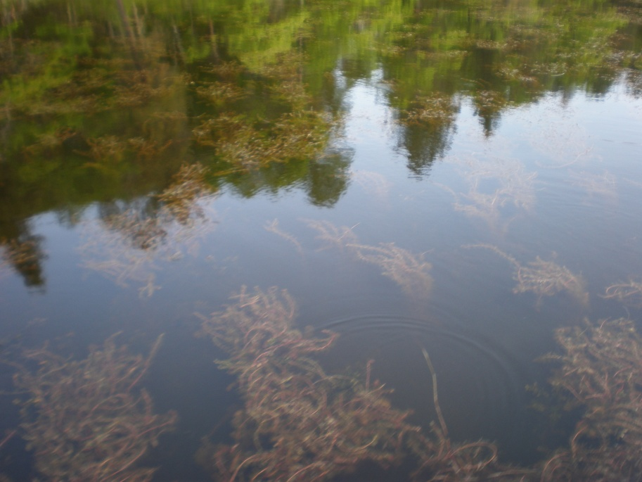
Eurasian Water-milfoil
First found in WI in 1960s
Currently found in 539 WI lakes
Forms dense mats - interferes with water recreation
Can spread from small fragments
Notes:
Eurasian Water-milfoil
-feathery underwater aquatic plant that can form thick mats in shallow areas of lakes and rivers
-crowds out native plants, interferes with recreation
-can reproduce via small stem fragments, so can spread easily and over long distances
-control is very expensive and eradication is virtually impossible

Slide 15
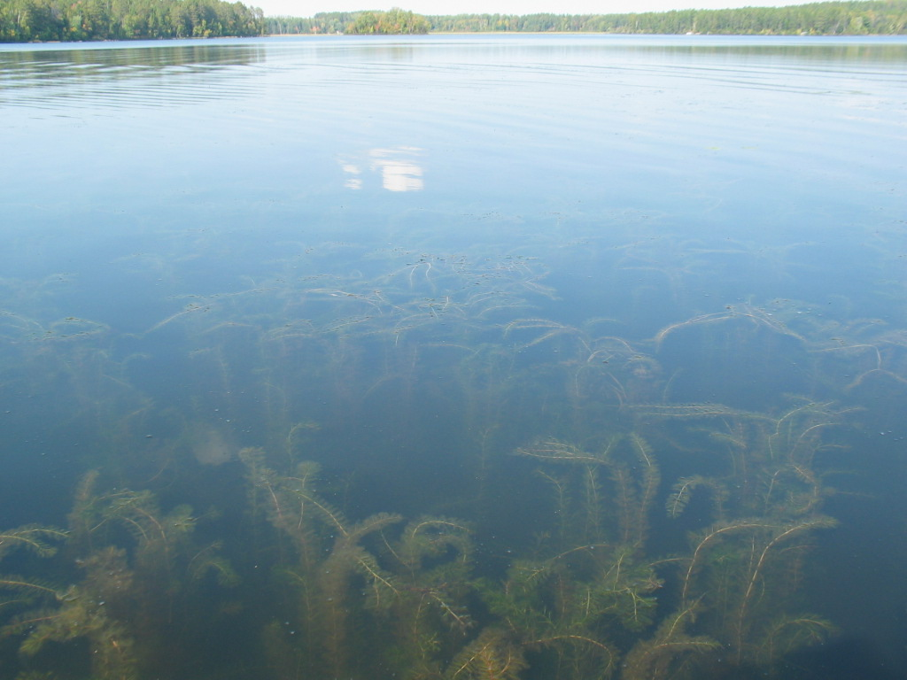
EWM
Where, When, and How to Look
In all plant growing shallow water (littoral zone) May - October
Concentrate efforts along disturbed shorelines, boat landings, and docks
Use rakes, polarized sun glasses
Collect samples for closer analysis

Slide 16
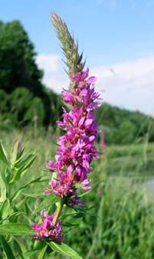
Purple Loosestrife
Imported from Europe for gardens (late 1800s), also seeds in ballast water
Crowds out native wetland species
Spreads rapidly: >1 million seeds annually, plus vegetative spread
Linda Wilson, University of Idaho, Bugwood.org
Notes:
Purple Loosestrife
-invasive perennial wetland plant 3-7 feet tall with purple flower spikes
-crowds out native wetland plants, reducing food and habitat for native wildlife
-spreading at a rate of close to 300,000 acres per year
-widely dispersed—found in all WI counties, but largest populations in southeastern part of state, Wisconsin River, and Wolf & Fox drainage systems

Slide 17
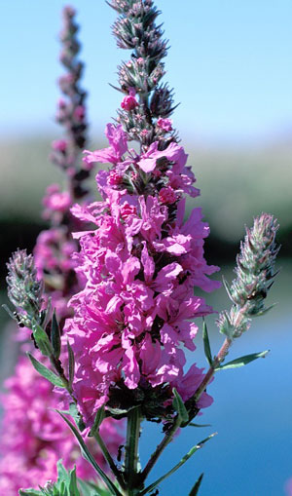
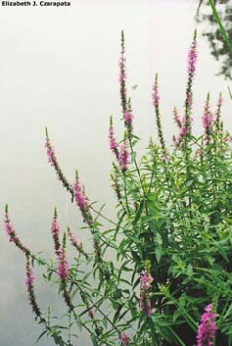
PLS
Where, When, and How to Look
Shoreline, adjacent wetlands, roadside ditches, flower gardens
July – September
Use binoculars to see into hard to reach areas
Remove single plants or small isolated beds by pulling or cutting
Look for evidence of beetle damage

Slide 18
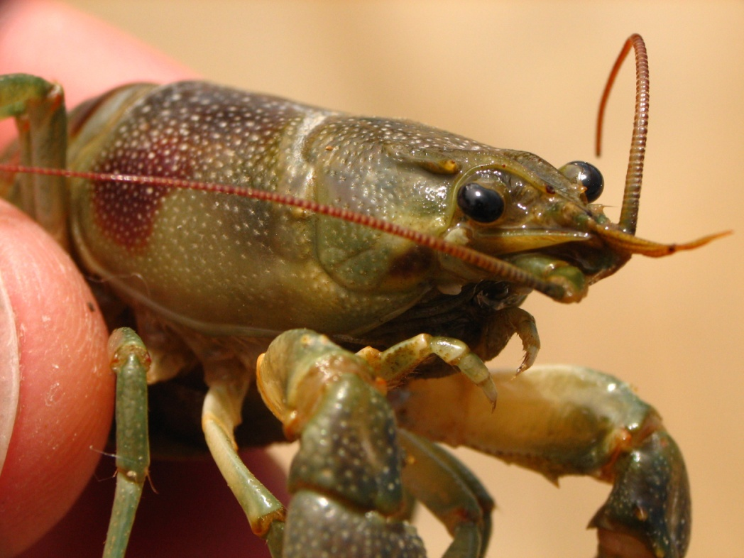
Rusty Crayfish
Brought to WI as bait 1960’s
In 463 inland lakes and streams
Severely reduce aquatic vegetation, impacting spawning
Aggressive; compete with native crayfish and fish for cover and food
ID tip: Dark, rusty spot on each side of carapace
Notes:
Rusty crayfish –
Introduced into WI by anglers using the crayfish as bait in the 1960s
Rusty crayfish are quite well spread throughout WI – inhabits many inland streams
Are extremely messy eaters. They act like mini-lawnmowers, snipping away at vegetation. As a result, are often helpful in spreading aquatic invasives plants such as Eurasian water-milfoil that spreads via fragmentation.
Also have aggressive personalities. Many anglers tell stories of pulling up fishing lines with rusty crayfish attached that are full of attitude. Rustys act this way towards native crayfish and fish as well. They compete with these native species for food and cover.
Fun ID tip! One way you can identify a rusty crayfish is by the dark, rust-colored spot on each side of the carapace. It looks as if someone had dark paint on their fingers and then picked up the crayfish. While most rustys will have these characteristic spots, how dark and evident the spots are will vary from crayfish to crayfish.

Slide 19
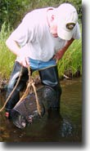
Rusty Crayfish
Where, When, and How to Look
Check shallow hard bottom areas of the shore after dark with a flashlight
Place a crayfish trap out for 3-days at least once during the season
Place ground up fish parts in the trap along with a rock or brick to weigh it down
Check daily
June through August

Slide 20
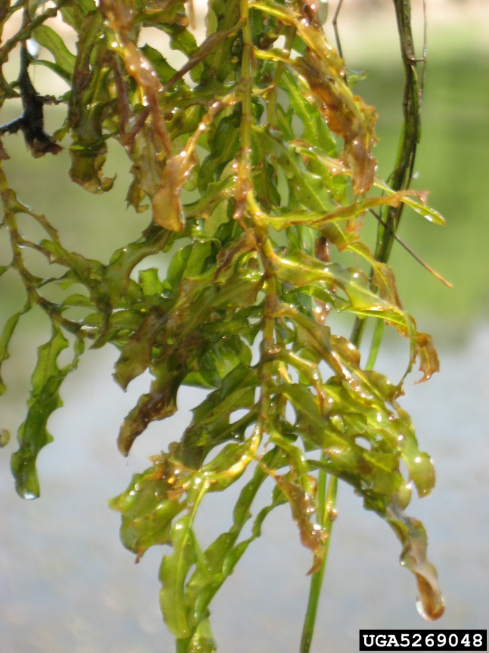
Curly-leaf Pondweed
Accidentally introduced as aquarium plant (1880s)
Fairly widespread – in 382 water bodies
Active very early in growing season – even under ice
Can form dense mats, interfering with recreation and native plants
Chris Evans, River to River CWMA, Bugwood.org
Notes:
Curly-leaf pondweed -
Native to Eurasia, Africa, & Australia
Introduced by hobbyists as plant to use in aquariums
Begins growing earlier than many other aquatic plants. New plants form under the ice in winter, making it one of the first invasive aquatic plants to emerge in spring. By getting a head start in the spring, it can outcompete other plants.
Prefers soft substrates and shallow water depths
Mainly spreads using burr-like winter buds called turions.
Can form dense mats on surface of lake that can interfere with recreation.
In mid-summer, when most other plants are growing, curly-leaf dies off. The die off can result in a loss of dissolved-oxygen and can increase nutrients that contribute to algal blooms.

Slide 21
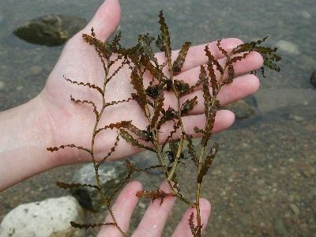
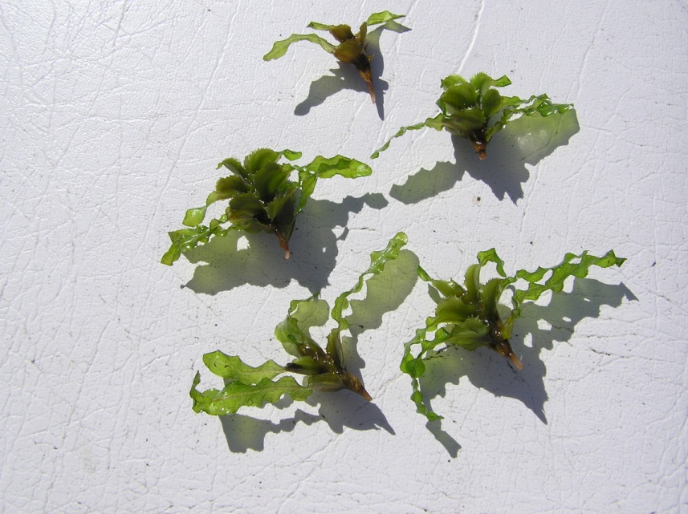
CLP
Where, When, and How to Look
Look ice out to end of June
Use the rake to pull samples
Once positive on ID, can remove isolated plants by pulling or raking
Early season CLP survey being completed as a part of the larger project
Look for formation of turions

Slide 22
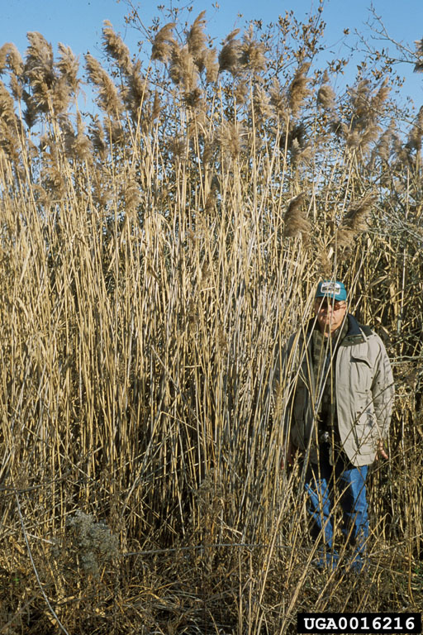
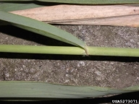
Giant Reed Grass (Phragmites australis)
Non-native Phragmites is a perennial that grows to 15’
Stems are green in summer, tan in winter, ribbed, hollow, unbranched
Leaves are wide, flat, rough on margins, and sheaths adhere to stem all winter
Spreads rapidly once introduced

Slide 23
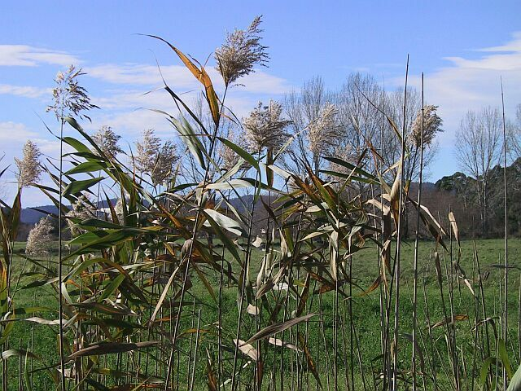
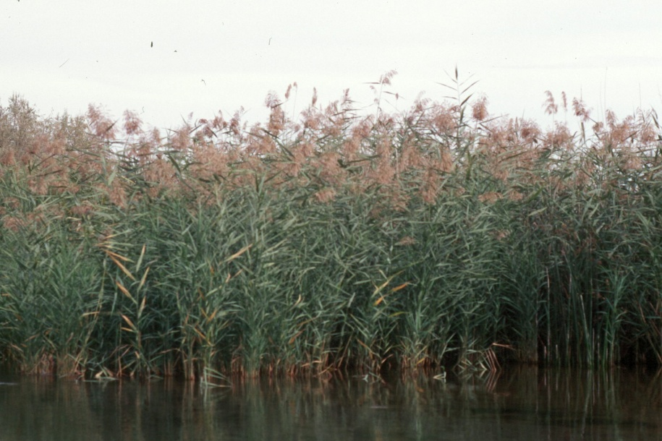
Phragmites Native vs. Non-native
  Native
    Red stems
    Runners (rare) and tan in color
    Low density
    Non-robust seed head
  Non-native
  Tan stems
  Extensive runners (30’-50’) red in color
  high density
  much taller
  robust seed head

Slide 24
Phragmites
Where, When, and How to Look
Wetlands & natural areas
emergent aquatic
marsh/lake edge
dry lake bed
sedge meadow
Ditches
ponds
road sides
Late June through October
In the winter on the ice
Take photos and get a sample of stem and seed head if a suspect plant is found
Dry leaves are very sharp, be careful of paper cuts
Notes:
Roadside ditches, farmed wetlands, I-43 bridge extensive wetland of phragmites

Slide 25
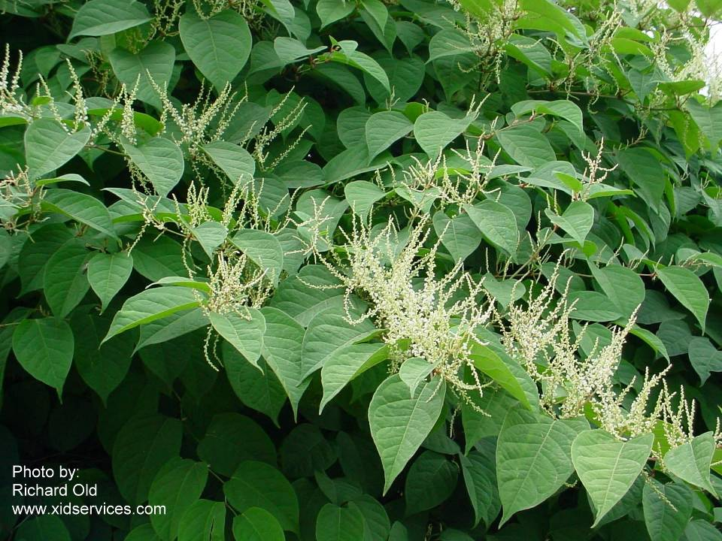
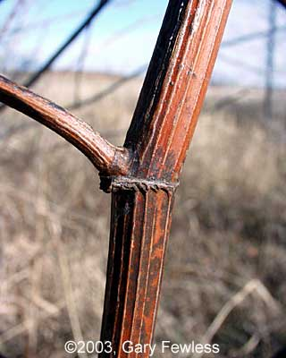
Japanese Knotweed
Tall, robust plants from Asia in the buckwheat family (Polygonaceae)
Large, un-toothed, heart-shaped leaves growing alternate on stems
Small white or greenish flowers
Bamboo type stems, red in the winter

Slide 26
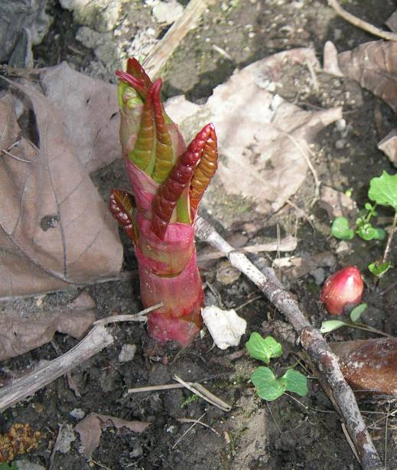
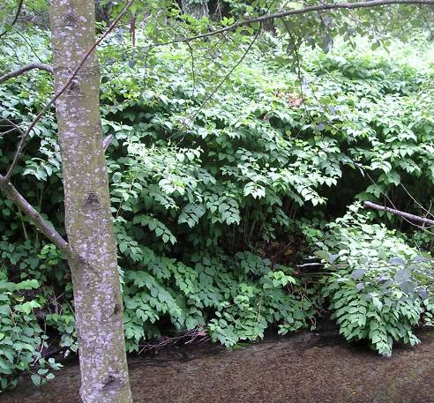
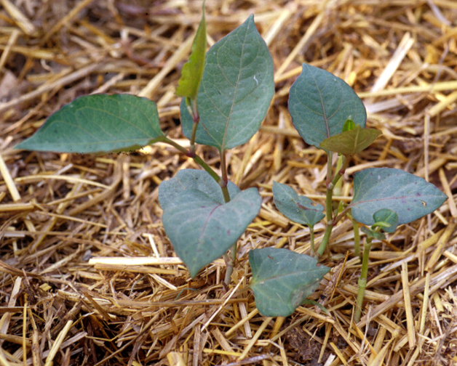
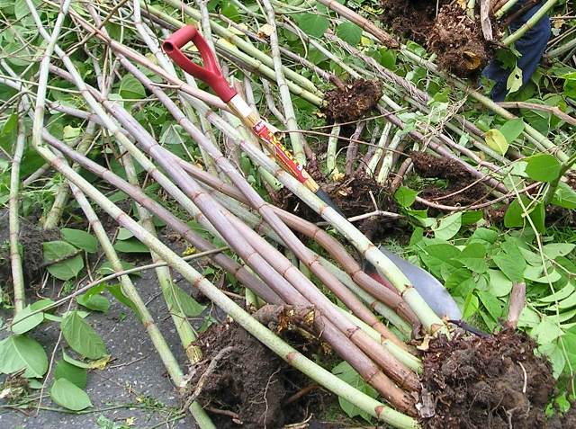
Japanese knotweed: What it looks like in different stages

Slide 27
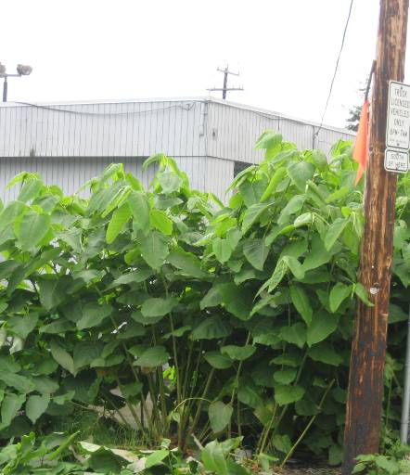
Knotweed
Where, When, and How to Look
May -October
Fast growing stems in May and June
  Giant knotweed can reach 15 feet by late June
Flowers forming in dense clusters in July and August
Stems from deeply buried roots may emerge in late summer
*knotweed stems in early June

Slide 28
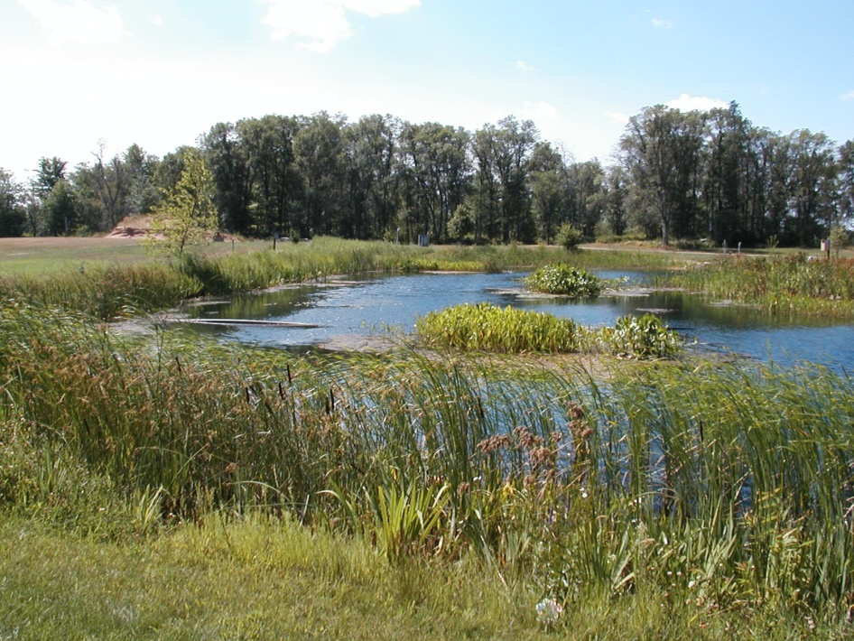
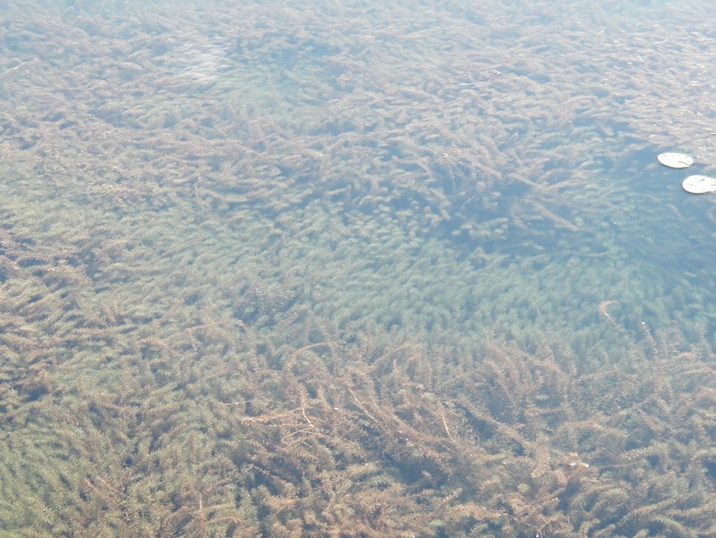
Hydrilla
Way worse than EWM
Prolific, submerged aquatic plant
Grows rapidly in water a few inches to 20-ft deep
Has five or more leaves attached to a node
Two look-a-likes:
  Elodea (common waterweed) Native
  Brazilian Waterweed Non-native

Slide 29
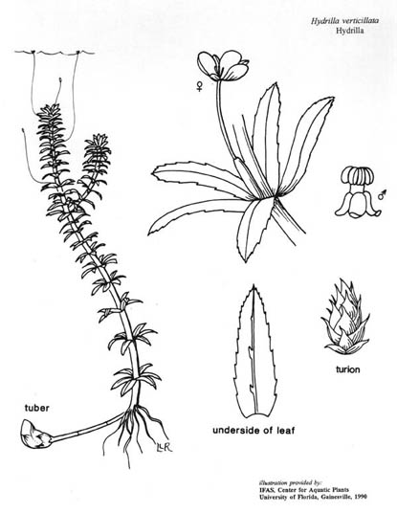
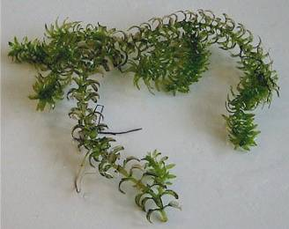
Where, When, and How to Look
May –October
Look underwater, near the bottom (use the rake)
Count leaflets

Slide 30
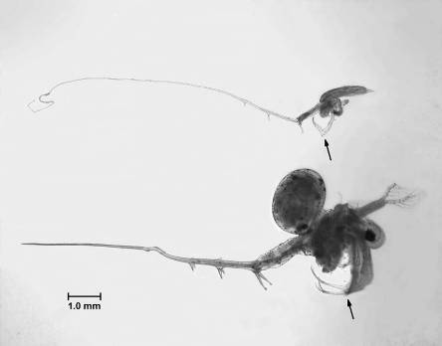

Spiny & Fishhook Waterfleas
Ballast water introduction to Great Lakes in 1980s
Found in 6 inland WI lakes—Gile Flowage (Iron Co.), Stormy Lake (Vilas Co.), & 4 Dane Co. lakes
Disrupt food chain & harm native fish
Foul fishing gear—form gummy clumps
Native Daphnia
Notes:
Spiny Waterflea
-important one to be aware of—still early enough to catch it and slow/stop spread—only found in one WI inland lake
-tiny crustacean predators
-disrupt food chain
-not palatable to young fish—spine gets caught in gullet
-collect in masses and foul fishing lines and equipment

Slide 31
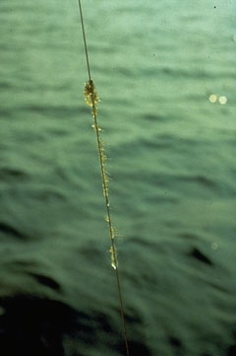
Spiny Water Flea
Where, When, and How to Look
June – August
Check fishing line and anchor ropes coming out of the water
White slime on the line
Black eyes are visible

Slide 32
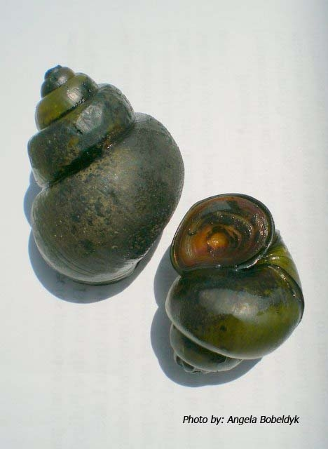
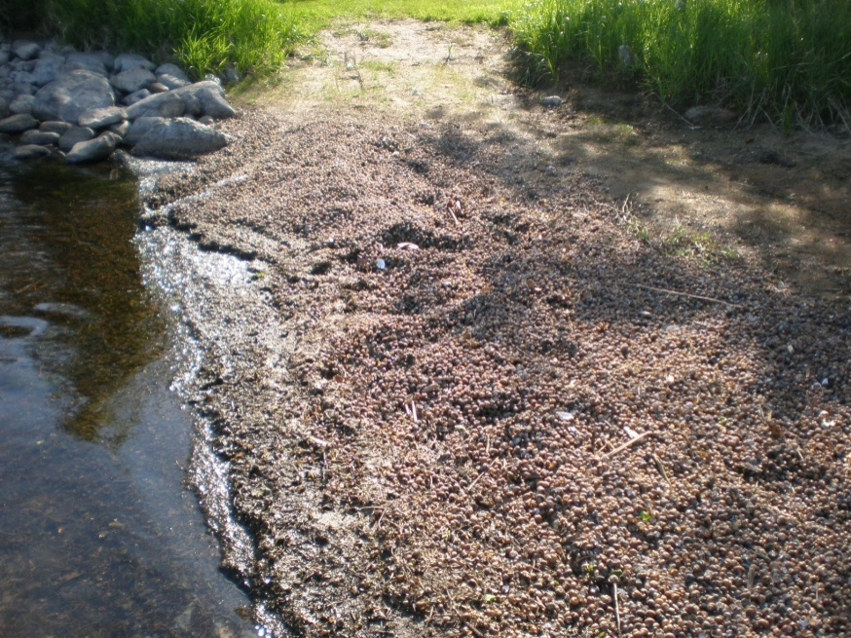
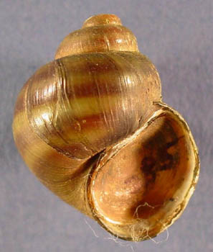
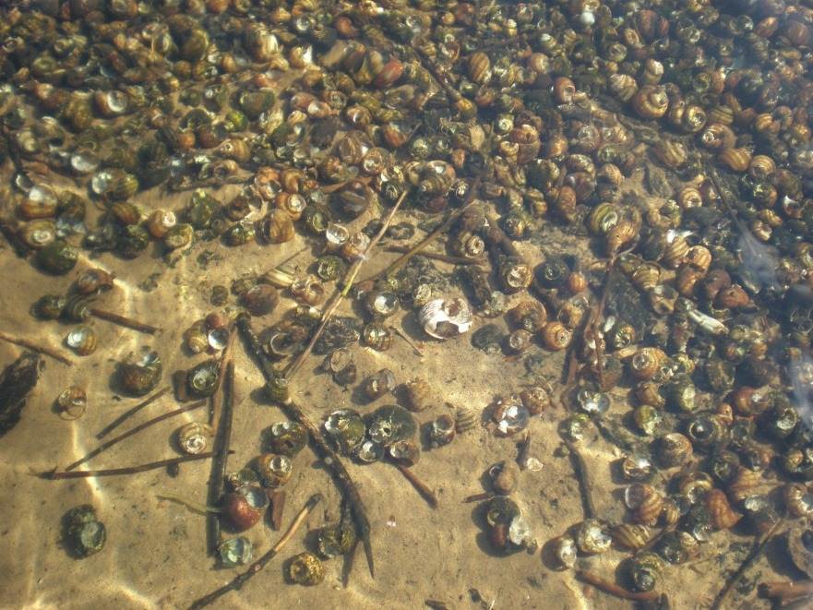
Chinese and Banded Mystery Snails
Chinese
Upper St Croix Lake Banded Mystery Snail Shells June 2009
Banded

Slide 33
Snails
Where, When, and How to Look
Look in shallow water on both hard and soft surfaces June through September
Banded Mystery Snails are smaller with a stripe all the way around the shell
Chinese Mystery Snails are large often 2 or more inches in diameter
Chinese Mystery Snails are probably in 70% or more of our lakes

Slide 34
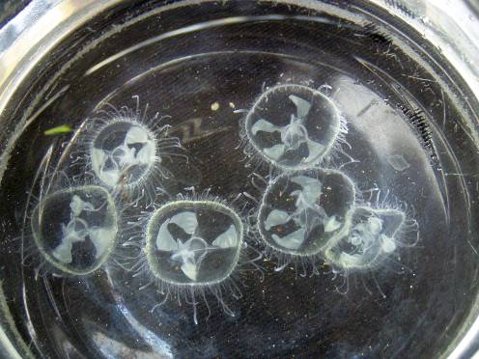
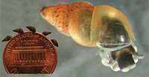
Others to Look For
Freshwater Jelly fish
New Zealand mud snail
Floating in the water August through early October
Coating a hard bottom May -October

Slide 35
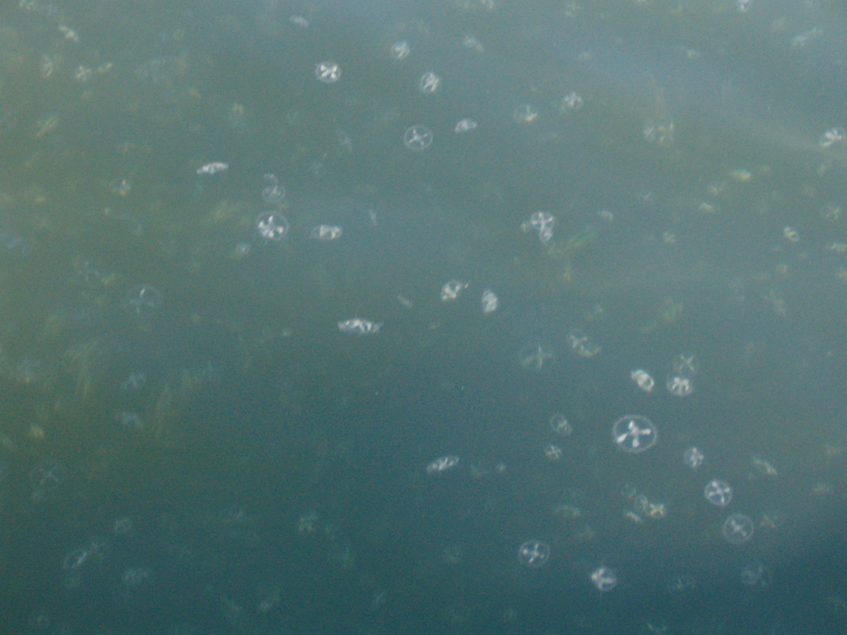
Viola Lake, Burnett County 2007(?)

Slide 36
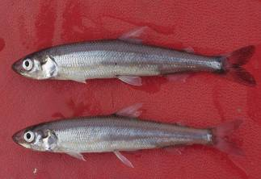
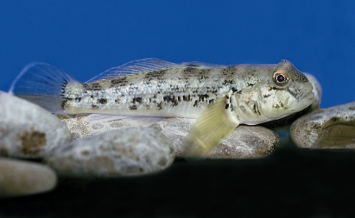
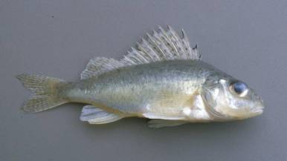
Many More in Wisconsin…
Rainbow Smelt
Round Goby
Ruffe
Notes:
These are only a few of the aquatic invaders causing problems in WI. Many other species of fish, plants, and invertebrates are present in WI lakes.
Problematic species differ from lake to lake and region to region. It’s important to have a good understanding of which species are in your lake and surrounding lakes—helps focus control and prevention efforts. Check with local DNR staff or other experts to find out which species are in your area.

Slide 37
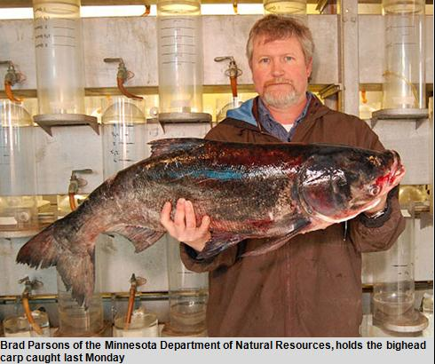



And Many More on the Way…
A few future threats:
Bighead Carp
Water hyacinth
Photo: John Lyons
Asian carp
Northern Snakehead
Notes:
Unfortunately, species move around rapidly in our global economy and society, and new invaders are always appearing on our borders. Hydrilla, water hyacinth and Asian carp are only a few of the invasive species that are moving toward Wisconsin.
The constant flow of new invasive species highlights the importance of prevention techniques to keep them out of our waters.

Slide 38




Wisconsin’s Aquatic
Invasive Species Program
Education & Outreach
  Statewide coordination
  Publications & boat launch signs
  Displays & presentations
  Media
Contact: Christal Campbell
608-266-0061
Notes:
DNR has many efforts underway to prevent and control the spread of aquatic invasive species. Next few slides will highlight different elements of the program.
Education & Outreach
-partnership with DNR, UW Extension, Wisconsin Association of Lakes, and UW Sea Grant
-working with citizens and resource professionals to teach boaters, anglers and other water users how to prevent the spread of aquatic invasive species
-many resources and educational tools available—publications, signs, displays, presentations, etc
-also working with other audiences with the potential to introduce/spread species—aquarium & pet trade, water gardeners

Slide 39


Wisconsin’s Aquatic
Invasive Species Program
AIS & Water Monitoring
  Volunteers collect data on lake health including aquatic invasives
  Data used to map extent of spread for species
Contact: Laura Herman
715-365-8998
Notes:
Volunteer Monitoring
As with watercraft inspection, both DNR staff and volunteers monitor lakes for invasive species—staff monitor for spiny waterfleas and zebra mussel larvae. Volunteers monitor for adult zebra mussels, invasive plants, rusty crayfish and invasive snails.
Data collected by volunteers are very important in tracking and mapping the spread of invasive species.

Slide 40


Wisconsin’s Aquatic
Invasive Species Program
Purple Loosestrife
Biological Control
  Volunteers help raise & release beetles
  Beetles available for free—great school or family project
Contact: Brock Woods
608-221-6349
Paul Skawinski
Notes:
Purple Loosestrife Biocontrol
-Partnership between DNR and UW Extension
-citizen based project uses safe, highly tested beetles that feed on purple loosestrife to control populations
-two types of beetles – weevils and two species of leaf-eating beetles (one pictured in slide)
-volunteers can raise and release beetles into local wetlands
-a great success story—one of our only examples of long-term non-chemical control, and great way for citizens to get involved

Slide 41

Any other questions?

