Slide 1
WQ Recommendations Winter 2016/17
Rephrasing and advancing management recommendations

Slide 2
WQ Plan Recommendations
Assessment
Land use/ Context
Interested Parties
Management Opportunities
Recommendations
Grant funding process or DNR workplanning
Condition
Issue: don’t prescribe answer, identify issue and potential way to address.

Slide 3
Example Recommendations
“Bear Creek (huc12)”
  Priorities
    Project collaboration with county
    Runoff management
    Sediment Toxicity
  Goals
    Consistent assessments in county land & water plan
    Grant funding for bear creek restoration projects
    Sediment characterization
  Recommendations
    WQ and runoff provide monitoring & assessment data to Ashland County Conservation department in 2017 when CLWMP is in update process.
    Consider Bear Creek a high priority for TRM grant funding to cost share alternative actions to reduce runoff and stream bank erosion.
    Encourage type City of Ashland to apply for a Great Lakes Initiative or other grant to conduct sediment characterizations in the northern port area.
Fictitious Area

Slide 4
Process flow for recommendations
Pass through grants
Plan update
Existing recommendations
DNR work planning
Collaborator decisions
Download of existing
Priorities, goals and
recommendations
Update Priorities, Goals and Recommendations
Posted online, in document and in Water Condition Viewer

Slide 5
Suggestions?
Review all existing recommendations and convert to “issue identification”.
Provide examples of how to work recommendations as “issue identification” focused.
Work closely with grant coordinators and managers to ensure access to and use of recommendations during work plan.
PMT discussion?

Slide 6
Natural Community Validation
Winter 2016/17
Central database storage of NC decisions and automation of the Fish IBI Package

Slide 7
NC validation process
Reference site NC reviews (2008)
IR NC review spreadsheets (2012, 2014, 2016)
  Fish IBI prompting reviews & data stored in spreadsheet
Project based NC reviews – TWAs & more
  As project write ups occur – NCs are reviewed.
Use new tools like Fish IBI package to pick up decisions and apply for state wide and site specific analyses.

Slide 8

What is needed?
Checklist of steps for methodology
Formal guidance for dealing with:
  1 site, 1 survey, 1 assessment unit.
  1 site, multiple surveys, 1 assessment unit.
    Conflicting answers over time.
  More than 1 site, multiple surveys, 1 assessment unit
  Sample representativeness** (line traces)

Slide 9
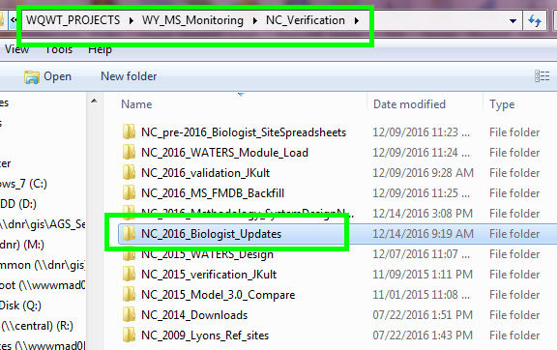
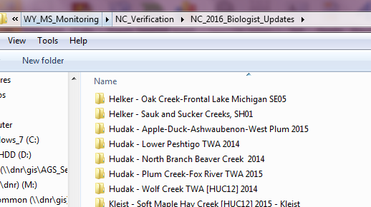
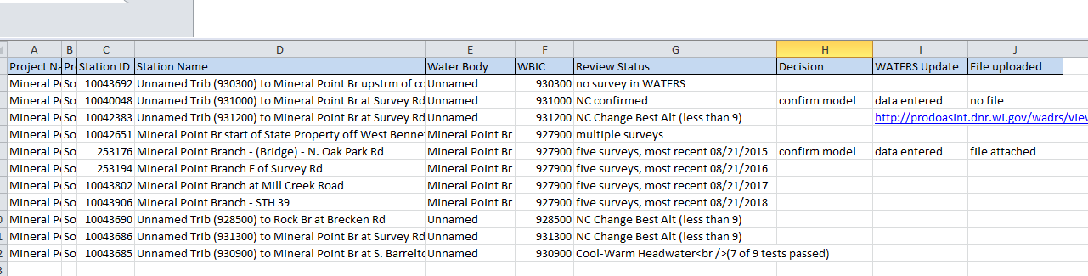

Slide 10
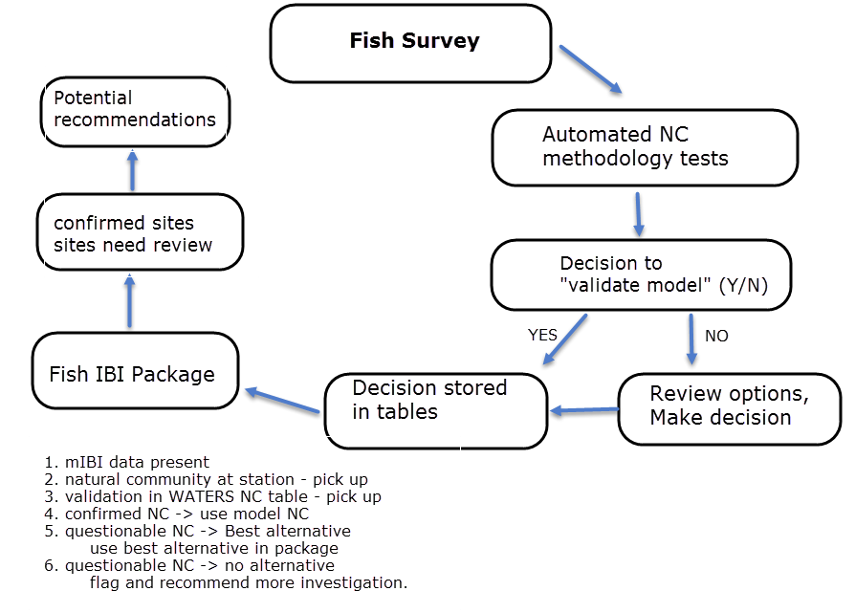

Slide 11
Tools & Steps
Fish DB tool
WATERS for storage
Fish IBI package
Next Steps
Kristi, Lori, Lisa & Mike to meet
Move forward with NC review in excel
Lisa to send fish surveys by data entry name

Slide 12
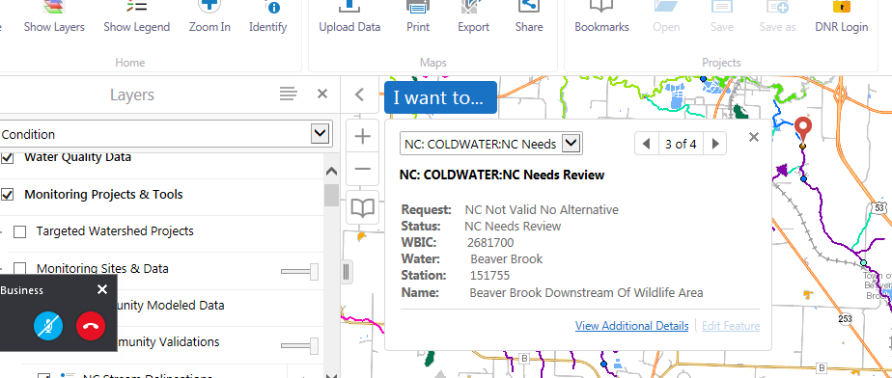
Water Condition Viewer

