Slide 1

Wisconsin Clean Water Act Water Quality Management Plans: Evolution and Relevance
Clean Water Act basis for Water Quality Planning
Lisa Helmuth
Water Quality Programs
Environmental Management
Notes:
Welcome to this series of presentations supporting the public comment period for Wisconsin’s 2017 Water Quality Management Plan Updates.
The material presented in this series will explain the foundation of water quality plans, the locations of the monitoring and planning areas, and the findings of these plans including the water condition and recommendations.

Slide 2





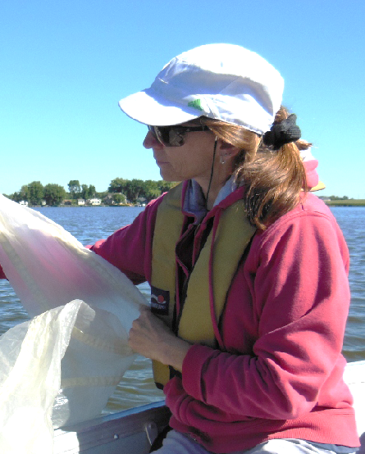

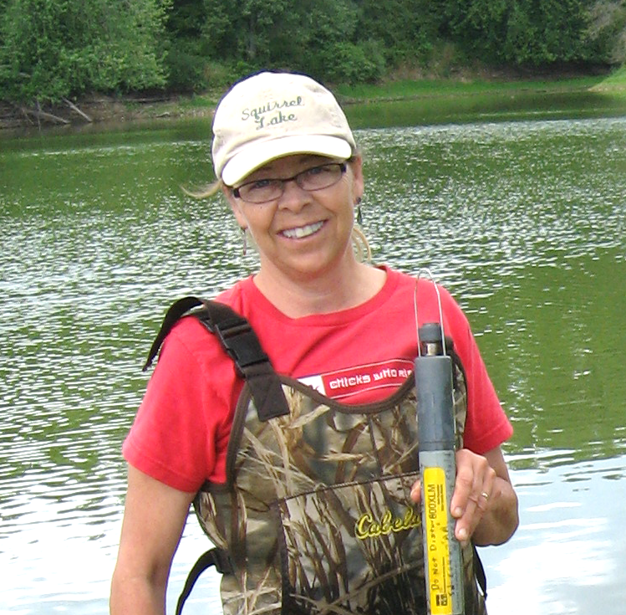



Notes:
Water Quality coordinates and supports water quality management plan activities. This presentation is written and presented by Lisa Helmuth of the DNR, a 25 year veteran employee in the water program, who was hired in the early 1990s to coordinate “basin plans” and related guidance, implementation and outreach. Lisa works with biologists statewide to update plans for watersheds statewide.

Slide 3
  Areawide Water Quality Plans - CWA Section 208
  Clean Water Act – Section 208 and Section 205j
  State Administrative Code - NR121, NR110
  Continuous Planning Process
  Areawide Water Quality Management Plans
    WWTP Facility Plans & Sewer Service Area Plans
    Basin Plans
  History of Basin Plans
    Basin Plans in 1970s – Wastewater Treatment
    Plans in the 1980s-90s – Nonpoint Pollution
    Today – Online Plans – Resource Information,
      Online Water, watershed, basin and monitoring report data.
Notes:
The Wisconsin Department of Natural Resources (WDNR) is responsible for implementation of the federal Clean Water Act (United States Public Law 92-500). Since the law went into affect in 1972, Wisconsin has used a combination of federal and state resources to monitor its surface waters to determine whether or not they were meeting the goals of the Clean Water Act.
The Clean Water Act Section 208 and relatedly Section 205j outlines the requirements and funding sources for water quality planning. This federal law, with subsequent amendments, required the creation of several programmatic structures for state’s with delegated authority. Wisconsin, as one of those delegated states, developed a comprehensive framework of structures and processes to comply with the USEPA and its authorities for the sole purpose of restoring, protecting and managing our state’s water resources. NR 121, the Water Quality Planning rule, reflects federal requirements for resource condition assessments, planning to improve condition, and implementation work through total maximum daily load analyses and related to restore water quality.
Each state is required to create what is called a Continuous Planning Process which outlines the rules, processes and procedures designed to meet the requirements of delegation authority for the Clean Water Act.
Wisconsin’s CPP, for many years, was held in large black binders on our shelves, updated with new rules, program guidance and procedures. Today’s modern CPP is located “online” through links to program areas that fulfill CPP requirements.
Today, adherence to continuous planning work is conducted through federal-state reporting on Wisconsin’s Environmental Performance Partnership Process or ENPPA. The ENPPA identifies key requirements to meet CWA goals and adhere to grant funding guidelines and serves as a living extension to the state’s existing continuous planning process.
Through this and related programs, state water quality managers have identified waters not meeting Clean Water Act goals and have worked cooperatively with partners to control factors inhibiting attainment of the applicable designated uses.
Today we will review a brief history of the basin planning process, how monitoring and water management plans can help identify issues and direct restoration efforts through documenting issues and concerns and advancing implementation actions.

Slide 4
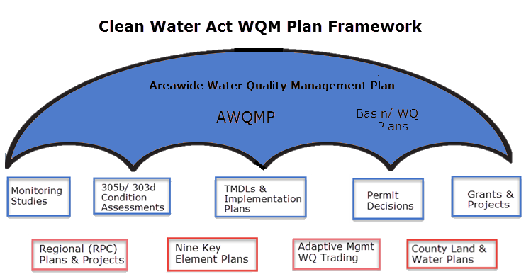
Continuous Planning Process – Wisconsin
Notes:
The Areawide Water Quality Planning Framework is much like an umbrella structure in which many programs and process are interconnected. Like the visual picture that you can see, in Wisconsin our Monitoring, Assessment, Restoration, and Implementation work are driven by the known condition of our resources. At the core of this effort are the state’s water quality standards, our assessment protocols, and our resource management activities.
DNR is required by Section 303(e) of the Clean Water Act to develop a Continuing Planning Process (CPP) Plan.
CPP is an umbrella document that helps ensure states maintain progress toward protecting and preserving water quality.
The state CPP is a description of the state's water quality management and planning activities, referencing technical documents and sources that explain water quality programs.
The CPP describes ongoing processes and planning requirements of the state’s Areawide Water Quality Management Plan (AWQMP).
The updates open for public comment today are part of the state’s Water Quality Management WQM Plan and are important components of the state’s Continuous Planning Process.

Slide 5
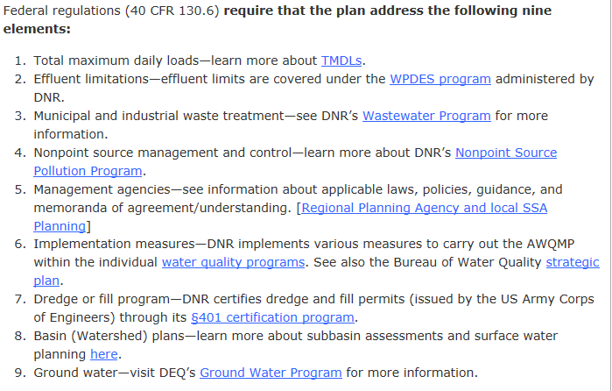
Wisconsin’s Areawide Water Quality Plan
Notes:
Water Quality Planning as first envisioned, was designed as a large-scale public participation effort to blend together the disparate elements of programs and processes that identify, describe and control the condition of water resources. The Federal Code of Regulations explicitly lists items displayed on this slide.
Wisconsin has worked to incorporate each of these elements into a coherent set of programs rules, processes and procedures that not only address the issue listed but remain connected to the other aspects of the Areawide Water Quality Plan through the concept of “conformance”, i.e.., activities carried out must be in conformance with the state’s overall plan, which at its core are the water quality standards that organize and protect our water resources.
While in hindsight this list of items may resemble an organizational chart or a list of DNR programs, at the time the law was written, the founders of the Clean Water Act were in fact designing what our modern water management programs would focus on today.

Slide 6
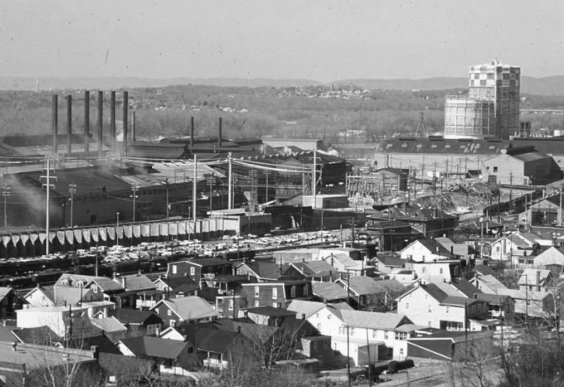
Basin Plans in 1970s – Wastewater Treatment
Notes:
Water Quality Plans were first developed in the early 1970s to advance monitoring, assessments and management.
Initial plans created in the 1970s focused on identifying wastewater treatment plants eligible for Clean Water Act grants to support wastewater treatment system development and upgrades. Later – and still today – funding came in the form of long-term state revolving loan program to communities to help update infrastructure so that treatment technology keeps pace with evolving science and continued improvements in public health and welfare. The legal and policy work undertaken in the 1970s laid the foundation for improved water quality conditions of today, as the first steps simply funded primary treatment, or removal of solids from wastewater prior to returning that water back to our rivers and streams.
As time advanced, basin plans evolved, identifying facilities for secondary and tertiary treatment, removing dissolved contaminants and ultimately leading to the modern wastewater removal systems we have today with biological treatment to remove phosphorus.
All this work happened through the structure and foundation of the state’s Continuous Planning Process and Areawide Water Quality Program implemented at the federal and state levels to secure fishable, swimmable waters.

Slide 7
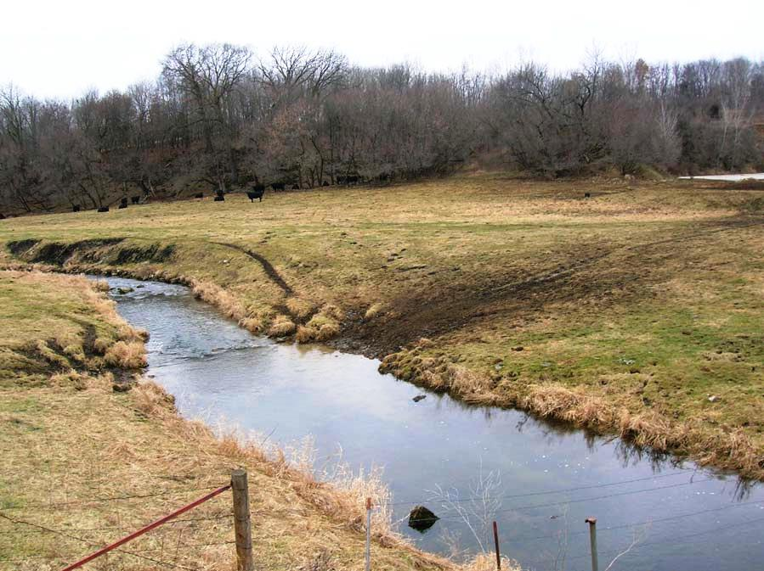
Plans in the 1980s-90s – Nonpoint Pollution
Notes:
In the 1980s and 1990s, “basin” plans evolved alongside our changing environment and the challenges posed by the waste streams at that time.
When the second and third round of plans were created, much of the state’s regulatory framework was in its infancy. So, basin plans served a coalescing function for compiling information and mobilizing resources into water inventory and action “plans” within a given area at the state level.
In the 1980s, DNR transitioned from publishing the large black and white mimeograph 8 point font plans of the 1970s into smaller, color-printed resource documents that described water conditions and pollutant sources by watershed within a basin and which advanced recommendations for management. These recommendations came with three grades of authority.

Slide 8
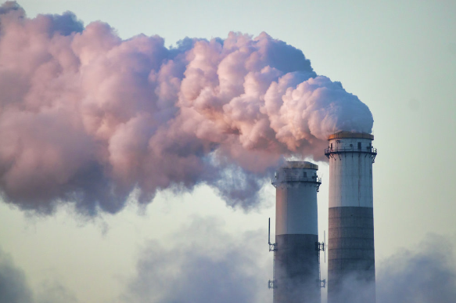
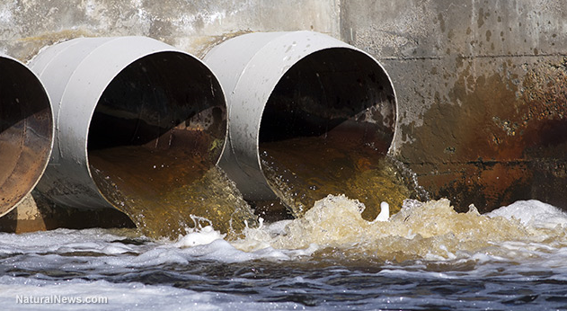
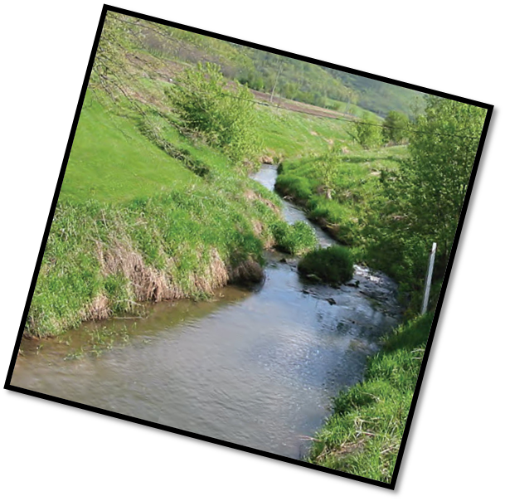
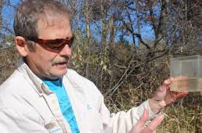
Dave Marshall,
Retired DNR Scientist
Notes:
The first grade of recommendations were Type A, reflecting legal requirements such as permit-related actions for compliance with Clean Water Act authority or funding under the state revolving loan program.
The second, Type B, were DNR management actions such as grant funding or outreach to make recommendations for projects under the state’s multi-million dollar Nonpoint Source Pollutant Runoff Management Program, the country’s first and premier watershed based restoration program.
The “Priority Watershed Program” as it was called for many years, funneled millions of dollars over a 10 or 20 year period into the state’s watersheds with the highest concentrations of pollution in rural or urban areas. This program resulted in large-scale restorations statewide. The Priority Watershed Program was a model for today’s federal “Nine Key Element Plans” which as you will learn about later, offer detailed plans to restore watersheds with impairments through a variety of partnership, government, profit and nonprofit partners.
Finally, Type C recommendations were those designed for communities and partners as recommended actions, while not required, would advance resource protection and restoration. Examples of these types of recommendations included creation of stormwater plans,

Slide 9
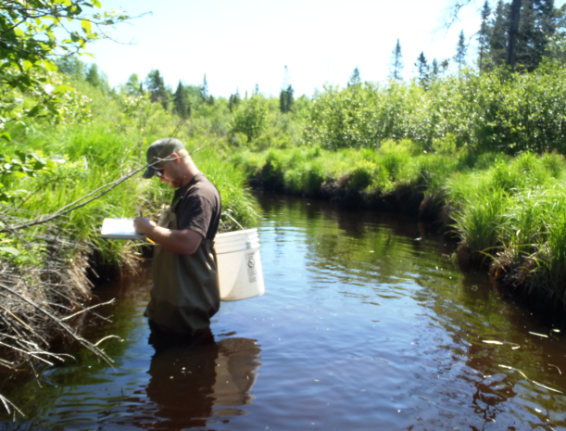
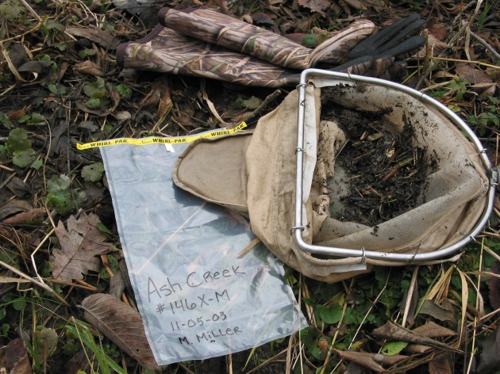
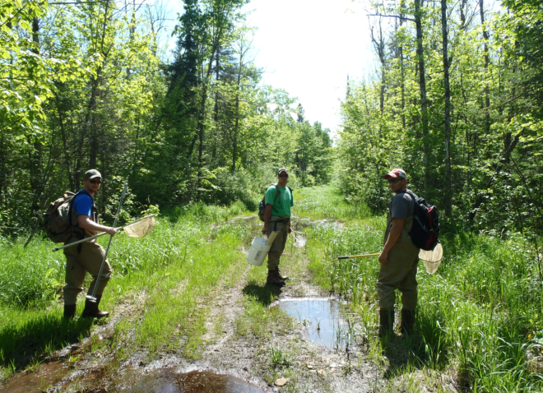
Today’s Plans – TWA/WQM Plans
Targeted Watershed Assessments → Technical Reports
Technical Reports → Water Quality Plans
Water Quality Plans → Recommendations
Recommendations → Monitoring
            → Grant Projects
            → Management Activities
Notes:
Today’s plans, like those of yesteryear, focus on priorities in watershed including water condition
Does the water meet water quality standards?
Is there a treatment plant that needs an upgrade?
And other contemporary issues such as streambank erosion, stakeholder involvement, and volunteer monitoring for the collection of data to better understand our water resources including the location of impaired waters and implementing TMDLs.

Slide 10
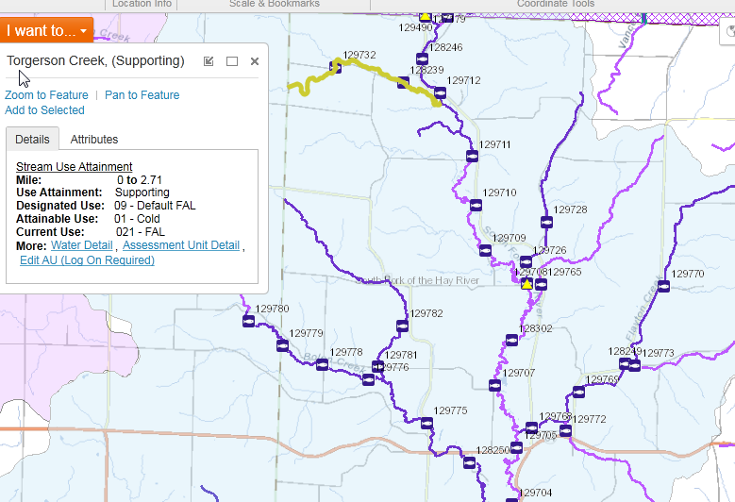
TWA Monitoring → Assessment → Planning
Notes:
Today’s plans summarize monitoring studies and provide online resource information

Slide 11
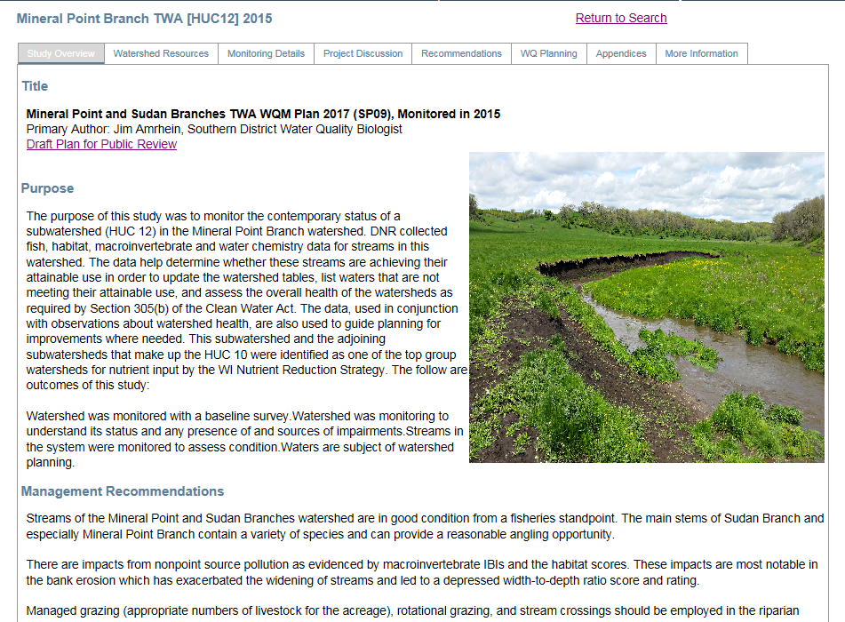
Online Monitoring, Watershed, & Water Data
Notes:
As this slide shows, much of our resource information is located online with downloadable PDF versions of the plans to print, read and share.

