Slide 1
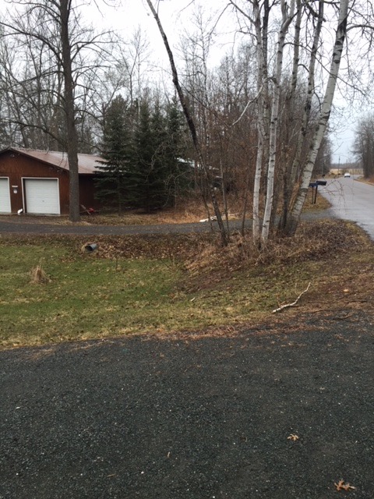
Richardson Court Watershed Culverts
Culvert under Richardson Court that drains the far ditch into the lake via narrow strip of Georgetown land
Culvert under Driveway that drains additional yards into the lake

Slide 2
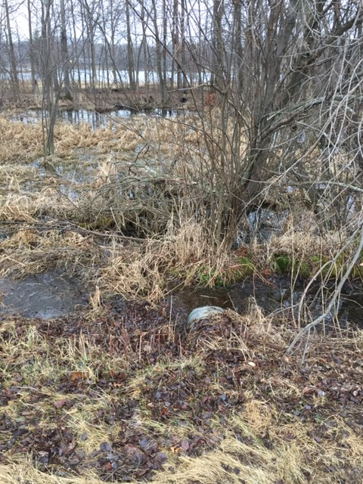
Culvert under Driveway that drains into the lake
Bystrom Lane Watershed culverts
Culvert under Bystrom Lane that drains the far ditch and farm land into the lake

