Slide 1
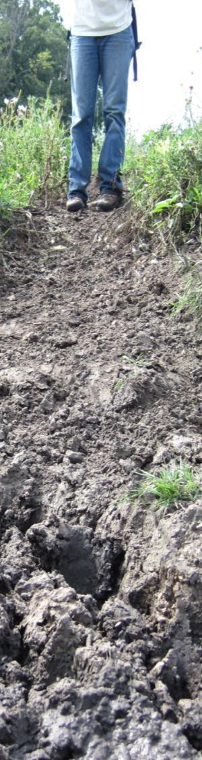
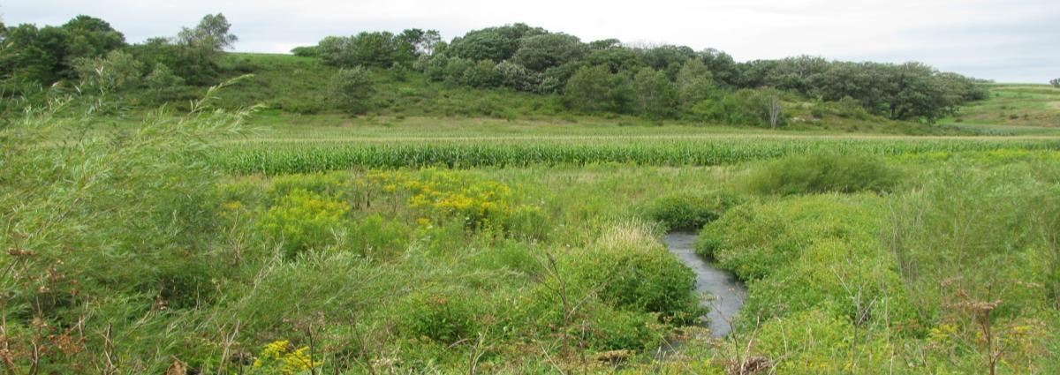
Channel sources of legacy sediment in agricultural streams and implications for nutrient and biological impairments
Driftless Area, Wisconsin
Faith Fitzpatrick and Rebecca Carvin (USGS WI Water Science Center),
Robert Hansis (WI Department of Natural Resources)
October 31, 2010, GSA annual meeting, Denver, CO
Photo Credit: Zachary Scott (right), Steve Westenbroek (bottom)
Notes:
Introduce a new integrated, multi-disciplinary study. Handouts in back from 75th anniversary.
HAVE 15 MINUTES TOTAL, 12 MINUTES FOR PRESENTATION AND 3 MINUTES FOR QUESTIONS
We are examining the role of channel processes and legacy sediment in the delivery of phosphorus and sediment to the Upper Mississippi River as part of a targeted phosphorus reduction project in the Pecatonica River headwaters in the southwest Wisconsin Driftless Area…

Slide 2
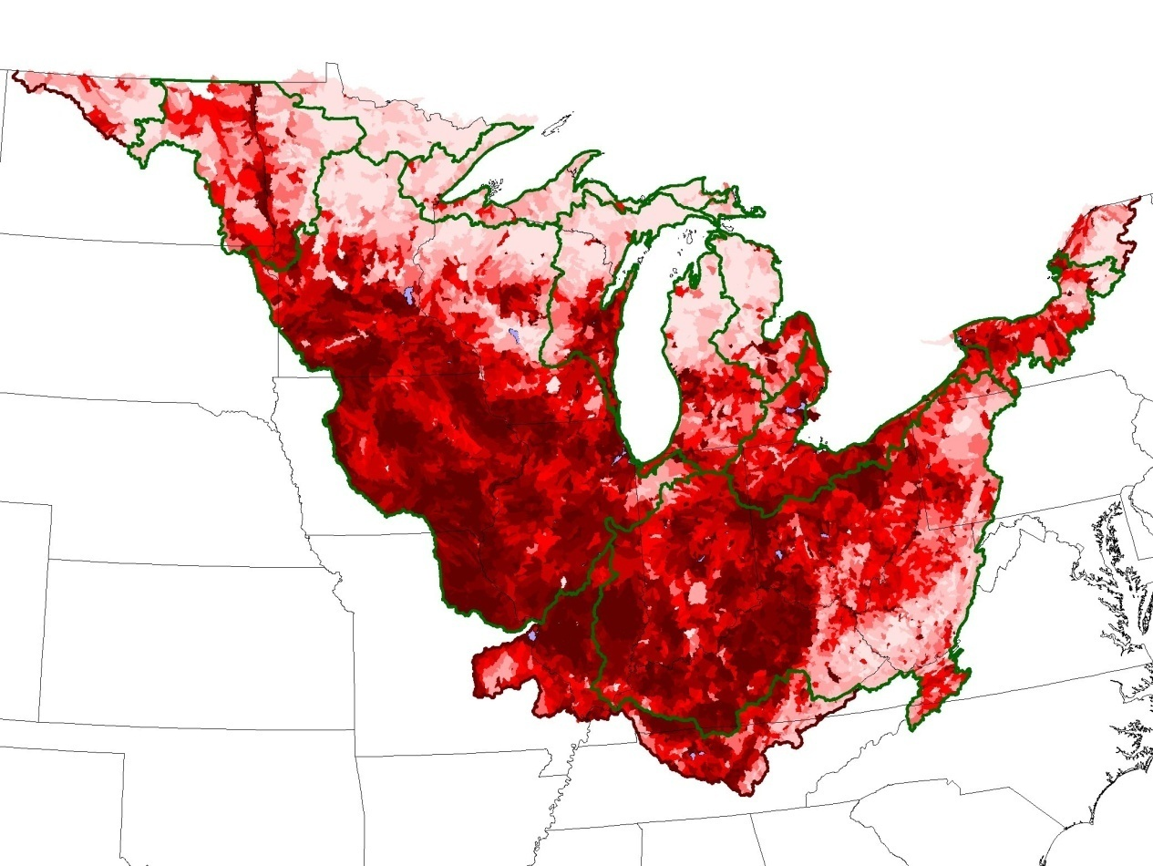
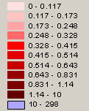
The Sediment – Phosphorus connection:
SPARROW Total Phosphorus Yields
Pecatonica River watershed
Total Phosphorus Yields
(kg km⁻²)
0 – 12
13 - 17
18 - 25
25 - 33
34 - 41
42 - 51
52 - 64
65 - 83
84 - 114
115 - 1000
1001 – 2,980
(Robertson and Saad, in press)
Notes:
Results from the SPARROW model suggest that potential for sediment-bound phosphorus yields to streams is high. This model is one attempt to connect what is happening in the fields with stream water quality.
2

Slide 3
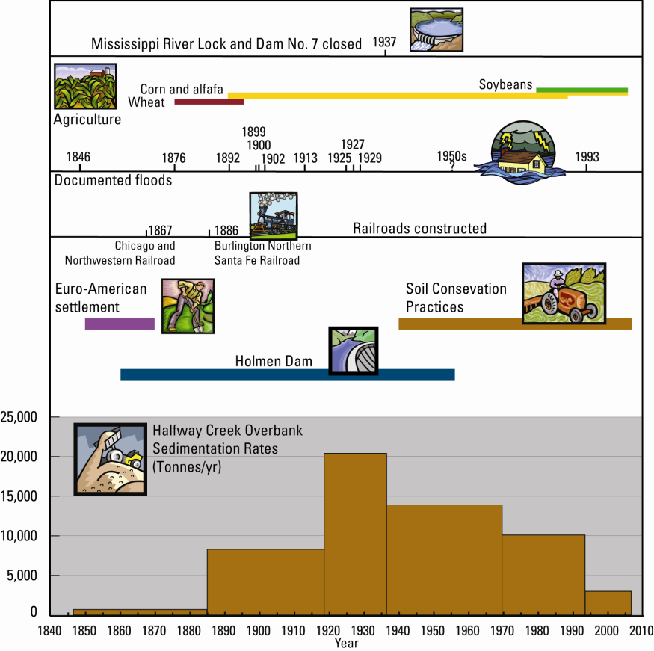
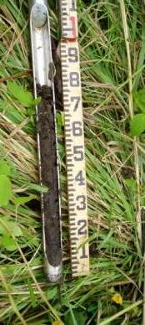
Historical sedimentation (and erosion) rates have decreased by an order of magnitude over the last 75 years because of widespread adoption of soil conservation practices
WI Driftless Area
Upper Mississippi River
Halfway Creek
(Fitzpatrick, et al. 2009)
Notes:
First, some historical background. Thanks to decades of best management practices to reduce soil erosion, sedimentation rates in the Driftless Area are about on order of magnitude less than what they were 60-70 years ago. A recent study of Halfway Creek (a tributary to the Upper Mississippi River in Western Wisconsin) showed that sedimentation rates in wetlands at its mouth indicate an order of magnitude reduction sedimentation following widespread adoption of soil conservation practices. Modern sedimentation rates are still double or triple pre-European settlement rates. ADD STATS ON YIELDS FOR FIELD TO WATERSHED

Slide 4
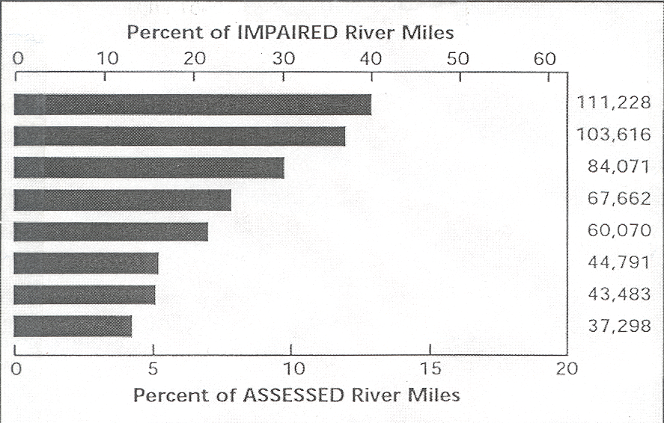
Fluvial sediment is a national and global challenge
USEPA 1998 303d Listings
miles
Siltation
Pathogens (bacteria)
Nutrients
Oxygen depleting substances
Metals
Pesticides
Habitat alterations
Thermal modifications
Notes:
75+ years after major conservation efforts and almost 40 years after the Clean Water Act, siltation/sediment still the main cause for stream water-quality impairments. Whether you look at number of miles or number of water bodies, sediment is the #1 problem that remains on global and national levels as well as for WI and the Driftless area in the southwestern portion of the state. For SW WI, over 90% of listed impaired stream miles are habitat loss related to sedimentation (Grant, Platte, Sugar, Pecatonica) [Bob Hansis]. Impaired is a subset of assessed and assessed is a subset of total stream miles.

Slide 5
Siltation causes biological impairments
45% of stream impairments are habitat losses due to sedimentation
WisCALM
Supplemental monitoring work suggested for evaulating stressors related to excessive sedimentation and habitat impairment
Habitat (includes geomorphic measurements)
Total Suspended Solids
Transparency
Flow
Temperature
Notes:
BOB – GRAPHS, PHOTOS, BULLETS OF RELATION BEWTEN BIOLOGICAL INDICATORS AND SILTATION PROBLEMS
WI water quality report to congress—(click) 45% of impairments in Wisconsin are habitat losses due to sedimentation. (click)
DNR methodology for 303-D listing (WISCALM) is to assess habitat (which includes some geo-morph principles) along with biological indicators.

Slide 6
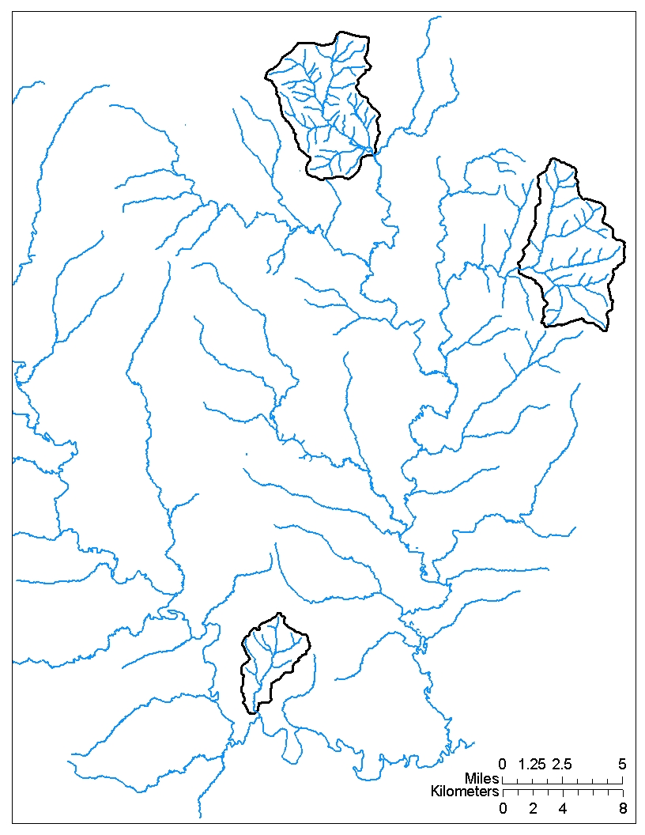
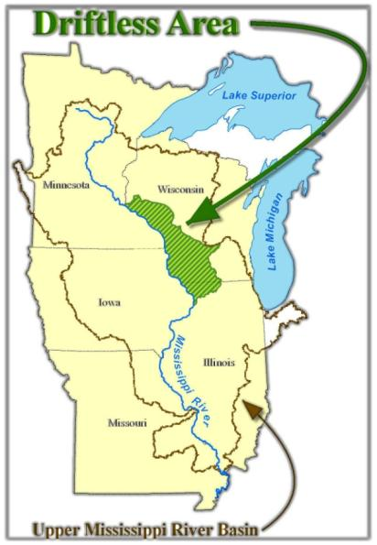
Study
Location
Smith-Conley
Pleasant Valley
Silver Spring
Streamgage
Notes:
Studies on the proportion of nutrient/sediment delivered from fields compared to channels are taking place in the WI Driftless Area. ADD ONE SENTENCE ON DRIFTLESS AREA. We’ve been working in three small watersheds between 10 and 20 square miles in the Upper Pecatonica River basin, a tributary to the Mississippi River. Recent studies have shown that working at the small watershed scale, or watersheds around 10-40 mi^2, is best for implementation of best management practices. This small watershed scale is a manageable size to be able to collect meaningful data and monitor and evaluate the effectiveness of the practices.

Slide 7
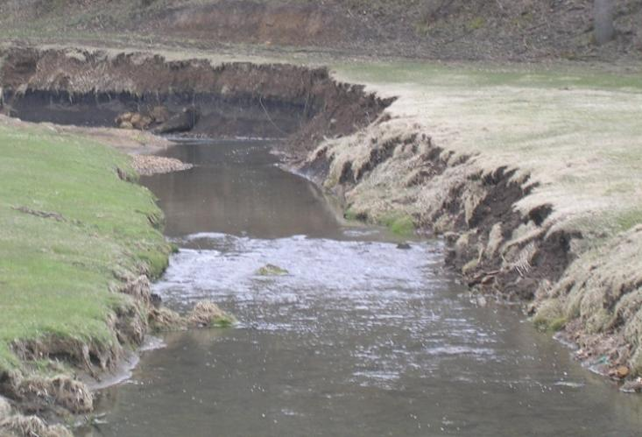
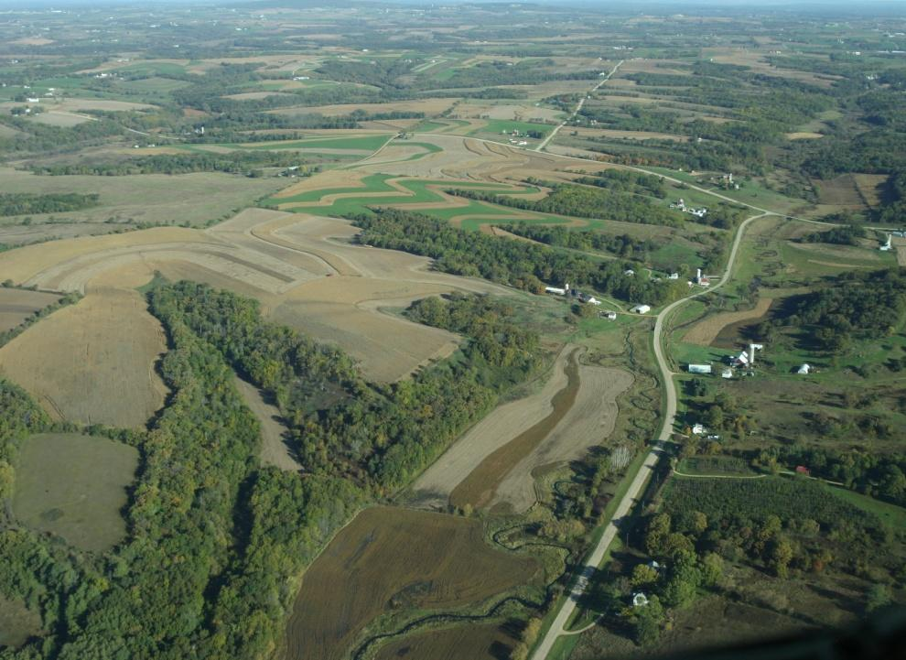
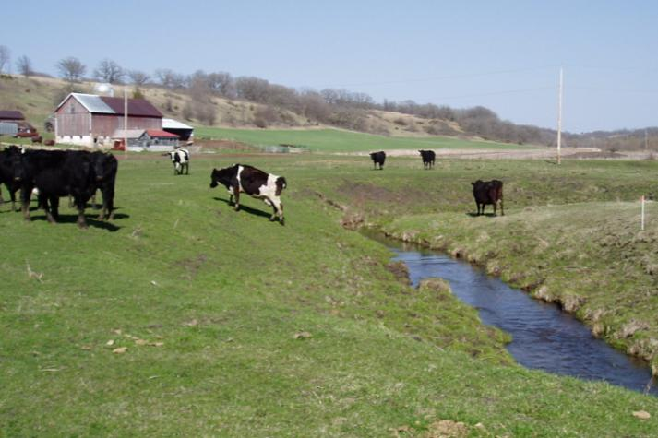
Connecting Field to Stream Transport of Sediment
Identify watersheds that are major contributors
Target areas
Identify watersheds that are major contributors
Target areas
Inventory major sources and sinks
Upland versus stream corridor
Photo Credit: WDNR (right);
Rebecca Carvin (left)
Photo Credit: Wisconsin DNR
Notes:
Sources include farm field soil erosion,

Slide 8
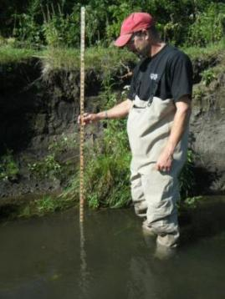
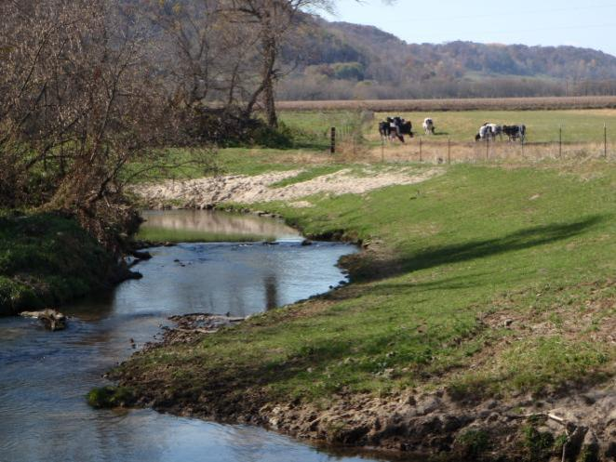
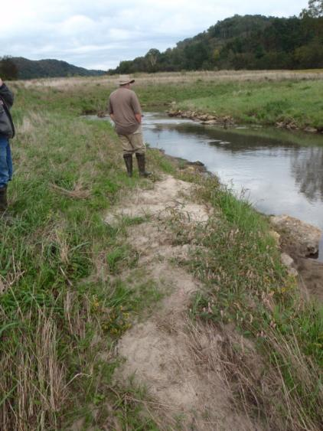
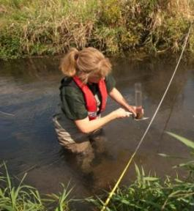
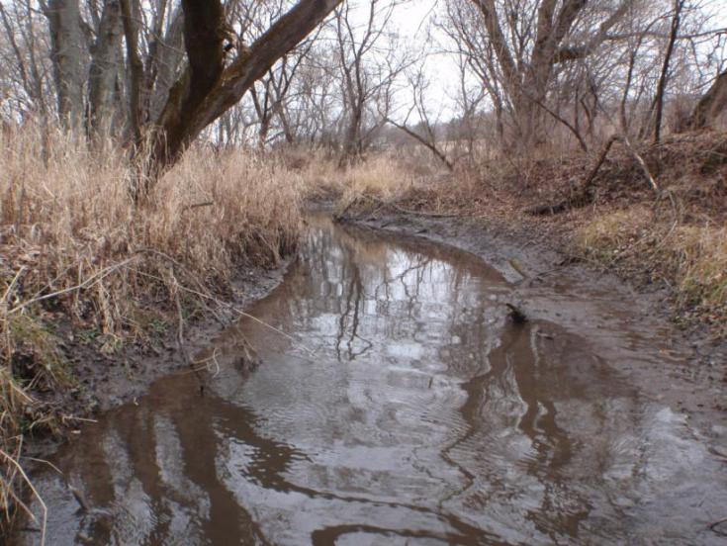
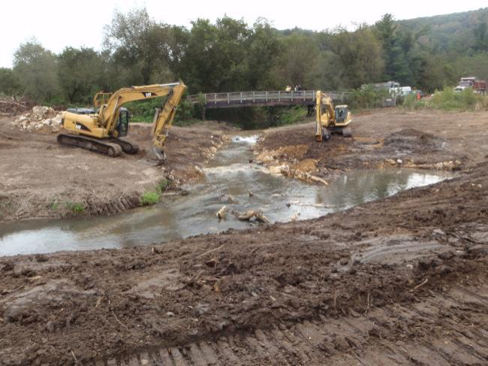
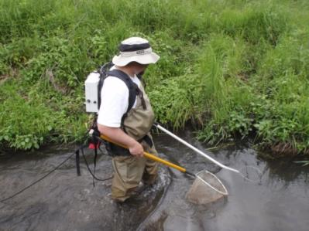
Connecting Field to Stream Transport of Sediment
Identify watersheds that are major contributors
Target areas
Inventory major sources and sinks
Upland versus stream corridor
Inventory major sources and sinks
Upland versus stream corridor
Target best management practices in areas with high losses
Stream corridor rehabilitation
Soil conservation
Target best management practices in areas with high losses
Stream corridor rehabilitation
Soil conservation
LAG TIME?
Evaluate effectiveness
geomorphology, water chemistry, habitat, biological response
Photo Credits: Rebecca Carvin (top),
Mark Godfrey (middle), WDNR (bottom)
Photo Credit: Faith Fitzpatrick (right);
Rebecca Carvin (left)
Notes:
while sinks include floodplain deposition, and streambed deposition.

Slide 9
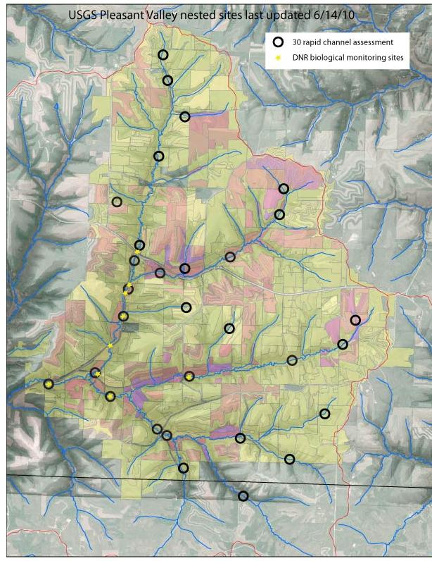
Upper Pecatonica Pleasant Valley Nested Design
Baseline Assessment and Monitoring
30 total sites
  Ephemeral and perennial throughout watershed
  Rapid channel/sediment stability assessment
  Quantitative measurements of eroding banks
  and fine sediment deposition
  Low-flow discharge measurements
15 nested sites
  Modified pebble counts
  Bank, streambed, and soil samples for particle size, total P, organic matter, and radioisotopes for sediment fingerprinting, streambed samples for EPC0 analysis
10 nested sites
  Channel cross sections
  Historical macroinvertebrate, fish, and habitat surveys
6 nested sites
  Walling suspended sediment tube samplers for event based sediment fingerprinting
1 streamgage at outlet
  discharge, total P and suspended sediment loads
Notes:
Geomorphic, sediment budget, and sediment fingerprinting methods have a nested design, with rapid channel assessments at 30 sites. These rapid assessments are augmented with measurements of surficial area of eroding banks and volume of fine sediment deposition. These factors are not usually included in watershed models of BMP evaluations. These studies will help in the understanding of what the loads are composed of at the watershed outlets. EPC0 = Equilibrium phosphorus concentration

Slide 10
Baseline Yields of
Suspended Sediment and Total Phosphorus
at Pleasant Valley and Smith-Conley Stream Gages
Annual yields range 70 to 182 T/mi²
Annual yields range 310 to 740 lbs/mi²
Notes:
Loads and yields from watershed outlets give us what comes out of the pipe but does tell much about the process that got the sediment and nutrients to that point. Typically loads used to set TMDL goals (?) BOB EXPAND MORE ON THE LANGUAGE HERE Want to know more about how sediment and related P are stored and transported at various locations between the field and watershed outlet. [FAITH ADDED – 70-182 T/mi^2 is about 0.1 to 0.3 T/acre]

Slide 11
RUSLE2 and WI Phosphorus Index
Area-weighted mean yields
Used to identify areas for targeted BMPs
Pleasant Valley Cropland:
Erosion: 2.4 (0.1 – 20) tons/acre
P Index: 4.2 (0.2 – 45) lbs/acre
Pleasant Valley Grazed Lands:
Erosion: NA (0.1 - 14) tons/acre
P Index: NA (0.4 – 80) lbs/acre
Preliminary data from Laura Good, UW-Madison Soils Department
Photo Credit: Wisconsin DNR
Notes:
Preliminary estimates from upland calculations of expected field-scale soil erosion, based on the Revised USLE and soil testing for P concentrations. Gives idea of how much potential erosion and P yields we can expect at the field scale. These numbers are only for field-scale sheet and rill erosion. Does not account for delivery/storage. Also can run as scenarios on how much we can expect to reduce amount through different management practices. Most p-budget models don’t account for grazed lands very well.

Slide 12
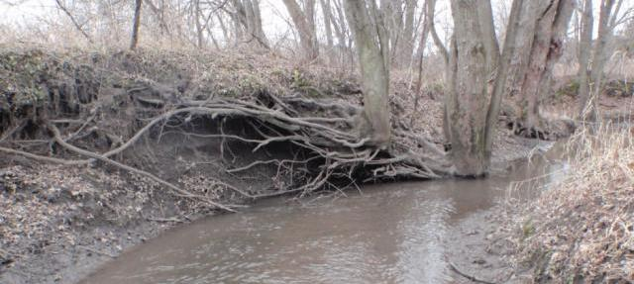
Bank Erosion Preliminary Sediment Yields
by Drainage Area and Slope
[Yields based on:
* surface area of bank erosion measured during 2009-10 rapid channel assessments
* estimated mean annual retreat rate = 0.13 ft/year (UW Pioneer Farm; Fitzpatrick and Peppler in draft)
Segment slopes measured from 1:24,000 quadrangle maps]
Notes:
Large range in bank erosion rates, not dependent on watershed position or slope but likely other factors like riparian land use. Some reaches are potentially large sources of sediment, especially Sliver Spring Creek. Pleasant Valley, the experimental watershed, shown in green, has common bank stabilization whereas the other two watersheds don’t. Combined with sediment fingerprinting results, these data will be used in a GIS to determine an estimate of annual watershed yield of sediment from bank erosion. These results can be used to help determine what might be an acceptable or more natural rate and amount of bank erosion. Bank erosion is a part of the natural processes of streams and promotes a diversity of habitats for a wide variety of aquatic and terrestrial species.

Slide 13
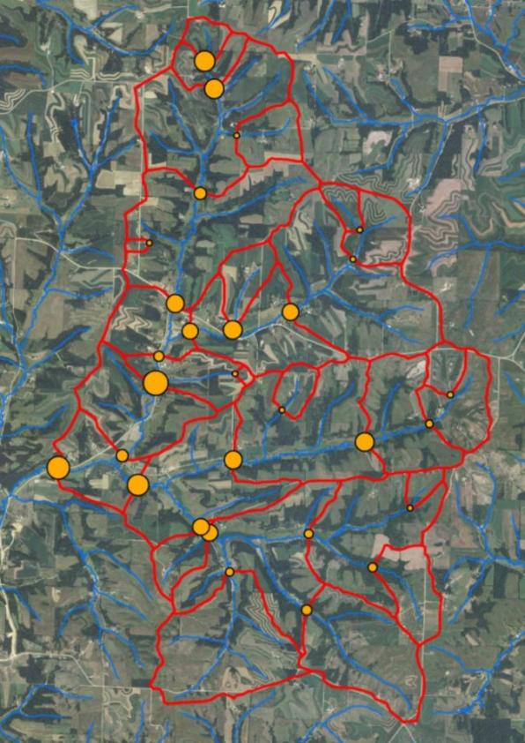
Fine Sediment Deposition
Highly variable within watersheds
PLEASANT VALLEY
Rapid Channel Assessment
2009
Fine Sediment Deposition
(Average = 0 to 0.54 ft³/ft²)
SILVER SPRING CREEK
2010 Fine Sediment Deposition
Notes:
Distribution is quite variable throughout even a small watershed such as Pleasant Valley. Deposition integration of slope, stream network position, riparian land use, relative location to trib input. Like bank erosion, it is difficult to set predetermined acceptable amounts of fine sediment deposition, realizing that some deposition is natural and healthy.
13

Slide 14
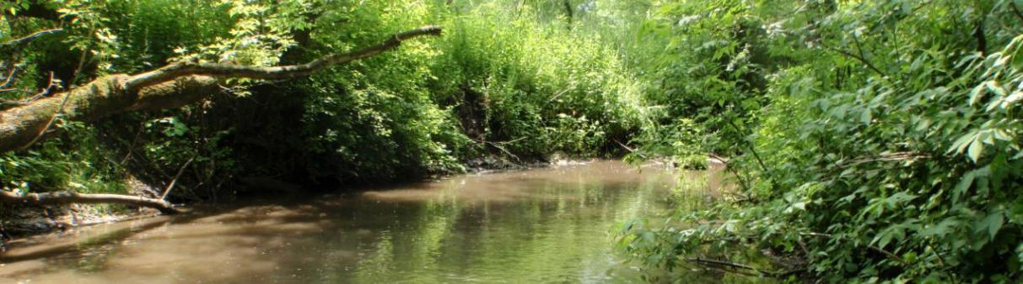
Fine Sediment Depositional Areas
Sediment and Phosphorus “Savings and Loan”

Slide 15
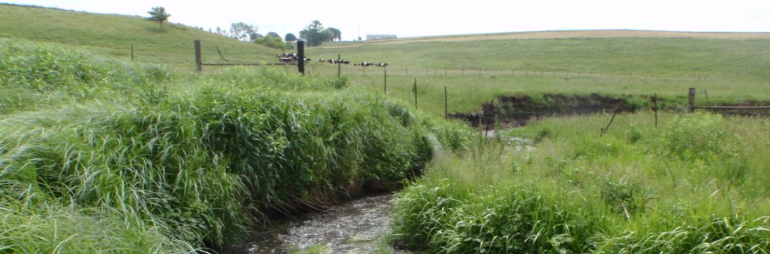
Conclusions
Fine sediment deposition in channels is an important source of sediment and nutrients in Driftless Area streams and should be included in sediment budgets
Phosphorus is unevenly distributed in the fine sediment deposits, with higher amounts in headwater streams potentially
Quantification of bank erosion (and overbank sedimentation) helps managers partition resources between upland practices and stream restoration techniques
Quantification of channel sources and sinks help determine the lag effects from field-scale best management practices to improvements in aquatic biological integrity

Slide 16
Acknowledgments
STUDY PARTNERS AND FUNDING
  Dane County, Land Conservation Division
  Lafayette County, Department of Land Conservation
  Iowa County Land Conservation Department
  Green County Land Conservation Department
  University of Wisconsin-Madison
    Biological Systems Engineering
    Soil Science
    Nelson Institute of Environmental Studies
    Agricultural and Applied Economics
    Civil and Environmental Engineering
  University of Wisconsin-Extension
  U.S. Geological Survey
  Natural Resource Conservation Service
  Wisconsin DNR
  Wisconsin DATCP
  The Nature Conservancy
  Monsanto Corporation
  McKnight Foundation
  USDA Cooperative State Research, Education, and Extension Service

