Slide 1
Black Earth Creek Real-Time Monitoring
11-29-11

Slide 2
Study Objectives
monitor the water-quality parameters of water temperature, specific conductance, pH, dissolved oxygen, and turbidity along BEC and use the data to identify the parameters of concern.
collect water-quality samples of suspended sediment, ammonia, and chloride to help describe water quality parameters of BEC and develop relationships between the real-time water-quality parameters and the water-quality sample results
establishing an alert system

Slide 3
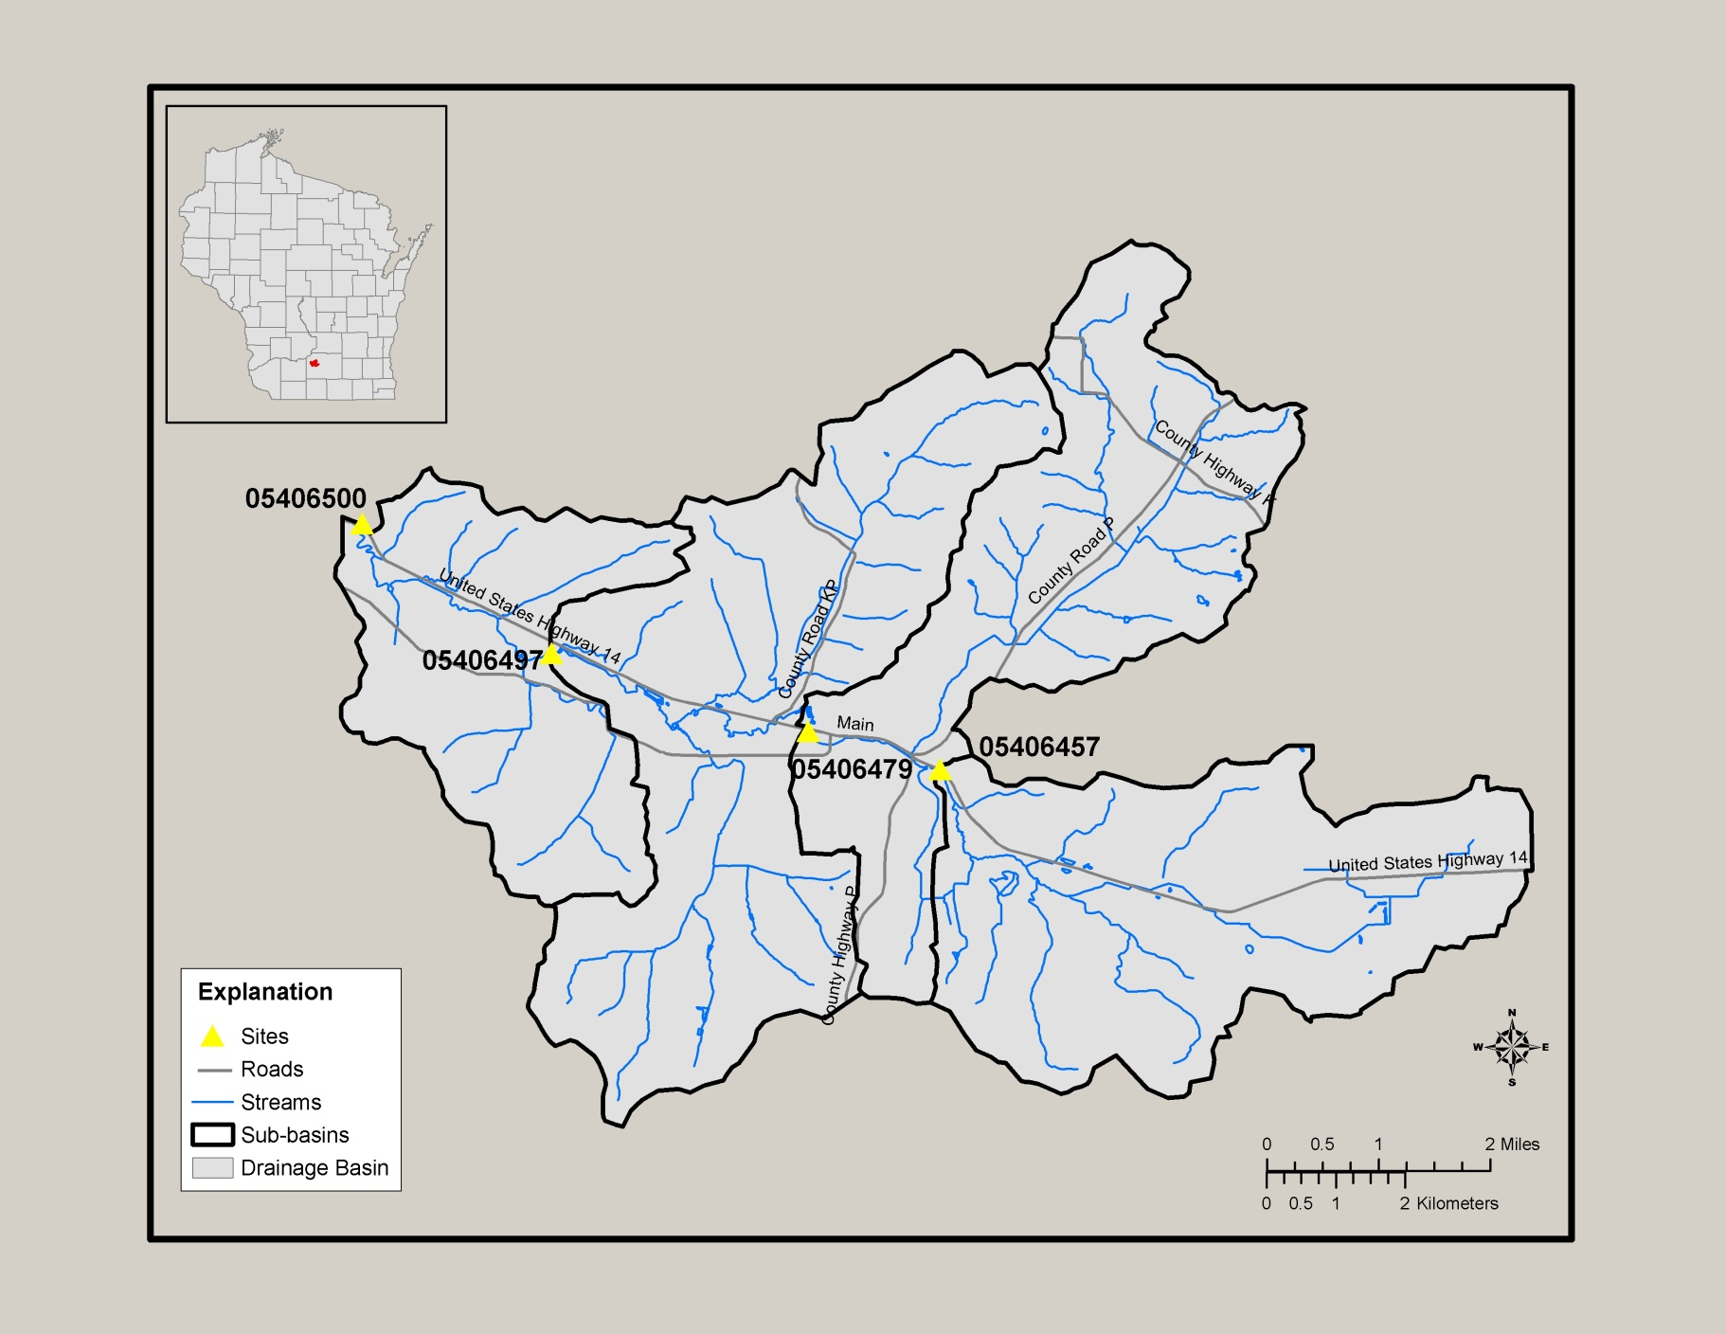

Slide 4
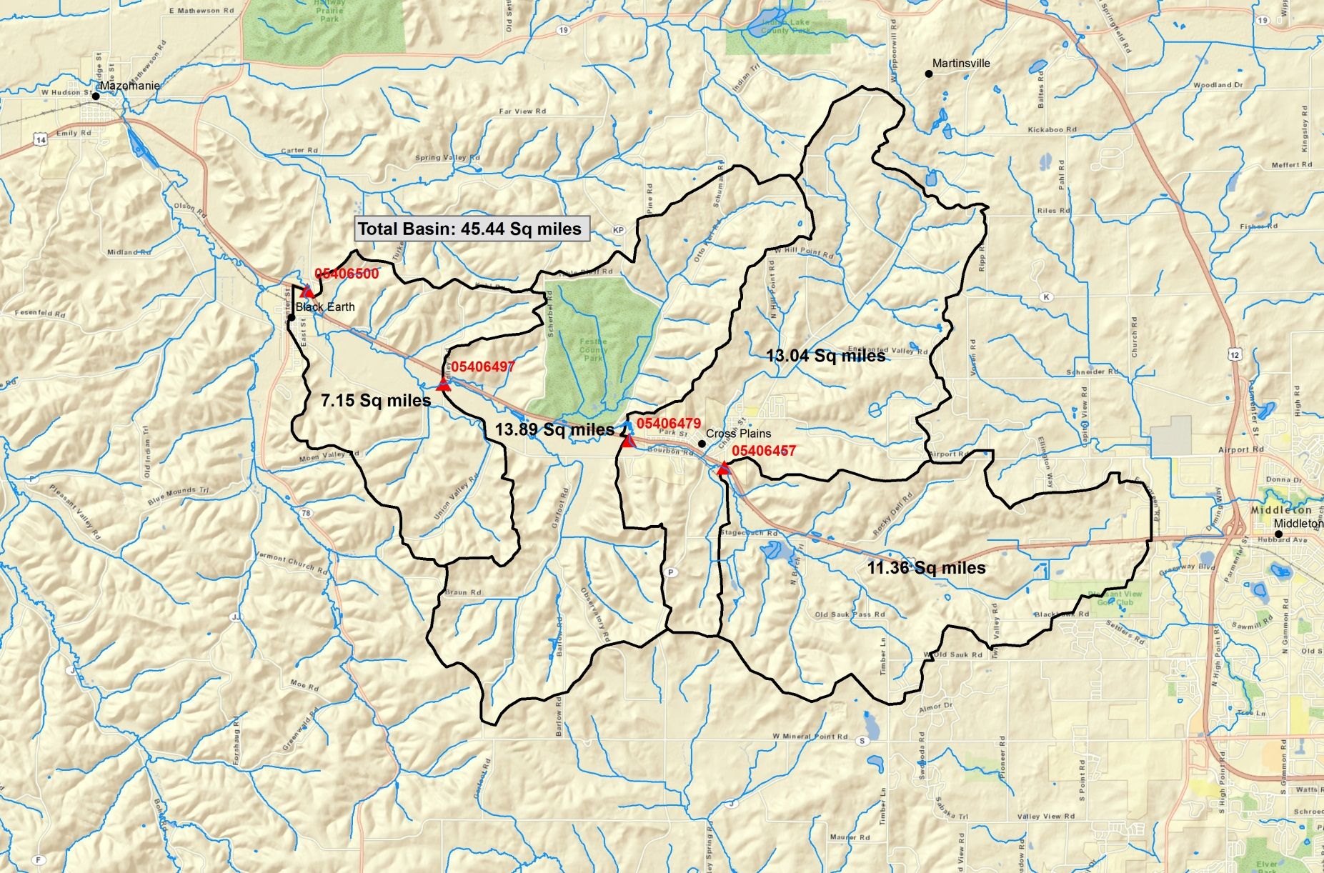
Basin Delineation

Slide 5
Discharge
WY10
  Upstream = 19.24”
  Downstream = 17.46”
WY11
  Upstream = 17.10”
  Downstream = 16.32”
  The peak discharge in WY10 was ~370cfs (07/24/10) at the site near Black Earth and 193cfs in WY11 (03/20/11)

Slide 6
Discharge

Slide 7
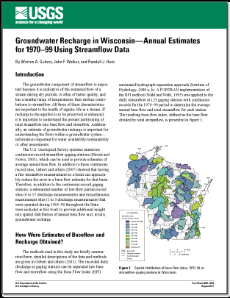
Groundwater Recharge
According to a recent USGS publication (Gebert, 2011), base flow has been increasing in southwestern Wisconsin potentially due to improved agricultural practices.
With increasing recharge rates, it is suspect that daily mean water temperatures may be decreasing.
In a comparison of the average annual baseflow for the Black Earth gage for the full period of record (44years) to the data collected from 1970-99, there has been a 10.7 increase in the average annual baseflow.

Slide 10
Black Earth Creek Stormflow

Slide 11
Discharge
Recharge Rates have been increasing
Stormflow in recent years has been minimal
There hasn’t been any “large” runoff events since monitoring started in 2009.
Improved recharge and decreased stormflow can impact fish communities and should be considered when evaluating the “condition” of Black Earth Creek

Slide 12
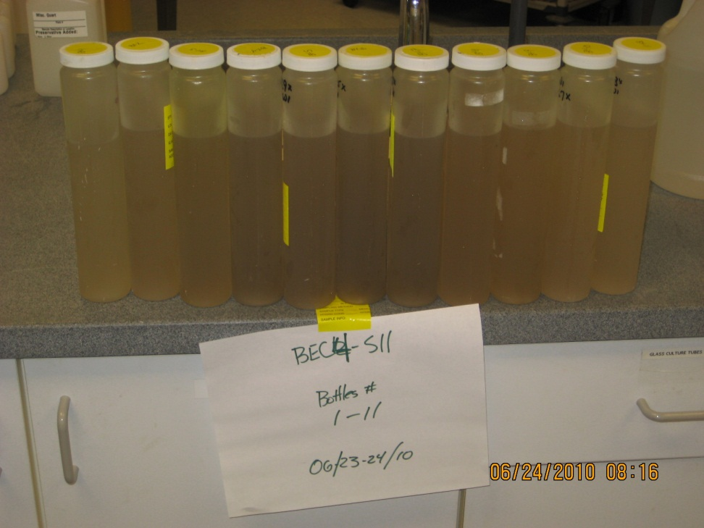
Water Quality - samples
WY10 took 130 storm samples at the Brewery Rd and Black Earth locations
Took 6 storm samples at the remote sites
Monthly Baseflow samples

Slide 13
Water Quality – Samples
Analyzed Water Quality Samples for:
Chloride
Total Kjeldahl Nitrogen
Ammonia
Nitrate
Suspended Sediment
Added the extra forms of Nitrogen to calculate Total Nitrogen and to see if a surrogate would be needed for Ammonium estimations.

Slide 14
Ammonia
The highest ammonia concentrations occurred from snowmelt/rainfall event on 02/17-18/11. There were several discrete concentrations of ammonia over 2 mg/L at the downstream site that spanned over six hours.
The same event at the upstream site had concentrations at and just below 1 mg/L and just over on the grab sample from the Treatment Plant.
Using the conversion of the total ammonia nitrogen to un-ionized ammonia given the temp and pH at the time, the downstream max concentration of uni-ionized ammonia was 0.013mg/L. In this case the cold water temperature help keep the un-ionized ammonia concentrations low.

Slide 15
Snowmelt Event
Ammonia concentrations were “high”
Conductivity didn’t show an increase due to the increased source of ammonia
Water temperature are low during this runoff event

Slide 16
Ammonia distribution between sites
Ammonia concentrations were highest at the downstream most site, despite lower concentrations at South Valley Rd.
Concentrations increased between the upstream site and the treatment plant but may be a result of the timing of the discrete sample collection.

Slide 17
Real-Time Water Quality Trends WY10

Slide 18
Real-Time Water Quality Trends WY11

Slide 19
Dissolved Oxygen

Slide 20
Daily Minimum Dissolved Oxygen
All Sites were <5mg/L ~2% of the time
No Sites were <5mg/L

Slide 21
Regressions
Ran stepwise linear regressions on the water quality data against the real-time water quality sondes outputs
Regressions looked at the both the sonde results and the log of the results (except pH)
Did this for every parameter measured
Current regressions represent relationships determined for ranges in flows and water quality conditions measured

Slide 22
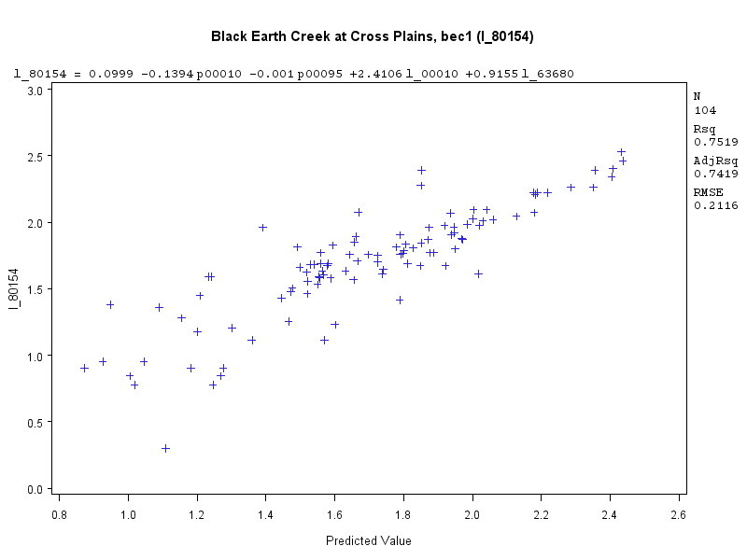
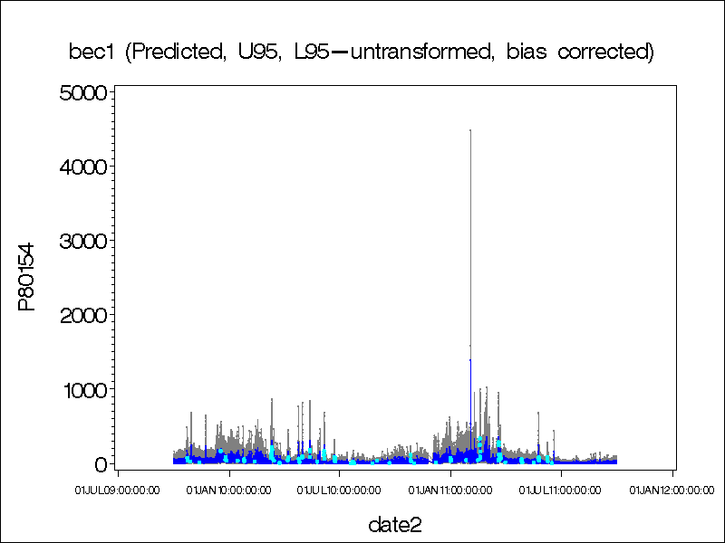
BEC @ Cross Plains Suspended Sediment
SS = 0.099-0.1394*w.temp-0.001*sp. Cond+2.4106*log w.temp+ 0.9155*turbidity

Slide 23
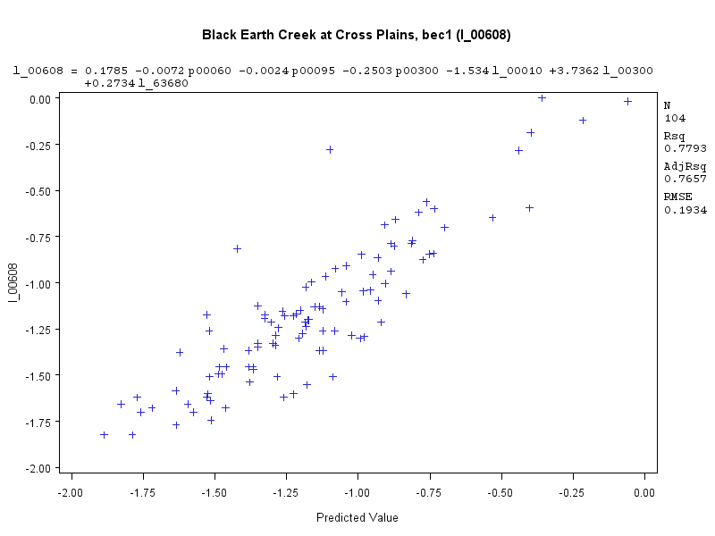
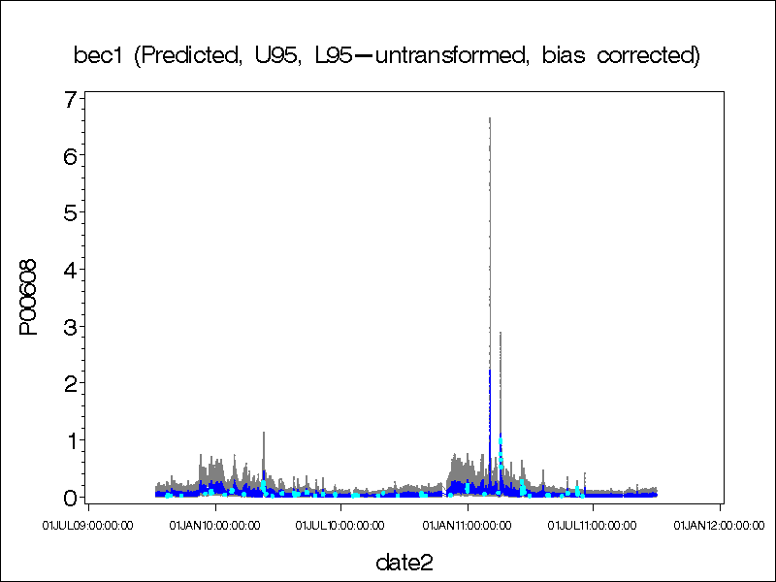
BEC @ Cross Plains Ammonia
NH4 = 0.1785-0.0072*Q-0.0024*sp.cond-0.2503*D.O.-1.5341*log w.temp+3.7362*logD.O.+0.2734*logturbidity

Slide 24
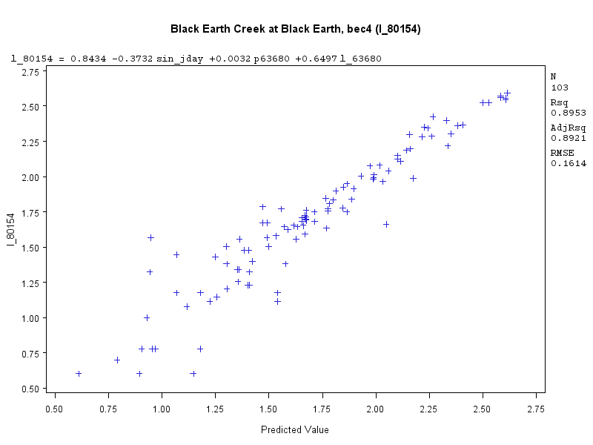
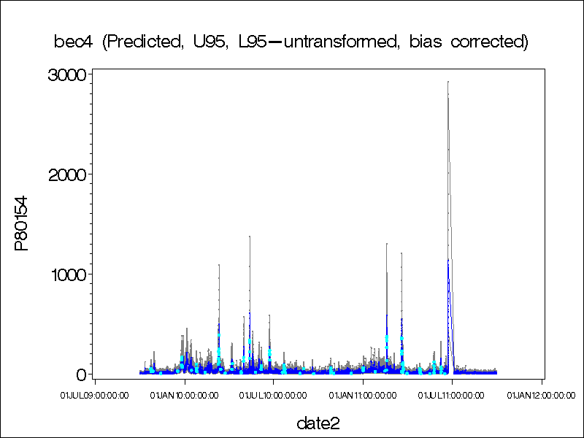
BEC @ Black Earth Suspended Sediment
SS = 0.8434-0.3732seasonal+0.0032*turbidity+0.6497*log turbidity

Slide 25
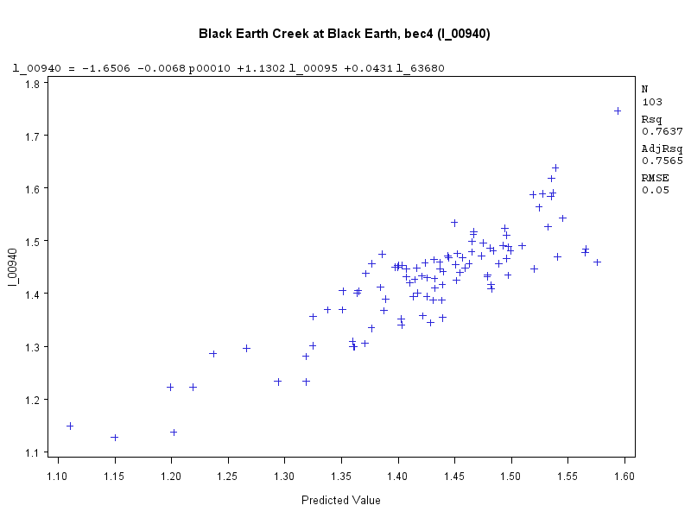
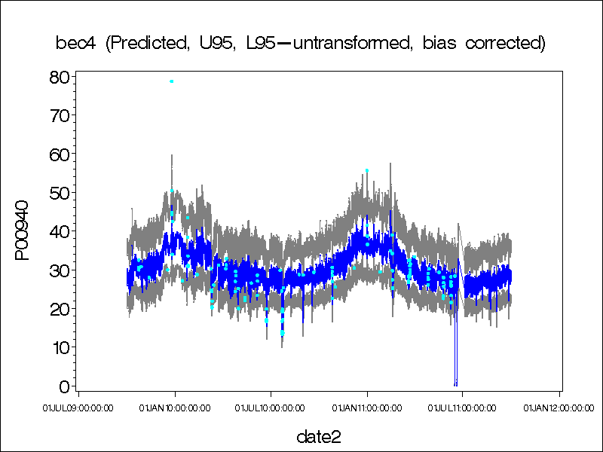
BEC @ Black Earth Chloride
Cl = -1.6506-0.0068*w.temp+1.1302*log sp. Cond.+0.0431*log turbidity

Slide 26
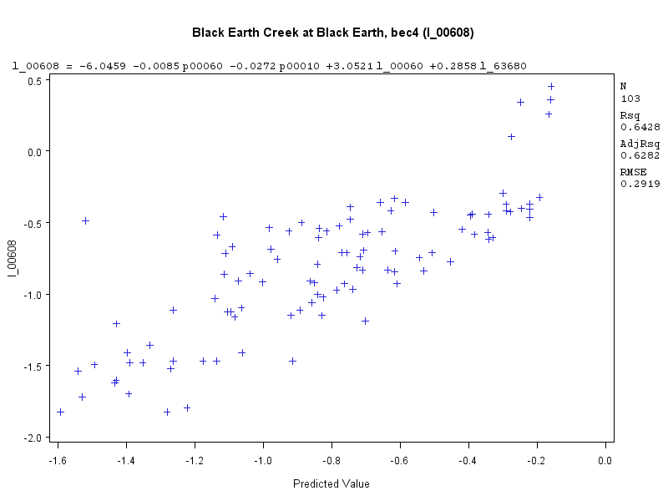
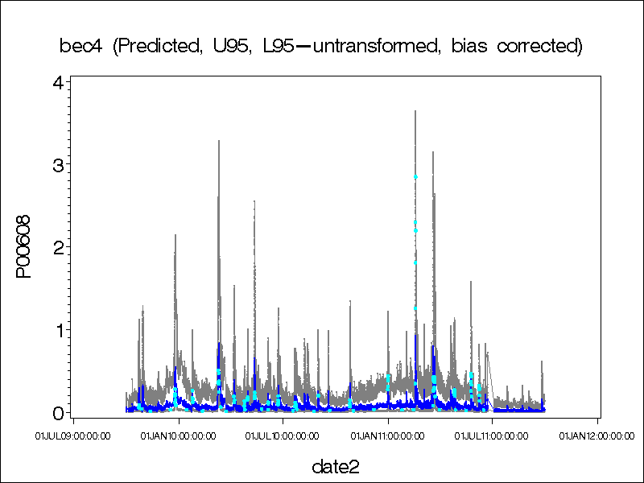
BEC @ Black Earth Ammonia
NH4= -6.0459-0.0085*Q-0.0272*w.temp+3.0521*log Q+0.2858*log turbidity

Slide 27
Regression Status
As more data has been added the regression equations have been changing.
Need to get “bigger” storms or get through another year and see if the regression equations hold

Slide 28
Alerts
No Conditions were met that required an alert to be sent
Though a couple of alerts were sent during calibration and probe malfunctions

Slide 29
Publication
Review of historic and new water-quality data
Include real-time results
Initial regression review
Potential review of historic and current “bug” data
Identify times and water quality parameters of concern.

