Slide 1
Watershed Assessment Restoration and Protection (WARP) Team Monitoring Recommendations
& USEPA Performance Measures
Lisa Helmuth
January 2014

Slide 2
TMDL Program Redesign & WARP Recommendations
TMDL Program Redesign (2009-10)
  Project management/workload allocations.
  Guidance development.
  Monitoring considerations.
  Assessment work.
  Funding strategies.
Watershed Assessment Restoration and Protection Team (WARP)
  2013-14 – 2nd Year
  TMDL guidance, sub teams.
  Monitoring needs assessment.
  Project management, support tools, water resources program support.

Slide 3
WARP CWA Monitoring Needs
Identified Primary Monitoring Needs in 3 areas:
  Integrated Reporting (use attainment and WQ standards, 305(b) and 303(d)) assessments
  TMDL development monitoring
  NPS and WPDES implementation
White paper on terminology and Clean Water Act goals

Slide 4
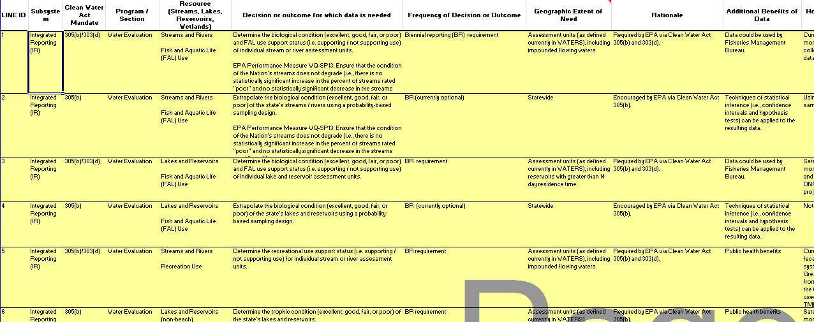
WARP Recommendations
File:\\central\watershed\Monitoring\Monitoring_Strategy\Monitoring_Work_Group_2012\Monitoring_Issues_Table_V1_MWG.xls

Slide 5
WARP Recommendations
Identified Primary Monitoring Needs:
  WQ standards
    Natural Communities
    Rule Making Requirements
    Confirmation Monitoring, update protocols
  Integrated Reporting
    WisCALM Assessment Gaps
      Condition Assessments
      Standards Attainment status
  TMDL development monitoring
    Project by Project Basis -> special funding mechanisms
  NPS and WPDES implementation
    Project Evaluation, Impaired Waters Clusters, Federal Performance Measures, Adaptive Management/WQ Trading

Slide 6
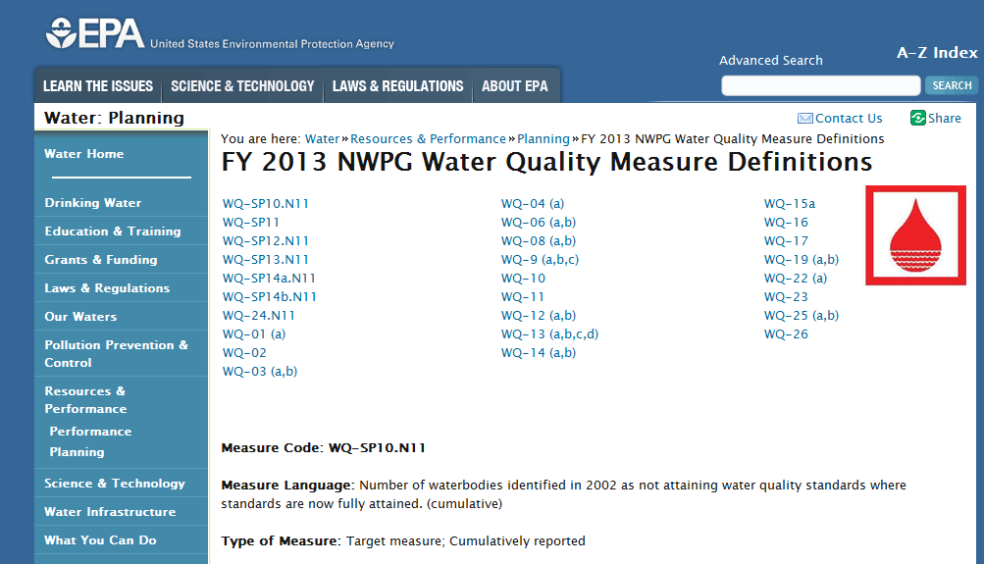
USEPA Water Perf. Measures
http://water.epa.gov/resource_performance/planning/FY-2013-NWPG-Measure-Definitions-Water-Quality.cfm

Slide 7
USEPA Performance Measures and ATTAINS Redesign
ATTAINS: USEPA Database → Monitoring, Assessment, 303d Tracking, TMDL Tracking, Restoration Tracking, Future: USEPA Performance Measure Calculation
WATERS → Data flows to ATTAINS
Future: → USEPA derive performance measures from state integrated dataset submittals.
Four ATTAINS Workgroups – Data Transmittal, Assessment Methodology: Data Calculations: Monitoring/Assessments, Performance Measures – USEPA Strategic Plan FF15 & beyond

Slide 8
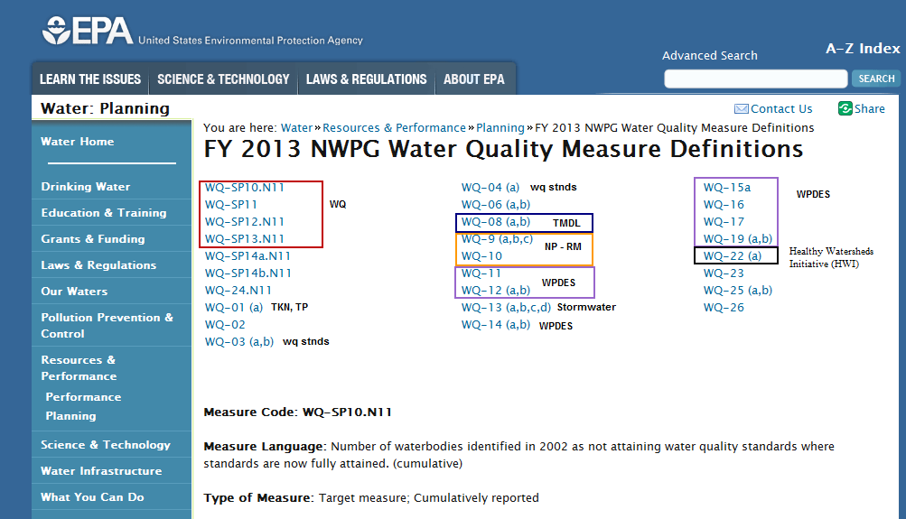
Key Indicator Overview

Slide 9
Key USEPA Measures
WQ10 (Number of waterbodies identified by States (in 1998/2000 or subsequent years) as being primarily nonpoint source-impaired that are partially or fully restored. [Non-Point Program]
SP10 (Number of waterbodies identified in 2002 as not attaining water quality where standards are now fully attained. Cumulative.) [Revisions Pending]
SP11 (Remove the specific causes of waterbody impairment identified by states in 2002. Cumulative.) [Revisions Pending]
SP12 (Improve water quality conditions in impaired watersheds nationwide using the watershed approach. Cumulative.) [Potential Revisions Pending]
SP13 (Ensure that the condition of the Nation's streams does not degrade (i.e., there is no statistically significant increase in the percent of streams rated "poor" and no statistically significant decrease in the streams rated "good"). [Potential Revisions Pending]

Slide 10
New 303d/TMDL Measure
Key performance measure: Extent of priority areas identified by each State that are addressed by EPA-approved TMDLs or alternative restoration approaches for impaired waters, or protection approaches for unimpaired waters.
2022 target: Based on the universe identified in 2015 or 2016 and the most current CWA 303(d) list, set a target for the percent of priority watershed areas where the State plans to have all TMDLs or alternative restoration or protection plans completed by the end of 2022 (based on State-defined priorities).

Slide 11
Additional Measure Ideas
Extent of water resources with a TMDL and non-TMDL Approach (Alternative - extent per HUC12) | % of total impaired state miles of rivers and streams, and acres of lakes
Extent of water resources addressed by a TMDL and non-TMDL approaches with a focus on a specific pollutant (NPS pollutants) (Alternative - extent per HUC12) | GIS-calculation of percentage of impaired waters within a state that have a TMDL for NPS pollutants
Percent of addressed WLAs and LAs | Percentage of approved WLAs and LA's that are being addressed through permit requirements or watershed plans.
Impairments now meeting WQS | Number of previous impairments now meeting water quality standards due to corrective actions (go to page 78 of lhttp://www.legacy.leg.mn/resources/metadata-worksheets-2012-clean-water-fund-performance-report)
% of watershed restoration and protection strategies | Percentage of watershed restoration and protection strategies that are in progress/completed.
Watersheds showing parameters specific changes in WQ | Numbers or percentages of watersheds showing significant parameter-specific changes in water quality. This measure includes significant improvements as well as declines in water quality.
NPS success stories with TMDLs and non-TMDL approaches

