Slide 1
Assessment Units in WATERS
Lisa Helmuth

Slide 2
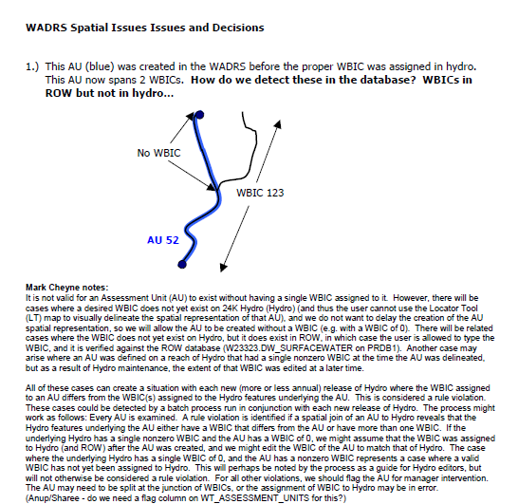
Assessment units in waters
System designed 2002-2004
  Spatial Model Decisions are documented
  AUs tied to Hydro
  AUs require a WBIC
  System designed to report to USEPA
  Features stored as individual features
  in SDE Environment
25,000 assessment units in WATERS
  Fraction of the state’s rivers/streams
  Most of the lakes, open waters
  Fraction (very small) of springs
  Great Lakes and Mississippi
  (Wisconsin Portion Only)

Slide 3
Spatial representations
Streams
  Single line streams (lines)
  Double line streams (polylines)
Rivers
  Double lines (polylines)
Lakes, Bays, Harbors, Flowages
  Polygons
Springs
  Polygons

Slide 4
Current conditions
Snap to Hydro
  Dependency on Hydro Shapes
WBIC required
  Dependency on Register of Waterbodies
Heads up digitizing is conducted
  Goal: incorporate wbic and connection to hydro as soon as hydro is updated to reflect additions.
    Example: trout waters, o/erw

Slide 5
Decision rules for assessment unit
WQ Standards Use Designations (i.e. Classes and/or Special Standards),
Point and/or nonpoint source input to the stream or its tributaries (and associated Water Quality Variance segmentations listed in NR104, Wisconsin Administrative Code.
Outstanding and Exceptional Resource Water designations (state and/or federal)
Classification of the water as a Wisconsin Trout Stream in NR 1.0 Wisconsin Administrative Code.
Identification of a water or segment of water as impaired and listed on the state’s Clean Water Act 303d List of Impaired Waters.
Lakes defined by natural community to clarify potential or attainable use

Slide 6
Potential chnages to spatial model
New eLT allows:
  Multiple wbic groupings [not implemented]
  Tracing upstream functions (all waters) [not implemented]
  Circle to select and define area [not implemented]
  Extension of existing wbic (rather than two wbics, one on hydro feature, one an edit to hydro)
  Custom modification of polygon features (once it has cloned hydro, vortex tool allows modification without losing connection to wbic and hydro
  Polygons can be sliced (good for bays, harbors, etc.)

Slide 7
Additional considerations
Changes to assessment units per say will require complete overall of data model in WATERS and remapping to federal database.
Alternatives:
  assessment group feature to WATERS - tabular - to achieve similar result without modifying how we send data to USEPA (result is the same on their end, data management more intuitive on our end).
  Search and Report Queries based on program need rather than restructuring data system.

Slide 8
Additional considerations
Decision protocols on data representativeness of monitoring - versus how assessment units are delineated…
WARP Project to describe supporting impaired waters and tmdl management.
Amendments

