Slide 1
Monitoring Update
July 2021 Meeting

Slide 2
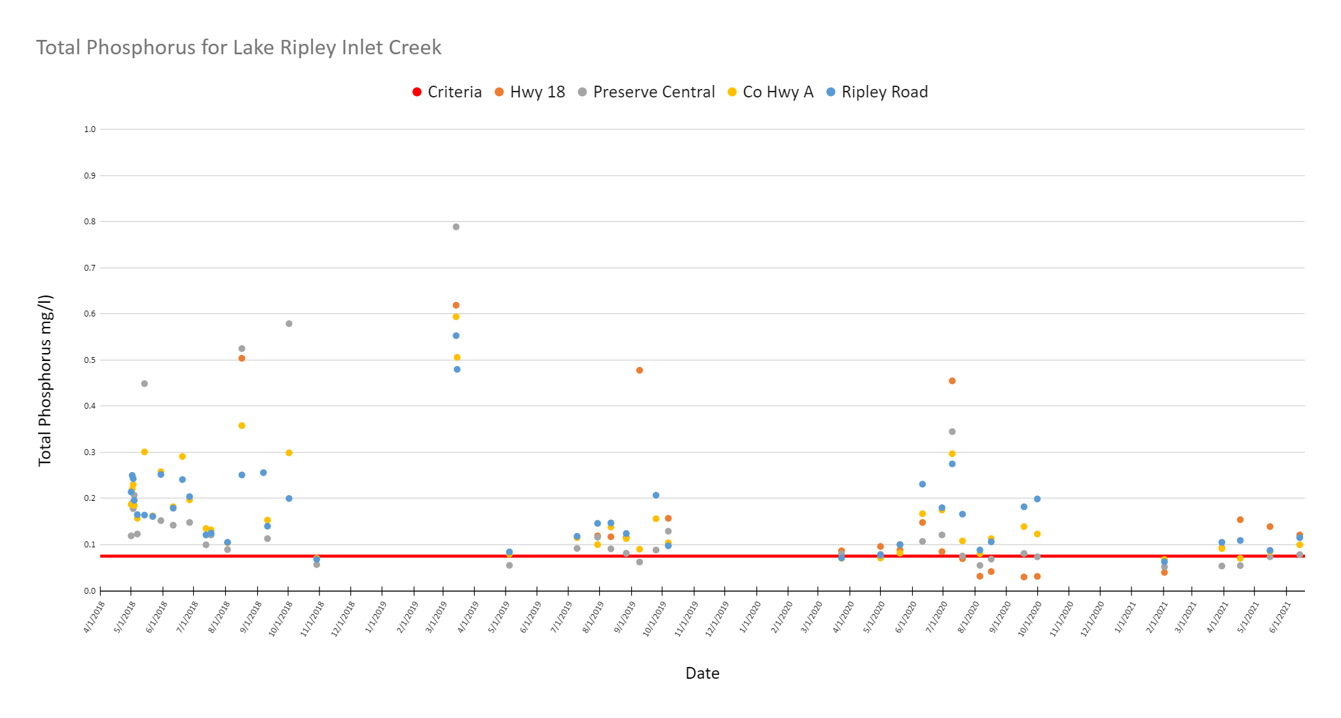

Slide 3
Total Phosphorus Summary Data
Statistic | Criteria | Hwy 18 | Preserve Central | Co Hwy A | Ripley Road
Average | 0.075 | 0.1660 | 0.1536 | 0.1695 | 0.1738
Maximum |  | 0.6190 | 0.7890 | 0.5940 | 0.5530
Minimum |  | 0.0298 | 0.0516 | 0.0679 | 0.0628
Standard Deviation |  | 0.1700 | 0.1565 | 0.1122 | 0.0969
% Exceed Criteria |  | 73.9 | 76.2 | 88.6 | 93.2
Samples |  | 23 | 42 | 44 | 44
Statistic | Criteria | Hwy 18 | Preserve Central | Co Hwy A | Ripley Road
Average | 0.0750 | 0.2299 | 0.1774 | 0.1877 | 0.1866
Maximum |  | 0.6190 | 0.7890 | 0.5940 | 0.5530
Minimum |  | 0.0866 | 0.0550 | 0.0704 | 0.0680
Standard Deviation |  | 0.1992 | 0.1735 | 0.1216 | 0.1052
% Exceed Criteria |  | 100 | 90 | 91 | 94
Samples |  | 12 | 31 | 34 | 34

Slide 4
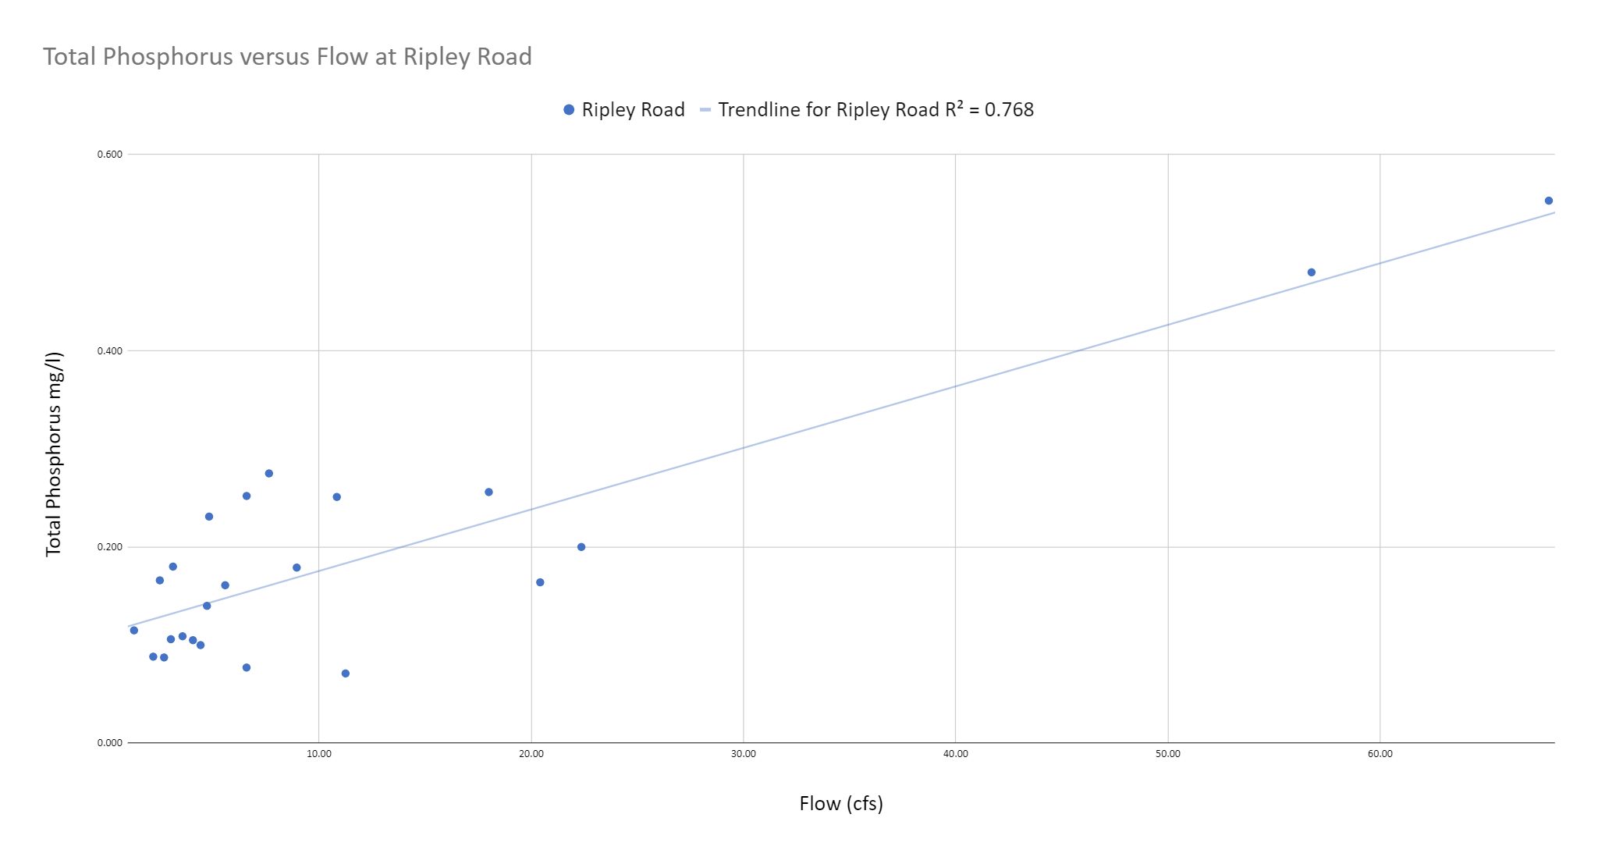
Phosphorus Loading is related to flow
Notes:
TP is really bad during storm events but is only kind of bad under base flow conditions

Slide 5
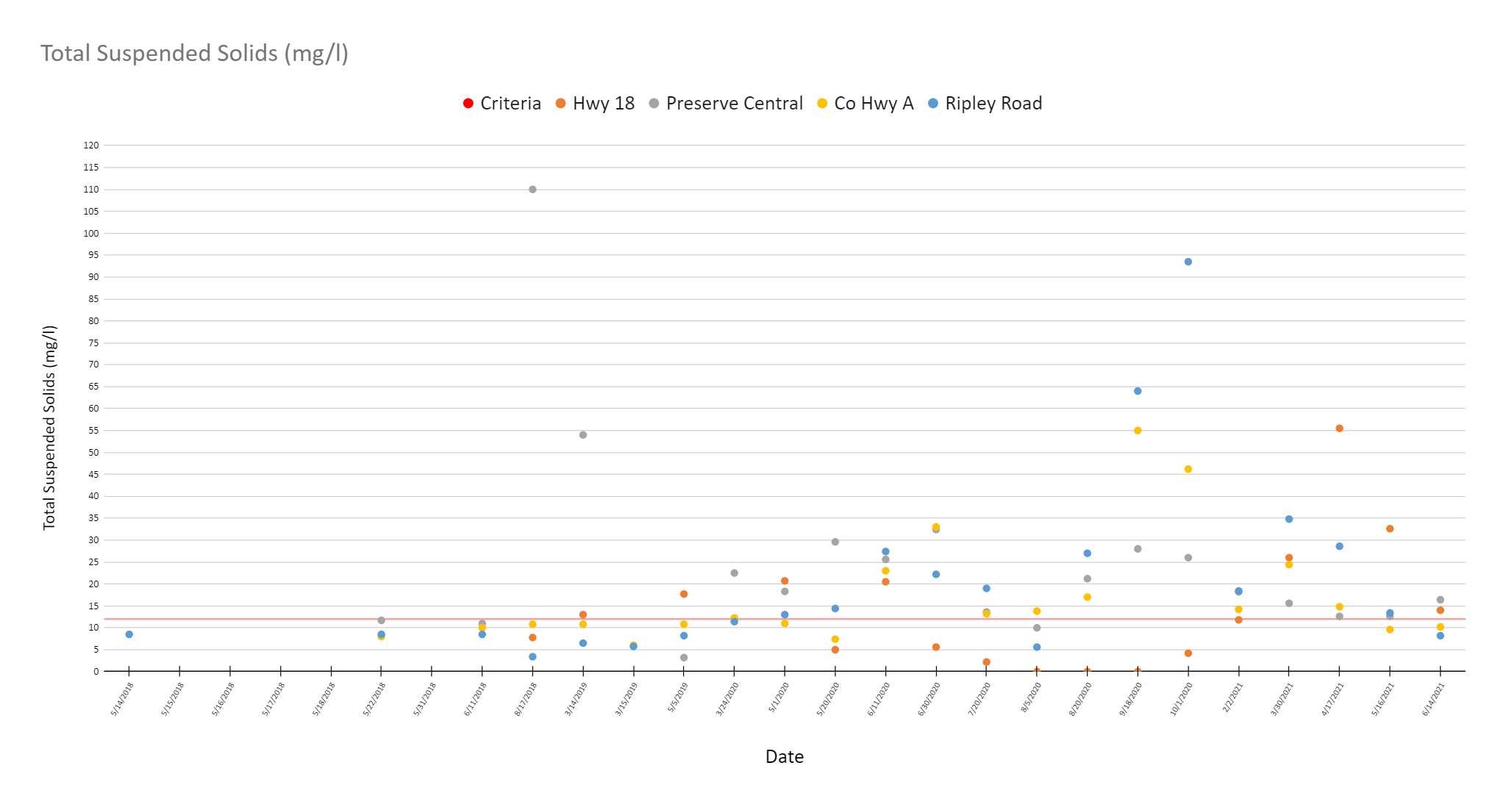
Total Suspended Solids

Slide 6
Total Suspended Solids Summary Data
Statistic | Criteria | Hwy 18 | Preserve Central | Co Hwy A | Ripley Road
Average | 12 | 12.8 | 31.8 | 14.8 | 11.8
Maximum |  | 20.7 | 110.0 | 34.6 | 27.4
Minimum |  | 5.0 | 3.2 | 6.0 | 3.4
Standard Deviation |  | 6.4 | 30.9 | 9.8 | 6.8
% Exceed Criteria |  | 63 | 70 | 33 | 38
Samples |  | 8 | 10 | 12 | 13
Statistic | Criteria | Hwy 18 | Preserve Central | Co Hwy A | Ripley Road
Average | 12.0 | 13.8 | 24.6 | 17.2 | 20.5
Maximum |  | 55.5 | 110.0 | 55.0 | 93.5
Minimum |  | 0.0 | 3.2 | 6.0 | 3.4
Standard Deviation |  | 14.0 | 22.9 | 12.8 | 21.2
% Exceed Criteria |  | 50 | 80 | 52 | 54
Samples |  | 18 | 20 | 21 | 22

Slide 7
Based on our current data, 1 ton of sediment is added to Lake Ripley about every 3 days!
Notes:
Lake Ripley receives about 8 MGD of water per day and one ton of sediment is added every 24 MG.

Slide 8
Conclusions
Big rain events in the watershed are a big deal.
Develop watershed BMP’s to address stormwater mitigation that encourages retention and infiltration.
Last year the Secchi depth decreased by 9 feet after one large rain event!!
Continue to work towards reducing TSS and TP loads.
What should we be doing?

