Slide 1
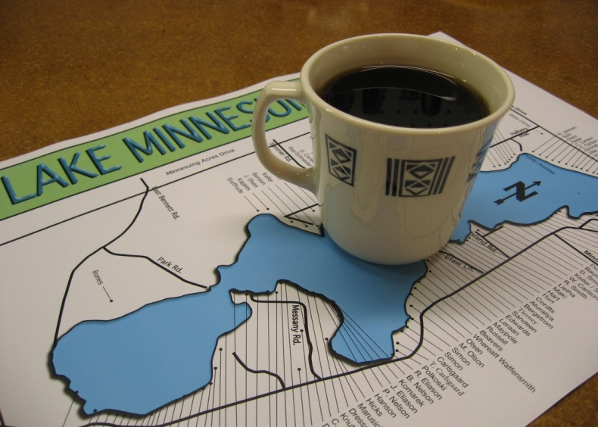
Yellow Flag Iris Herbicide Treatment
Lake Minnesuing
Douglas County
Jim Giffin
Lake Minnesuing Association
Lake Minnesuing Sanitary District sailjbg@gmail.com
Notes:
Good morning!

Slide 2
Yellow Flag Iris
Burst on the scene of our lake 5 or 6 years ago
Plant is invasive and spreads rapidly
Applied for & received a 4 year Early Detection & Response Grant in early 2015
Cutting plants
Digging plants
Cutting seed pods
Treated with herbicide in 2016
Notes:
Yellow Flag Iris is an invasive. It spreads fast and furiously on shorelines and in wetlands. After several years of cutting plants down I’m not sure cutting alone does much. I think it’s kind of like mowing grass in that it doesn’t seem to really stress the plant as hoped. Digging, when done completely, seed pod cutting, and the herbicide Rodeo, properly applied, are all effective at slowing the plant.

Slide 3
Yellow Flag Iris
Notes:
We all see more and more of this in mid June. This stuff is bad news!
It spreads through rhizomes and seed pods.

Slide 4
Herbicide Treatment
2016 DNR Pesticide Application Permit
Spraying – 8 densely populated properties – some of the worst on the lake
Cut Stump Treatment – 2 properties
Glove Wipe Treatment – 10 properties
Notes:
We applied for and received a pesticide application permit and used 3 treatment techniques all of which were effective. Let’s look at some examples.

Slide 5
Cut Stump Candidate #1
Notes:
We treated this area in 2016 using the cut stump treatment method.

Slide 6
Cut Stump #1 Results
Notes:
In 2017 you can see significant impact with about 60% reduction in stand density using the cut stump treatment technique.

Slide 7
Glove Treatment Candidate #1
Notes:
Not only was this a YFI candidate but we have a drainage pipe problem in this area too! We treated this area in 2016.

Slide 8
Glove Treatment #1 Results
The Stand is Gone 6-12-17!
Notes:
Based on all glove applications done in 2016, this technique thins densities about 50-60%.

Slide 9
Spraying Candidate #1
Notes:
We sprayed this with Rodeo September, 2016.

Slide 10
Spraying #1 Results
Notes:
2017 result. Extremely effective. However, what will replace the YFI?

Slide 11
Spraying Candidate #2
Notes:
This is a creek which is the outlet of Lake Minnesuing. YFI seeds lodge along the shore of creek just downstream of the mouth. Only the north side of the creek was sprayed in 2016.

Slide 12
Spraying #2 Results
Notes:
90% effective. Very limited collateral damage.

Slide 13
Do You Have Doubts of the Effectiveness?
Notes:
The south side of the creek in the same area was not sprayed. Here is what it looked like 6/12/17. Lovin’ life! When you use Rodeo you also use a surfactant to make it stick to the plant.

Slide 14
Spraying Candidate #3
Notes:
Huge stand of YFI several feet deep and 80’ long!

Slide 15
Spraying #3 Results

Slide 16
Spraying #3 Results

Slide 17
Spraying #3 Results

Slide 18
Spraying Candidate #4
Notes:
2 stands of YFI.

Slide 19
Spraying #4 Results
Notes:
No Stands of YFI!

Slide 20
Spraying With Care
Notes:
This guy was terrific!

Slide 21
Property Owner Participants

Slide 22
Moving Ahead in 2017
Week of Monday 7-24-17 YFI work Week
Need volunteers to cut plants and seed pods
We will dig some small clumps
Goal is the entire 7 mile shoreline
Won’t happen without you
Who will help?
Email sailjbg@gmail.com
Notes:
We will have some paid employees but need volunteers. The south end of the lake through the narrows has a lot of YFI. We could use volunteers from that area to help us.

Slide 23
Yellow Flag Iris
Notes:
These are the seed pods. They are formed after the plant flowers. On our lake we cut them late in July, before they dry and open to spread the seed. Last year we cut the pods on all 7 miles of our shoreline.

Slide 24
Moving Ahead in 2017 - Spraying
LMSD will again sponsor spraying of dense stands likely in September
LMSD will contact affected property owners for permission on 7 or 8 properties

Slide 25
Moving Ahead Cut Stump/Glove Treatments
This is effective
Process pinpoints the application
Almost no collateral damage
Much less shore disturbance than digging
If you want help doing this let me know by email at sailjbg@gmail.com
We will need volunteers to help
Notes:
We need volunteers to help property owners with this treatment.

Slide 26
Stand On Our Own
Grant ends in 2018
Requires property owner action to sustain progress

Slide 27
Yellow Flag Iris Herbicide Treatment
Lake Minnesuing
Douglas County
Jim Giffin
Lake Minnesuing Association
Lake Minnesuing Sanitary District sailjbg@gmail.com

