Slide 1
Waterflea & Veliger Sample Collection, Submission, & Analysis
Friday April 24, 2020
Maureen Ferry
WDNR

Slide 2
Training Agenda
Background & next steps
Collection reminders
Review new form (lab slip)
Sample submission
Analysis demonstration

Slide 3
Background
1986
Spiny waterfleas in Lake Michigan
Zebra mussels in Lake Superior
Zebra mussels inland
Lab established in Plymouth
Spiny waterfleas inland
Lab analysis moved to Science Operation Center in Madison
Lab analysis moved to Wisconsin State Laboratory of Hygiene in Madison
1989
1991
1994
2003
2013
2019

Slide 4
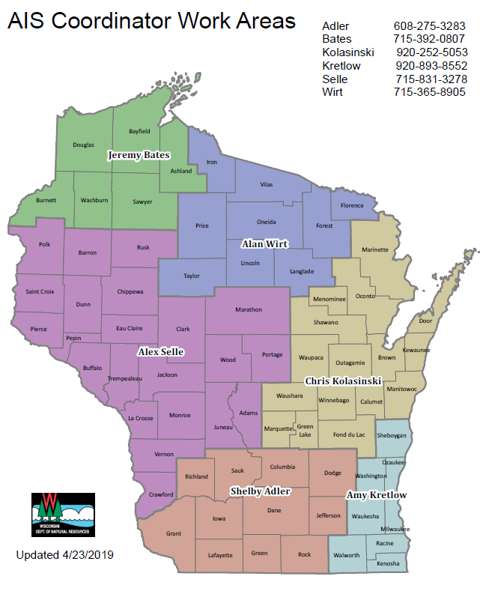
https://dnr.wi.gov search
“AIS Regional Coordinator”
Notify DNR AIS by May 15
DNR will log samples in central list

Slide 5
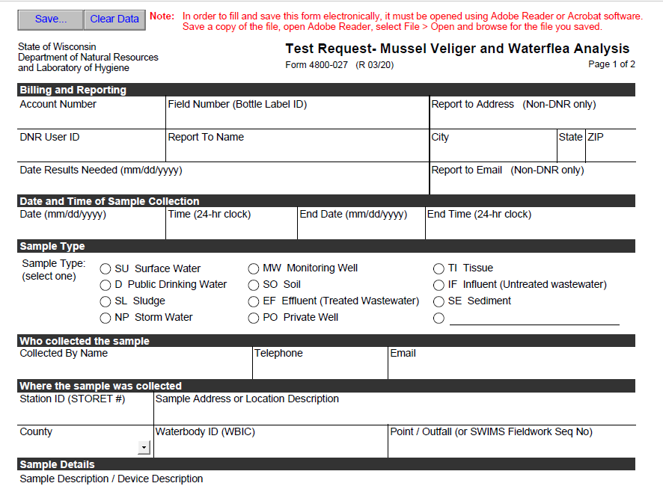
Lab slips/data form
Generated in SWIMS – collectors w/o SWIMS access will request pre-filled lab slip from
the regional
DNR AIS
coordinator
following
notification

Slide 6
Supplies
Use existing bottles until they are used up – then WSLH will provide bottles.
WSLH will provide labels for bottles & labelled bags.
Supplies will be sent to regional DNR AIS coordinator to distribute for collectors in their region
Pending COVID-19

Slide 7
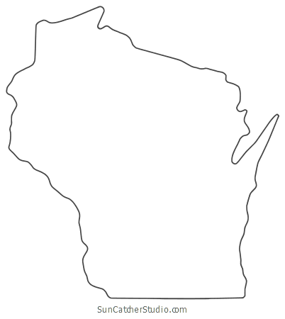
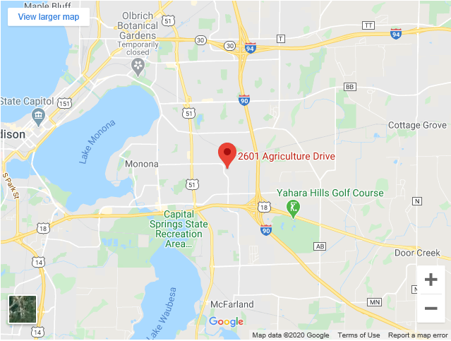
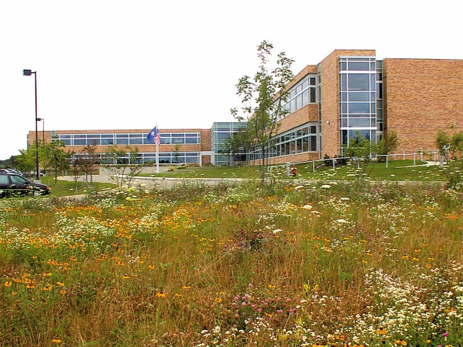
Wisconsin State Lab of Hygiene
Communicable Disease, Environmental and Occupational Laboratories; Forensic Toxicology; WSLH Proficiency Testing 2601 Agriculture Drive Madison, WI 53718
(608) 224-6230
Send samples monthly or during statewide meetings
Call the lab prior to delivering samples (>10) to tell them how many
Deadline to submit samples by October 31

Slide 8
Results
Results will be sent to the regional DNR AIS coordinator to determine appropriate status and follow up
Statuses: https://dnrx.wisconsin.gov/swims/downloadDocument.do?id=127413817
Need physical specimens of mussel and waterflea to verify population

Slide 9
Sample Collection
Waterflea & Veliger Protocol
Sarah Fanning
WDNR

Slide 10
Overview
Waterflea
Qualitative & quantitative methods
Veliger
Decontamination & disinfection

Slide 11
Waterflea Methods

Slide 12
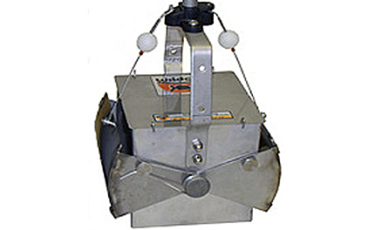
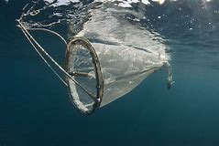
Waterflea Methods
Qualitative (presence/absence)
Waterflea Ekman Sediment Sample
Used year-round
Waterflea Oblique/Horizontal Tow
Verify established population
Used in late summer/early fall
Quantitative (abundance)
Waterflea Vertical Lake Tow
Used for long term trend analysis

Slide 13
Waterflea Ekman Sediment Sampling
Equipment
Boat
Lake bathymetry maps
GPS unit – optional
Ekman grab
Messenger
100 ft Braided polyester line
Spray bottle
Two State Lab of Hygiene provided plastic bags (double bag)
Sample labels
Pencil
Cooler with ice
Test Request – Mussel Veliger and Waterflea Analysis Form 4800-027 labslip
Large brush and small brush
Fresh rinse water

Slide 14
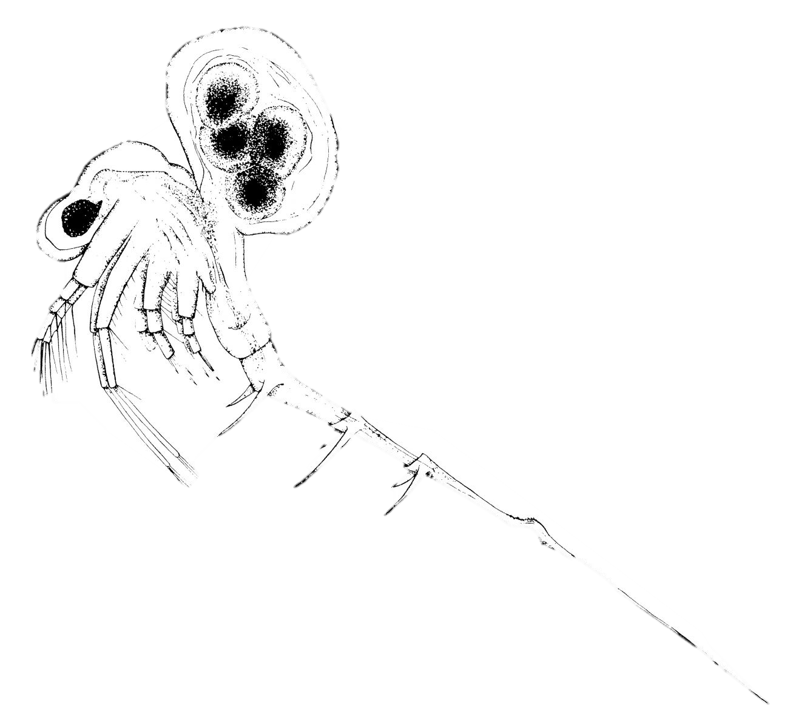

Slide 15
Waterflea Ekman Sediment Sampling
Anchor at the deep hole.
Lower the Ekman gently.
Drop the messenger.
Retrieve the Ekman.
Scoop out sediment sample.
Bag the sediment sample.
Record data.
Notes:
Anchor at the deep hole.
ower the Ekman to ~1 m off the lake bottom. Lower the rest of the way.
Drop the messenger and wait for the “click” of the trap closing shut.
Pull the rope to retrieve the Ekman dredge.
Open the top of the Ekman dredge and scoop out 1-2 cups of material into the one of the bags.
Double bag the sediments and include an “Internal Label” in the inside the bag with actual sediment. Also include an “External Label” which is inside the outer/second bag. Samples should be refrigerated or frozen and not preserved in ethanol.
Record data on the Test Request – Mussel Veliger and Waterflea Analysis Form 4800-027.

Slide 16
Waterflea Oblique or Horizontal Tows
Equipment
Lake maps
GPS unit (optional)
0.5 to 1-meter diameter, 253-micron mesh plankton net w/ rope
Spray bottle
250 ml and/or 1 L plastic bottles
Ethanol 95% (190 proof)
Sample label
Pencil
Test Request – Mussel Veliger and Waterflea Analysis Form 4800-027 labslip
Large brush and small brush
Fresh rinse water
Chlorine bleach

Slide 18
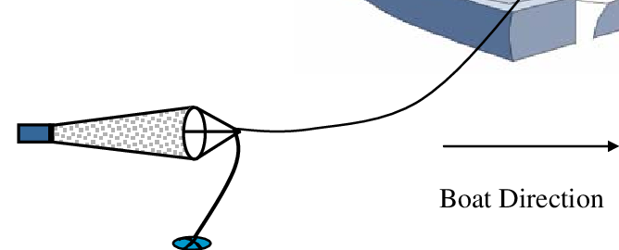
Waterflea Oblique or Horizontal Tows
Oblique Tow (deep lakes): Lowering of zooplankton net to the thermocline
Tow for 2 minutes driving backwards slowly
OR
Horizontal Tow (shallow lakes): Lower top of zooplankton to fully submerged without hitting bottom
Tow for 2 minutes driving backwards slowly
Notes:
Note: Care must be given that the net does not hit the lake bottom. When this happens, the sample will contain muddy water, which is very difficult or impossible to analyze. If you hit the lake bottom, rinse out the sampling equipment and go to a deeper area of the lake to perform a good tow.
Note: If lake is shallow and macrophytes are too dense to conduct a horizontal tow, attempt conducting a vertical tow. Avoid collection of macrophytes in tow

Slide 19
Waterflea Oblique or Horizontal Tows
2. Rinse the samples into the collection cup.
3. Transfer sample to sample bottle.
4. Repeat at the other two pre-selected sites.
5. Composite the samples.
6. Label bottle.
7. Preserve the sample.
8. Record data.
Notes:
3. Note: If waterfleas are present, they might be visible immediately within the collection cup (but not always).
Note: If the prescribed ethanol to sample ratio (4:1) cannot be achieved after repeated condensing and decanting, then the sample should be split between two sample bottles. Label the bottles in sequential order.
Note: Transport the sample bottle(s) on ice in a cooler if you are unable to preserve immediately.

Slide 20
Waterflea Vertical Lake Tow
Equipment
Lake maps
GPS unit (optional)
0.5 to 1-meter diameter, 253-micron mesh plankton net
Metered Rope
Spray bottle
250 ml and/or 1 L plastic bottles
Ethanol 95% (190 proof)
Sample label
Pencil
Test Request – Mussel Veliger and Waterflea Analysis Form 4800-027 labslip
Large brush and small brush
Fresh rinse water
Chlorine bleach

Slide 21
Waterflea Vertical Lake Tow
Lower net to 2 meters above the bottom.
Rinse sample into the collection cup.
Transfer sample to sample bottle.
Repeat at the other two pre-selected sites. These samples will not be composited.
Label the sample bottles.
Preserve the sample.
Record data.
Notes:
Note: Care must be given that the net does not hit the waterbody bottom. When this happens, the sample is of muddy water, which is very difficult or impossible to analyze. If you hit the lake bottom, rinse out the sampling equipment and go to a deeper area of the lake that will provide enough depth for a good tow.
Note: If waterfleas are present, they might be visible immediately within the collection cup (but not always).
Note: If the prescribed ethanol to sample ratio (4:1) cannot be achieved after repeated condensing and decanting, then the sample should be split between two sample bottles. Label the bottles in sequential order.
Note: Transport the sample bottle(s) on ice in a cooler if you are unable to preserve immediately.

Slide 22
Veliger Methods

Slide 23
Veliger Methods
Sample Lakes with a conductivity of 99 umhos/cm or greater should where adult mussels are not already known.
Conductivity can be collected with meter

Slide 24
Veliger Methods
Equipment
Boat
Anchor
Lake bathymetry maps
GPS unit – optional
50-cm diameter and 200 cm length plankton net with 64-micron mesh on a rope with 1-meter increments marked. Spray bottle
250 ml and 1-liter plastic bottles
Ethanol, 95% ethanol (190 proof ethyl ethanol)
Sample
Pencil
Test Request – Mussel Veliger and Waterflea Analysis Form 4800-027 labslip
Large brush and small brush
Fresh rinse water
Chlorine bleach
Vinegar
Large container to hold plankton net for bleach and vinegar solution

Slide 25
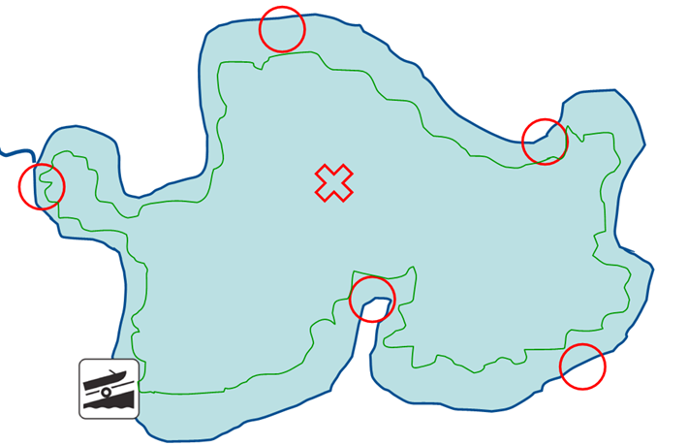
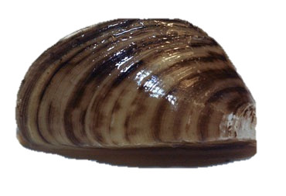

Slide 26
Veliger Tows
Sample deep, downwind portions of lake.
Lower net.
Rinse samples into the collection cup.
Transfer sample to sample bottle.
Repeat the other two preselected sites.
Composite the samples.
Label the sample bottle and preserve.
Record data.
Notes:
Note: If the prescribed ethanol to sample ratio (4:1) cannot be achieved after repeated condensing and decanting, then the sample should be split between two sample bottles. Label the bottle in sequential order.
Note: Transport the sample bottle(s) on ice in a cooler if you are not preserving immediately.

Slide 27
Decontamination & Disinfection

Slide 28
Decontamination & Disinfection
You do not have to decontaminate and disinfect equipment between sample sites on the same lake.
If multiple lakes are sampled in one day, decontaminate between each lake.
You should always decontaminate at the end of the day when you return

Slide 29
Ekman Dredge Decontamination
Remove spines to prevent false positives on the next lake:
Rinse and scrub equipment with lake water vigorously and thoroughly while on the lake.
Contain all equipment so no residual water can escape.
Ekman dredge and bucket can be pressure washed with hot water or steamed for 1 minute at a temperature higher than 122°F.
To kill any remaining resting eggs after removing spines:
Dry equipment for 6 hours at 63⁰F or for at least 5 days.
or
Ekman dredge and bucket can be pressure washed with hot water or steamed for 1 minute at a temperature higher than 122°F.

Slide 30
Waterflea Tow Net Decontamination
Option one:
Use a completely new set of gear for each waterbody during the work day and disinfect all gear at the end of the day
Option two:
Spray gear with a handheld Jiffy stream cleaner or high-pressure unit for 10 to 13 seconds. This method is preferred.

Slide 31
Veliger Tow Net Decontamination
Option one:
Use a completely new set of gear for each waterbody during the work day and disinfect all gear at the end of the day
Option two:
Soak gear in vinegar to dissolve veliger shells
Spray gear with a handheld Jiffy stream cleaner or high-pressure unit for 10 to 13 seconds.
This method is preferred
Option three:
Soak gear in vinegar to dissolve veliger shells
Soak or spray gear in 500 ppm chlorine solution for 10 minutes
Gear will degrade if chlorine is not rinsed off thoroughly

Slide 32
New Sample Submission Form
Zana Sijan & Shelby Adler
WDNR

Slide 33
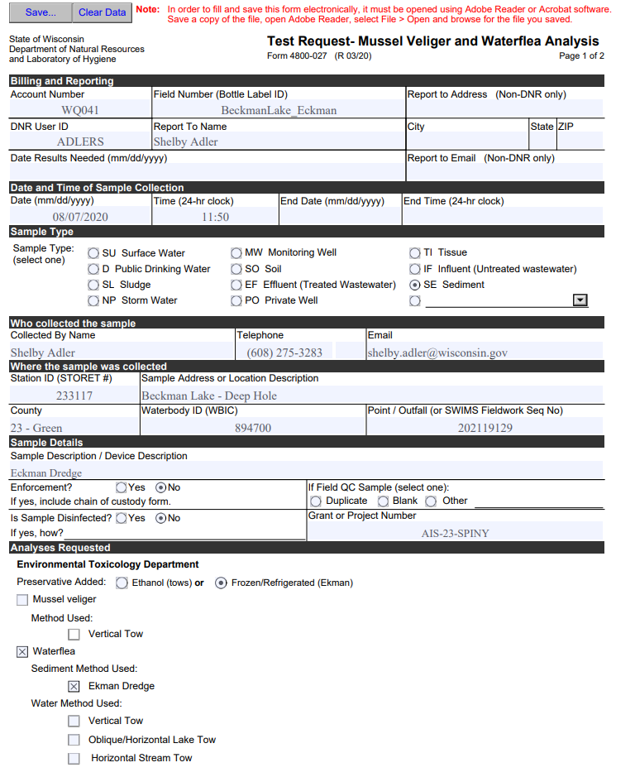
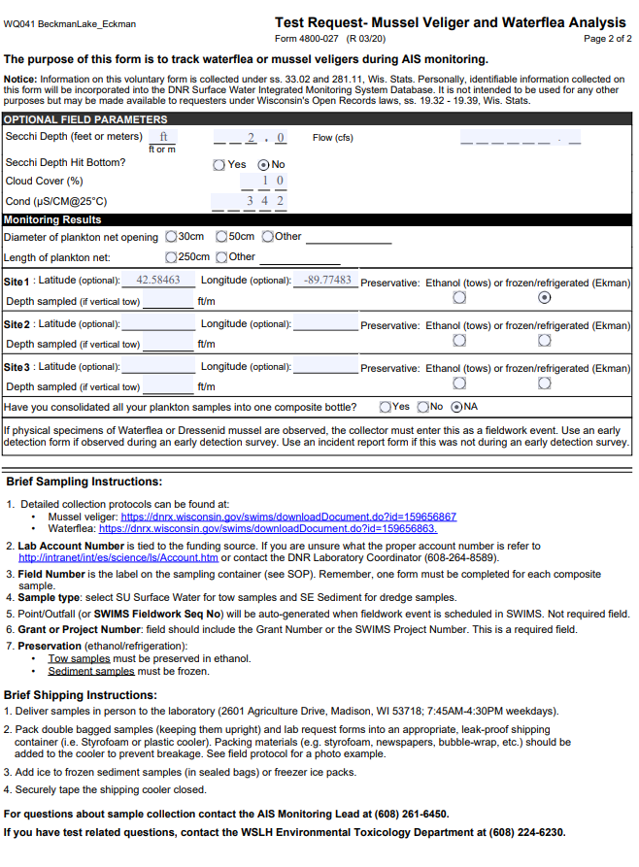
NEW FORM 4800-027 (LABSLIP)
Notes:
Form 4800-027 Mussel Veliger and Waterflea Analysis, important as there used to be two separate
Majority of your form can and should be prefilled before you go out into the field to collect the sample. You can pre-fill it in SWIMS and print it off.
Scanned copies of submitted forms will be available in SWIMS.

Slide 34
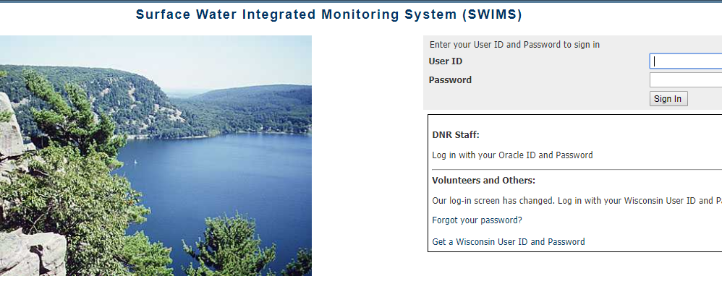
Where To Find FORM 4800-27
SWIMS
Non-DNR staff- Contact your Regional AIS Coordinator
Notes:
Majority of your form can and should be prefilled before you go out into the field to collect the sample. You can pre-fill it in SWIMS and print it off.
If you do not have access to SWIMS, you can find the form in the DNR Forms Catalog or the Lab Services webpage (Forms link).
Lab Services Intranet Link: http://intranet.dnr.state.wi.us/int/es/science/ls/

Slide 35
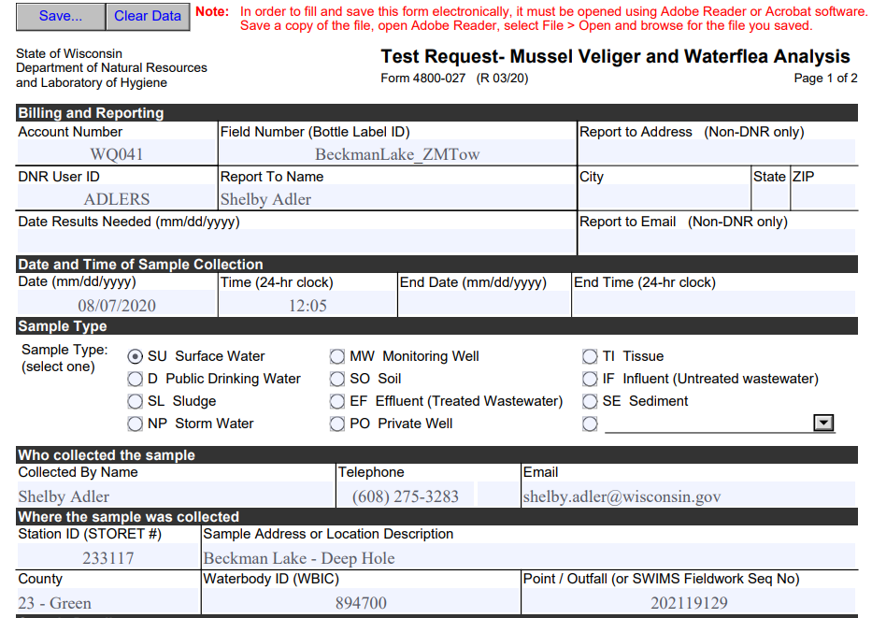
Upper Portion Example
Notes:
Deep hole (waterflea) or whole late (zebra mussels) for the Station ID
If you don’t know the Account Number or the DNR User ID, contact the Lab Coordinator Zana Sijan
Account Number- Associated with the billing of the analysis. Won’t get results if the field is left blank. The account number gets updated every fiscal year, be sure to have the correct one.
Field Number- Is the unique name/identifier that you label your sample – MUST MATCH SAMPLE LABEL
DNR User ID- Oracle ID of the DNR employee who will receive the automatic email notification stating that the results are in the system
Report To Name- To whom the lab report should be sent to, typically the same person as on the DNR User ID
Date and Time of Sample Collection- Date/time of when the sample was physically collected
Sample Type- What type of sample
Collector Name and Contact Info- Be sure to provide the phone number you are most accessible by. \
Station ID- SWIMS Station ID, critical component to get data into SWIMS
Location Description- SWIMS Station Name, will auto fill when Station ID is filled out.
County- the County in which the sample was collected
Waterbody ID- WBIC
Point/Outfall- SWIMS Fieldwork Seq No – AUTO FILL when labslip is created

Slide 36
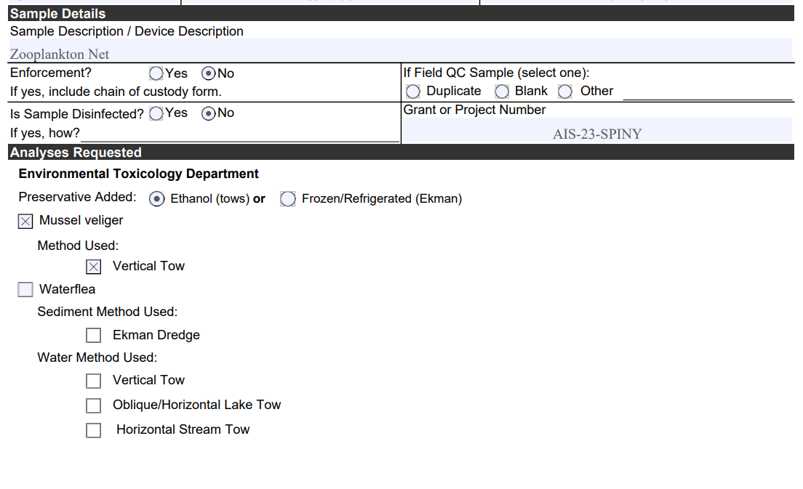
Mussel Veliger Tow Example-Front
Notes:
Sample/Device Description- Additional details about the sample or sampling technique
Enforcement- AIS samples are not enforcement samples
Disinfection- AIS samples are not disinfected before collection
Field QC Sample- If you are collecting a field duplicate or blank
Grant/Project Number
Analysis Requested

Slide 37
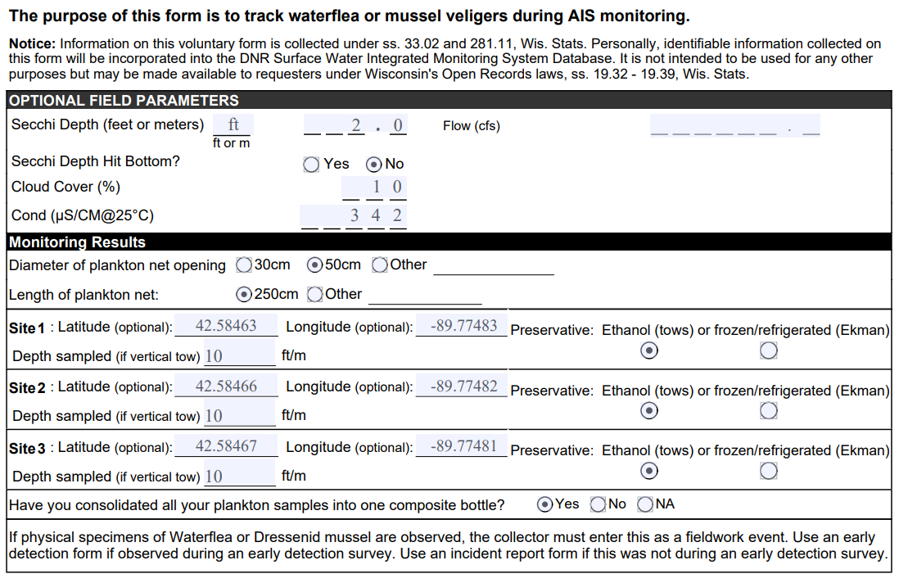
Mussel Veliger Tow Example-Back
Notes:
Optional field parameters if provided will be entered into the database by the WSLH data entry staff. There is no need to enter the data yourself into SWIMS.
Monitoring results are not entered into SWIMS, though it is still important to fill this section out when requesting enumeration analysis. Diameter of net opening and depth sampled factor into enumeration calculations.
Scanned copies of the labslips will be available in SWIMS so all of the Monitoring Results information will be accessible for your sample.

Slide 38
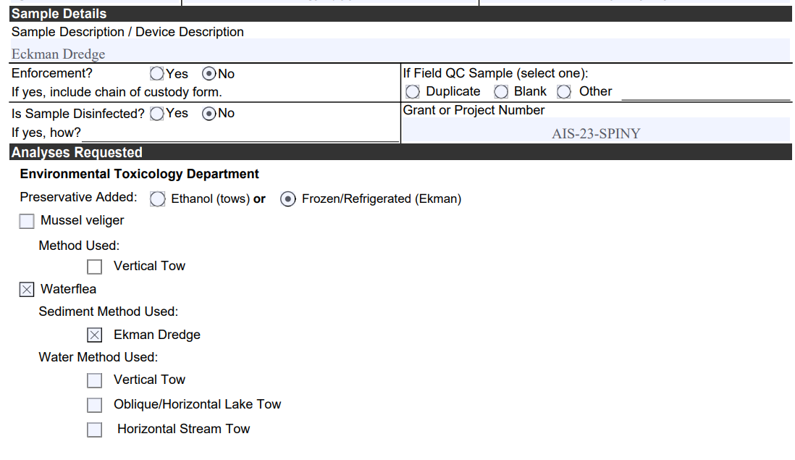
Waterflea Eckman Dredge Example-Front
Notes:
Sample/Device Description- Additional details about the sample or sampling technique
Enforcement- AIS samples are not enforcement samples
Disinfection- AIS samples are not disinfected before collection
Field QC Sample- If you are collecting a field duplicate or blank
Grant/Project Number
Analysis Requested

Slide 39
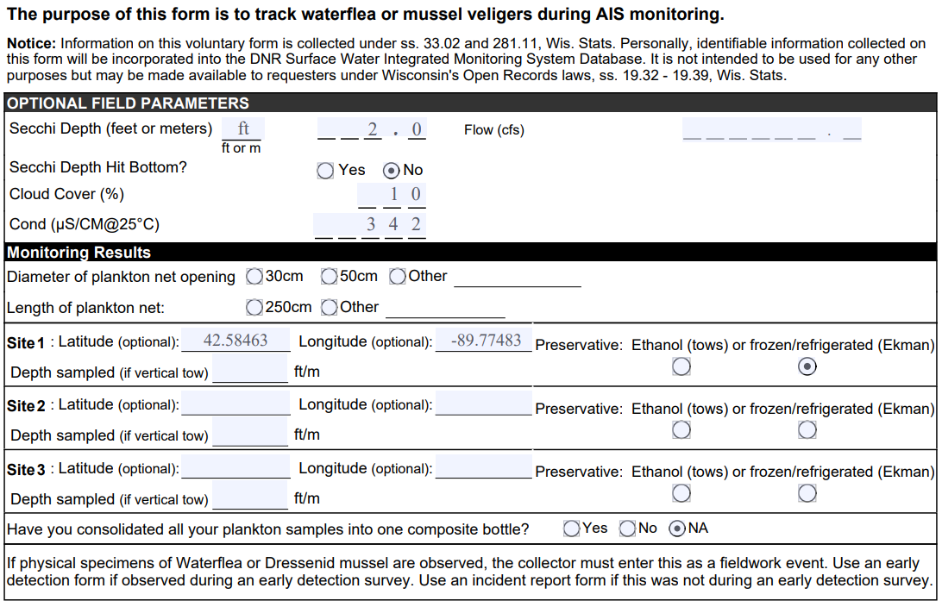
Waterflea Eckman Dredge Example-Back
Notes:
Optional field parameters if provided will be entered into the database by the WSLH data entry staff. There is no need to enter the data yourself into SWIMS.
Monitoring results are not entered into SWIMS. When submitting an Eckman Dredge sample, these fields are not required. But, scanned copies of the labslips will be available in SWIMS so all of the Monitoring Results information will be accessible for your sample. So, in the future if you ever need to, you can look back to see Lat/Long of sampling site.

Slide 40
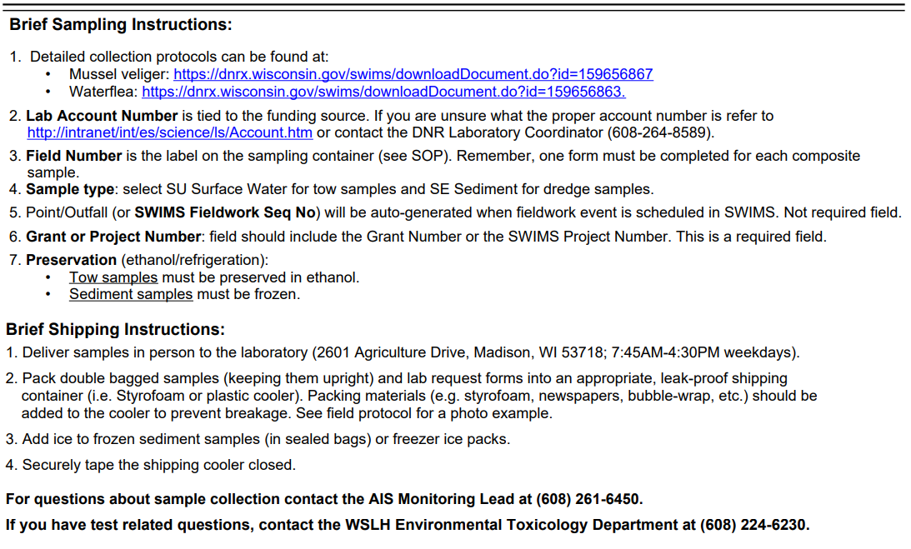
Sampling & Shipping-Back
Paperwork into Ziplock bag!
Notes:
Before you send off your samples for analysis, if possible, put the labslip paperwork into a ziplock bag to prevent the paperwork from getting wet and illegible.

Slide 41
Mandatory Fields For Data Transfer
Account Number (Note: New every FY)
DNR User ID
Collection Date and Time
Sample Type
Collector Name and Contact
SWIMS Station ID
SWIMS Project ID
Notes:
If you don’t know the Account Number or the DNR User ID, contact the Lab Coordinator Zana Sijan
Account Number gets updated every fiscal year

Slide 42
Mandatory Fields For Analysis
For All Analysis Types
-Analyses Requested
For Enumeration Analysis
-Depth Sampled
-Diameter of Plankton Net
Notes:
When submitting ZM and WF tow samples for enumeration analysis, you must also fill in “Diameter of Plankton Net” and “Depth Sampled” for each tow. These are used in enumeration calculations, if not provided, enumeration analysis cannot be performed.

Slide 43
Labslip Creation Tutorial
Shelby Adler
WDNR

Slide 44
Sample Submission
Shelby Adler
WDNR

Slide 45
Important Changes – WSLH Transition
WSLH will provide sample bags and labels
Deadline to Submit Samples - October 31st
When submitting >10 Samples at a time, you must notify WSLH prior to delivery/shipment
Email: biomonitoring@slh.wisc.edu
Phone: 608-224-6230
Notes:
Can avoid missing deadline and notification requirement by submitting to Maureen Ferry at Fall AIS Partnership meeting (as in past years) or by not stockpiling samples for delivery/shipment until the end of the field season but by shipping as you collect.

Slide 46
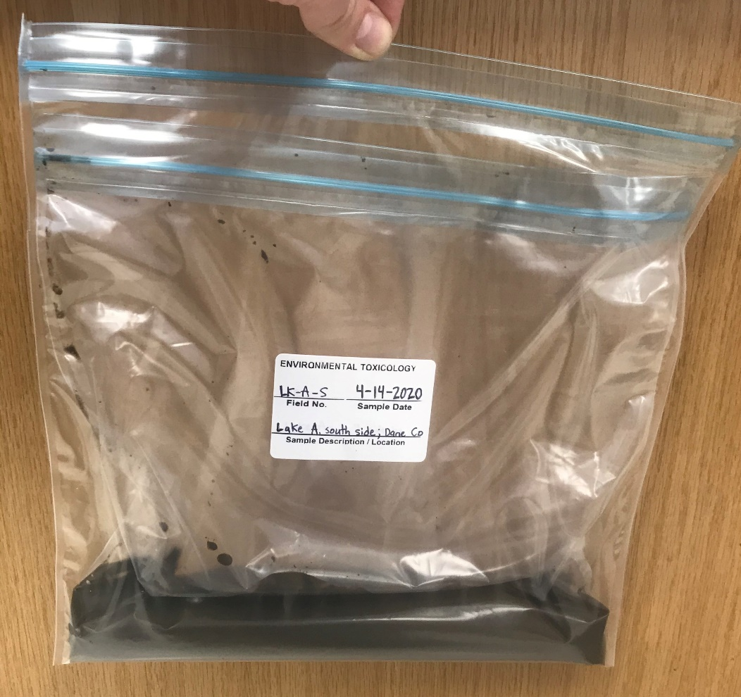
Waterflea Sediment Sample Submission - Correct
WSLH Provided Bag
Double-Bagged
Bag filled 1-2 inches of sediment
Complete Label
Frozen

Slide 47
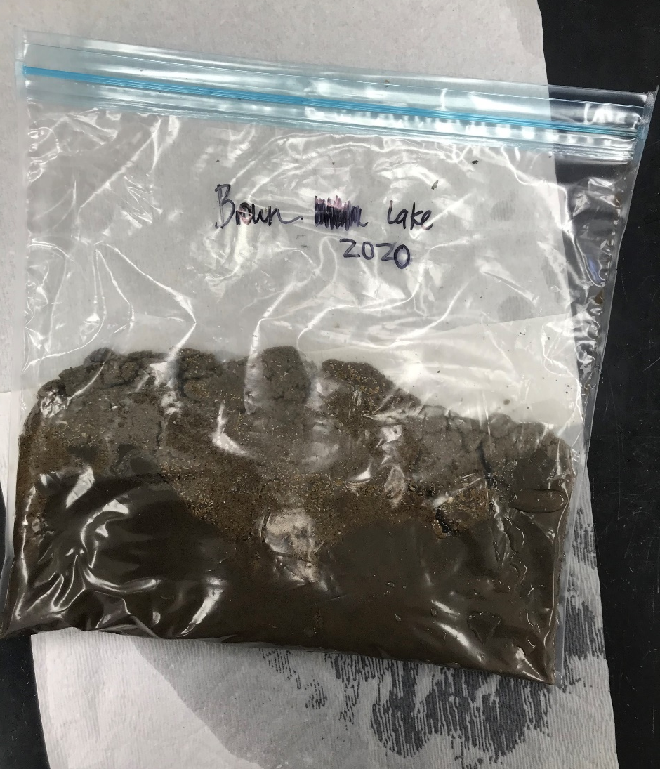
Waterflea Sediment Sample Submission – Common Mistakes
Single-Bagged
Overfilled Bag
Incomplete Label
Preserved with ethanol
Sample submitted a in bottle

Slide 48
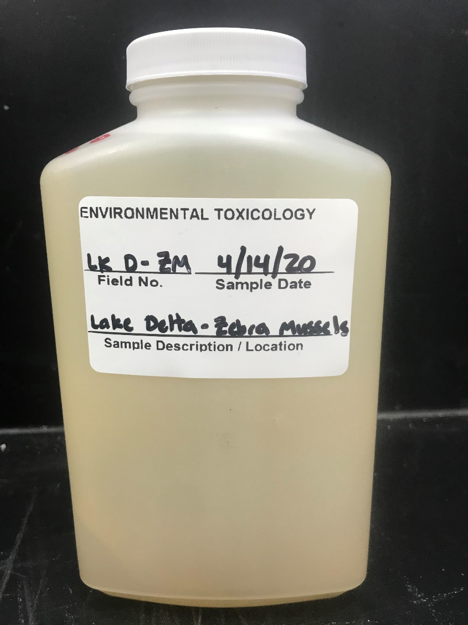
Waterflea and Zebra Mussel Tow Sample Submission – Correct
250 mL or 1 L Sample Bottle
Preserved with correct ethanol:sample ratio (4:1)
Complete Label
Notes:
Correct sample jar size will be important for shipping requirements.

Slide 49
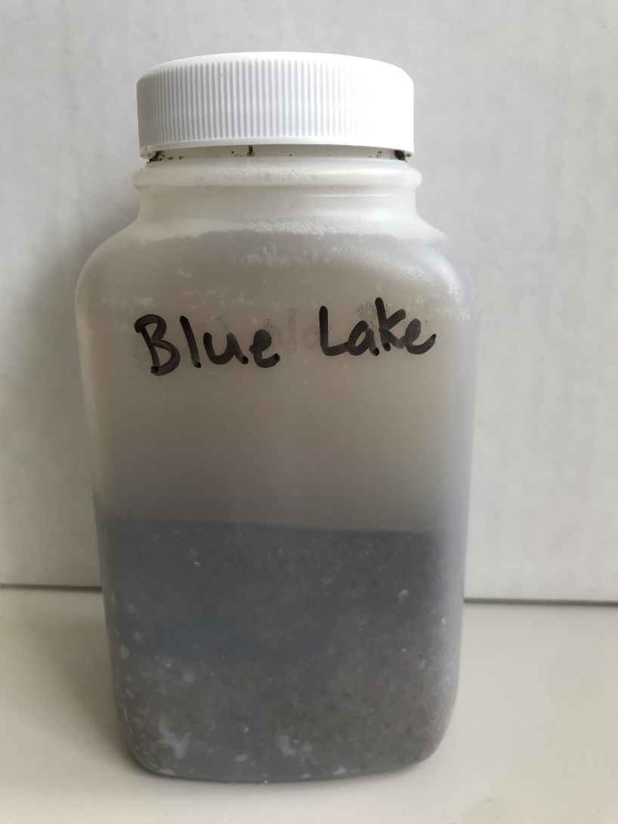
Waterflea and Zebra Mussel Tow Sample Submission – Common Mistakes
Inadequately Preserved
Incorrect bottle size
Incomplete label
Abundance of sediment/muck in sample
Notes:
Please use correct 4:1 ethanol:sample ratio for preservation, otherwise sample gets very smelly and zooplankton degrades. Please split between two samples bottles, label bottle _ of _, more on next slide.

Slide 50
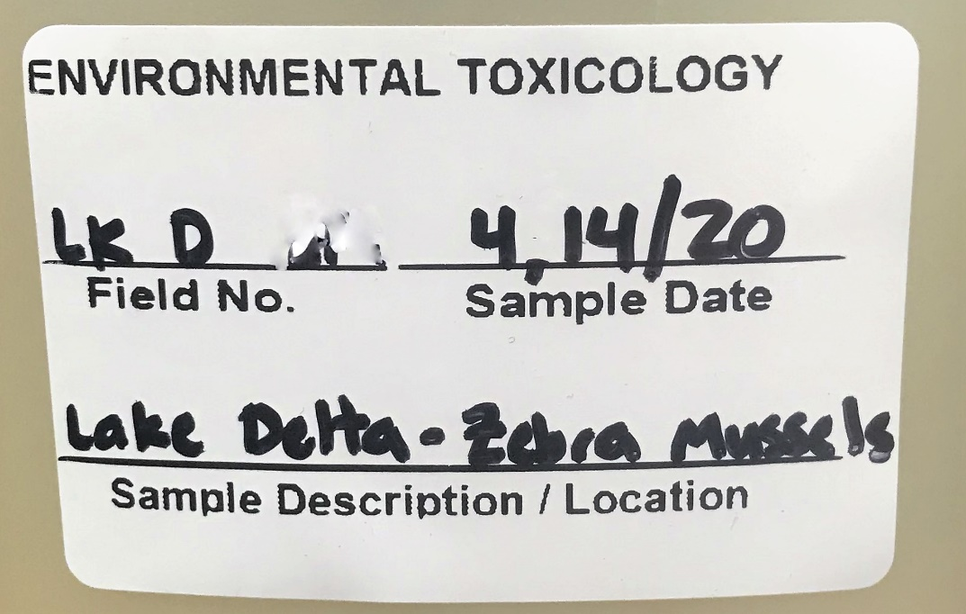
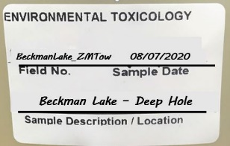
Label Guidance New WSLH Label
Split Samples
BeckmanLake_ZMTow
08/07/2020
Beckman Lake – Deep Hole
1 of 2
2 of 2
Notes:
WSLH bags will come pre-labeled and will receive labels for tow sample bottles. Less to fill out on new labels, because all information should be completely filled out on labslip. VERY important field number matches the labslip. Split samples should only happen with tows, all bottles should have same Field No, only on Field No on labslip. Then label bottles _ of _.

Slide 51
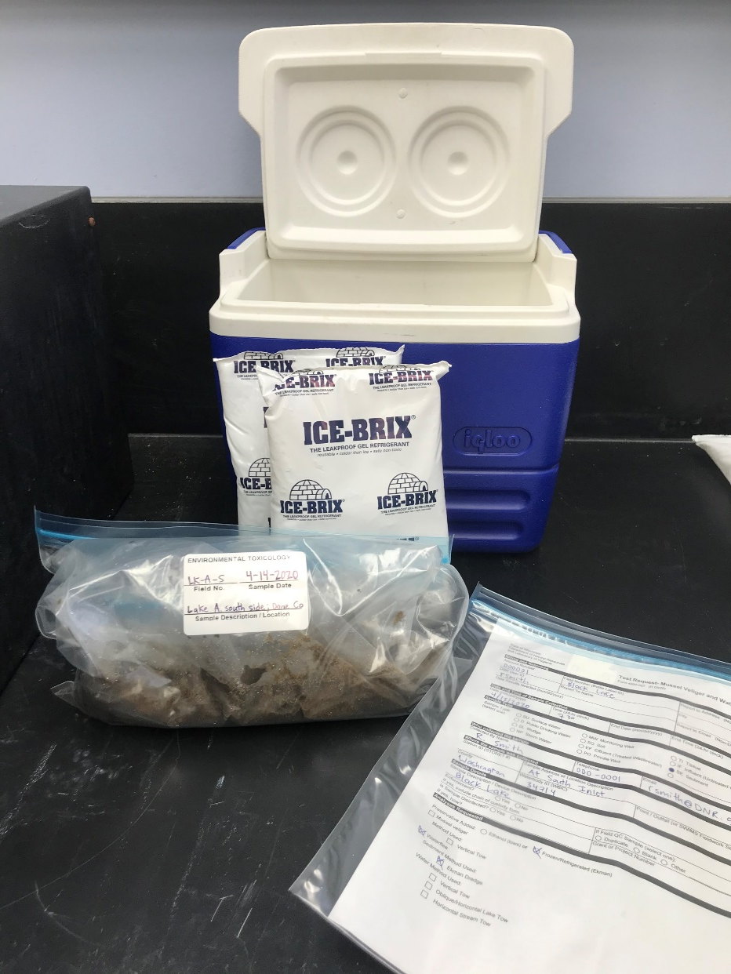
Waterflea Sediment Shipment
Pack double-bagged samples upright in leak proof shipping container
i.e. Styrofoam or Plastic Cooler
Add ice (in sealed bags) or freezer ice packs
Labslip(s) in separate zip bag
Securely tape shut shipping container

Slide 52
Tow Shipment
Wisconsin Dept. of Natural Resources 101 N Ogden Road Peshtigo, WI 54157-1708
State Laboratory of Hygiene
c/o Environmental Toxicology Dept
2601 Agriculture Drive
Madison, WI 53718

Slide 53
Waterflea and Zebra Mussel Tow Shipment
Classified as a flammable liquid by US Department of Transportation – ethanol solution
For shipment, must be certified in hazardous shipping.
http://intranet.dnr.state.wi.us/int/es/science/ls/Shipping/Training/
DNR Staff must use State Spee-Dee Delivery contract.
http://www.speedeedelivery.com/walkin-wi.html
http://www.speedeedelivery.com/OnCallLetter.pdf

Slide 55
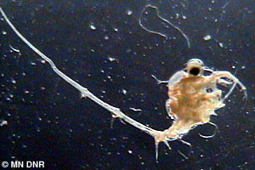
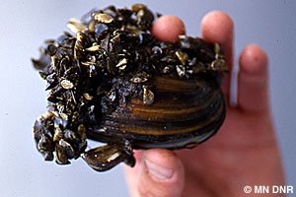
AIS Analysis
MN DNR
MN DNR
Presented by Abigail Merrick
WSLH

Slide 56
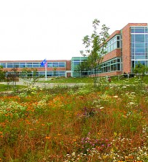
When samples are submitted to WSLH…
2601 Agriculture Drive Madison, WI 53718
biomonitoring@mail.slh.wisc.edu Ph: 608-224-6230
Goes through our receiving department
will not be accepted without the labslip
We review the labslip to determine…
What analyses are to be completed on the submitted samples (i.e. veliger, SWF, etc.)
If there is missing information
Who we should contact if there are any questions regarding the samples

Slide 57
Dreissena Veligers
Plankton Tow Method

Slide 58
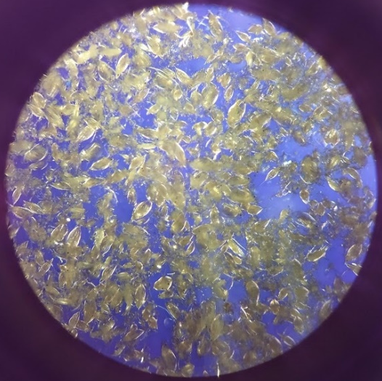
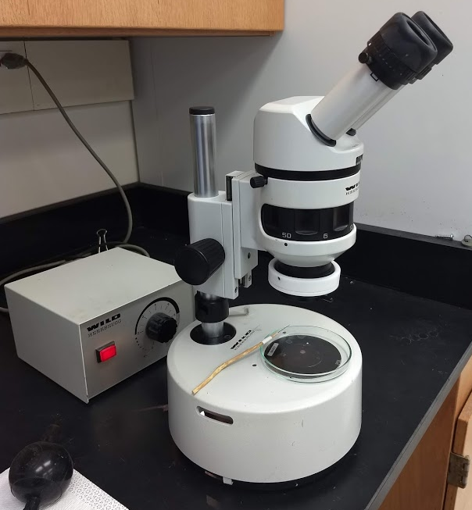
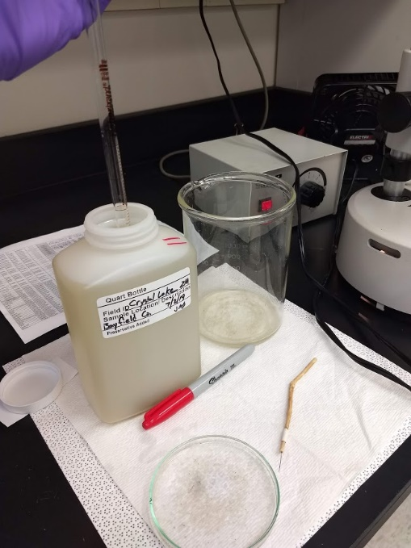
Veliger analysis
1. Screening
5 x 10mL aliquots from the settled material in the sampled using a cross-polarizing dissecting scope
Submitted sample filled with zooplankton
When we find a positive…
Photo by Gina LaLiberte

Slide 59
Veliger analysis
2. Counting
10 x 1mL Sedgewick-Rafter counting chambers
Calculation of organisms/meter³ is based on…
1.) average veligers in counts
2.) net diameter
3.) distance towed
4.) volume of submitted sample
Notification of positive samples will be sent via the AISD listserv
Veliger

Slide 60
Spiny Waterfleas
Ekman Dredge Method

Slide 61
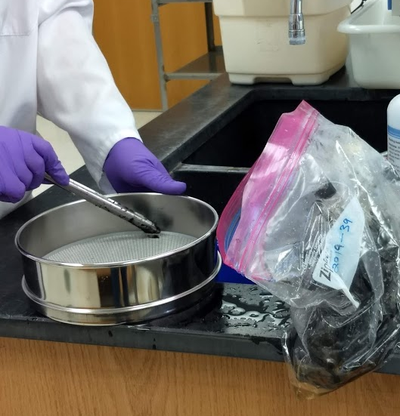
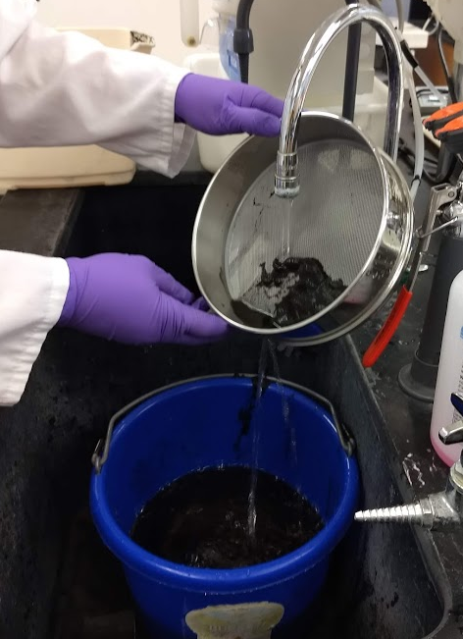
SWF Sediments
Representative aliquots from the submitted sediment sample are put into a 35mm sieve.
It is preferred that submitted samples contain 1-2 inches of sediment. Less is more!
1.
2.
2. The sediment is then rinsed with tap water to minimize unwanted material. The remaining sample is transferred into a glass petri dish with type I water.

Slide 62
SWF Sediments
3. The transferred material in the petri dish is screened for evidence of Spiny Waterflea spines using a dissecting microscope.
3.
If spines are found during scanning, that sample is marked as positive
and the AISD
listserv will
be contacted.
J. Liebig, NOAA GLERL, 2001

Slide 63
Spiny Waterfleas
Tow methods

Slide 64
SWF Tows
Vertical tows
Analyzed in the same fashion as Dreissena veliger samples, except they are homogenized before analysis.
If whole Spiny Waterfleas
are found, they will be
enumerated the same as the
Dreissena veliger samples.
Oblique/horizontal tows
Will only be screened for presence/absence; no enumeration
AISD listserv will be contacted about any positives.
J. Liebig, NOAA GLERL, 2001

Slide 65
Questions?
Collection – Maureen Ferry @WDNR
(608) 261-6450
Lab Account Number – Zana Sijan @WDNR
(608) 264-8589
Analysis – Environmental Toxicology @WSLH
(608) 224-6230

Slide 66
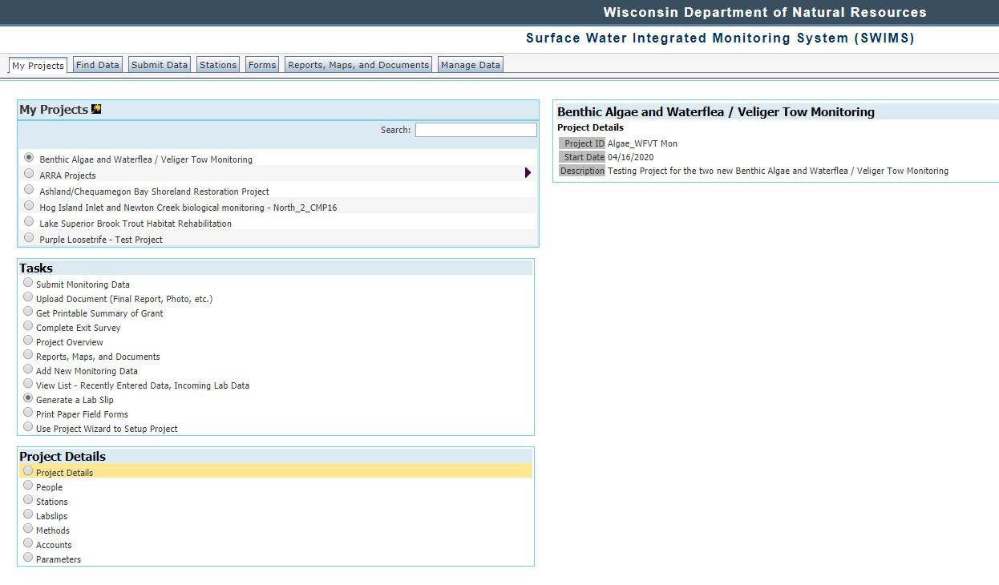
DNR AIS Monitoring - _______ County (Spiny Waterflea and Zebra Mussel Veliger Tows)

Slide 67
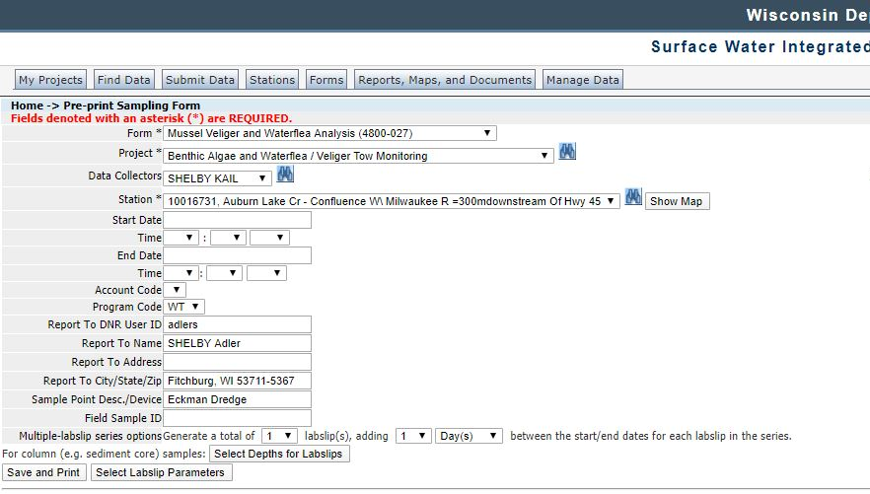

Slide 68
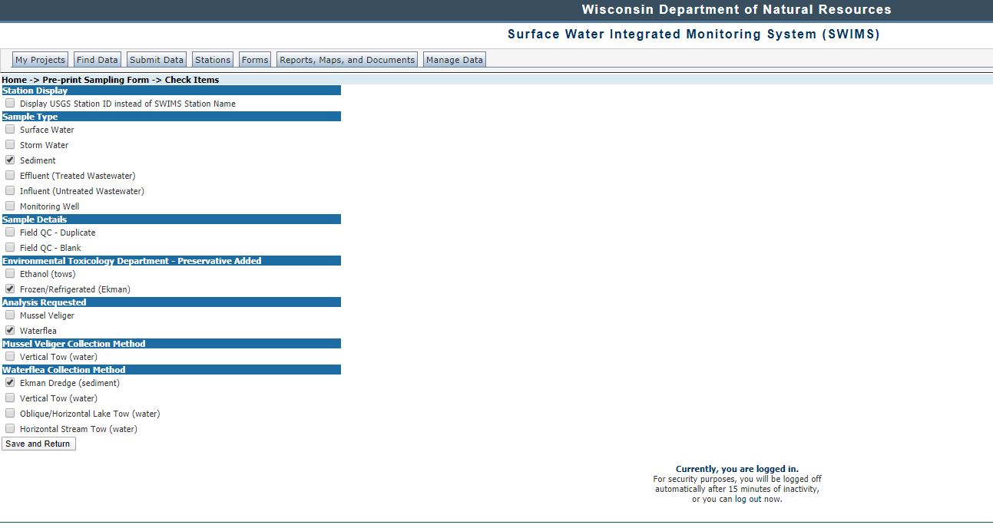
Notes:
Only one species, one preservation type, and one sample type.

Slide 71
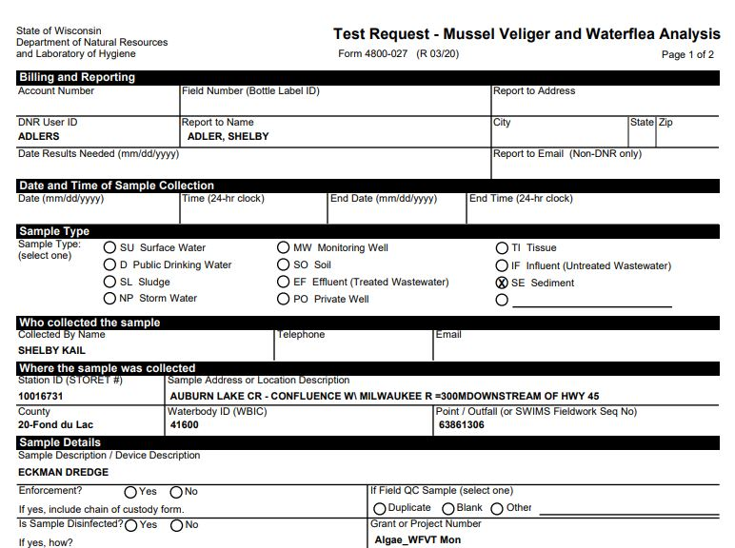

Slide 72
