Slide 1
Big Blake Lake Resident Survey
Katelin Holm
Polk County Land and Water Resources Department

Slide 2
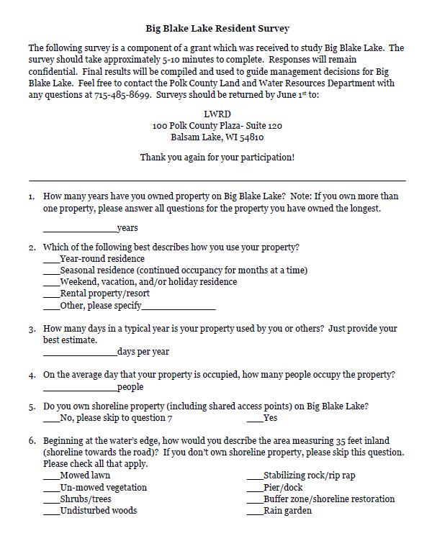
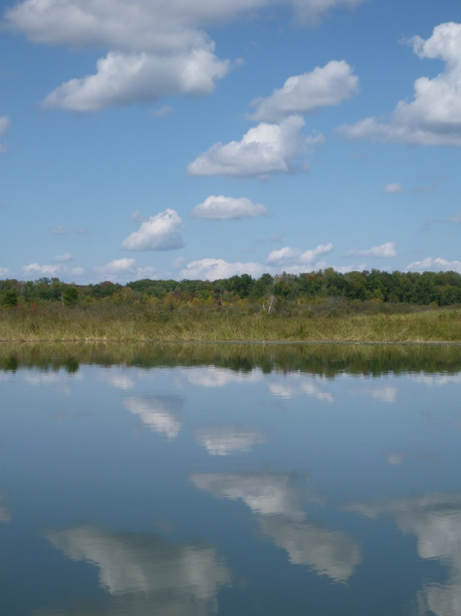
Mailed 217 surveys in May 2014
126 respondents, 58%
Thank you!

Slide 3
Big Blake Lake Owners
Property ownership: 21 years
People occupying property: 3.6
Number of days property used: 148 days
Most people are weekend residents (56%) One third are full time residents (33%)

Slide 4
Characterizing the Shoreline
Half of property owners think the amount of lawn on Big Blake Lake is just right,
one quarter think there is too much lawn,
and one quarter are unsure.
Most believe that buffers, rain gardens, and natives plants are somewhat (34%) or very important (37%) to the water quality of Big Blake Lake.

Slide 5
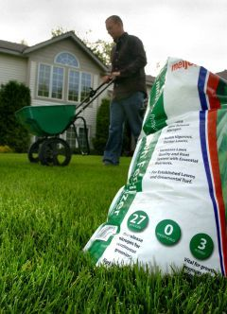
A Very Positive Side Note
98% of survey respondents either don’t use fertilizer or use phosphorus free fertilizers

Slide 6
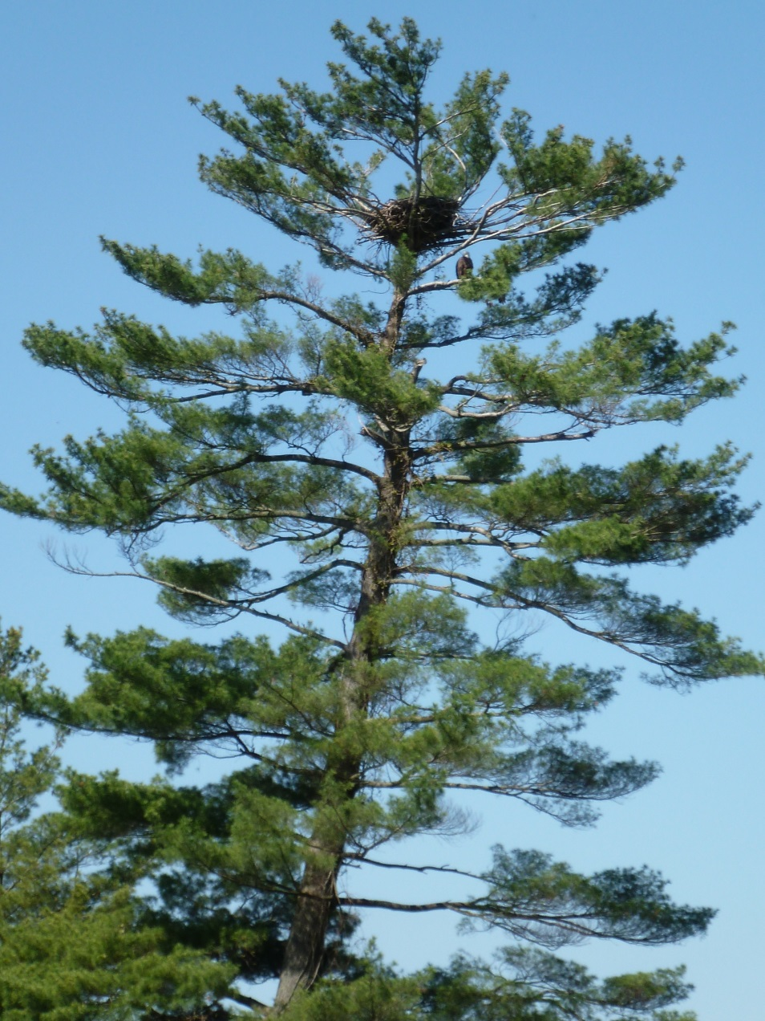
Activities Enjoyed on Big Blake Lake?
Peace and tranquility (93%)
Scenic view (89%)
Fishing (83%)
Motorized boating (80%)
Observing birds/wildlife (79%)
Swimming (70%)
Non-motorized boating (47%)
Ice fishing (45%)

Slide 7
Watercraft and Use
A quarter of respondents use their watercraft on other waterbodies

Slide 8
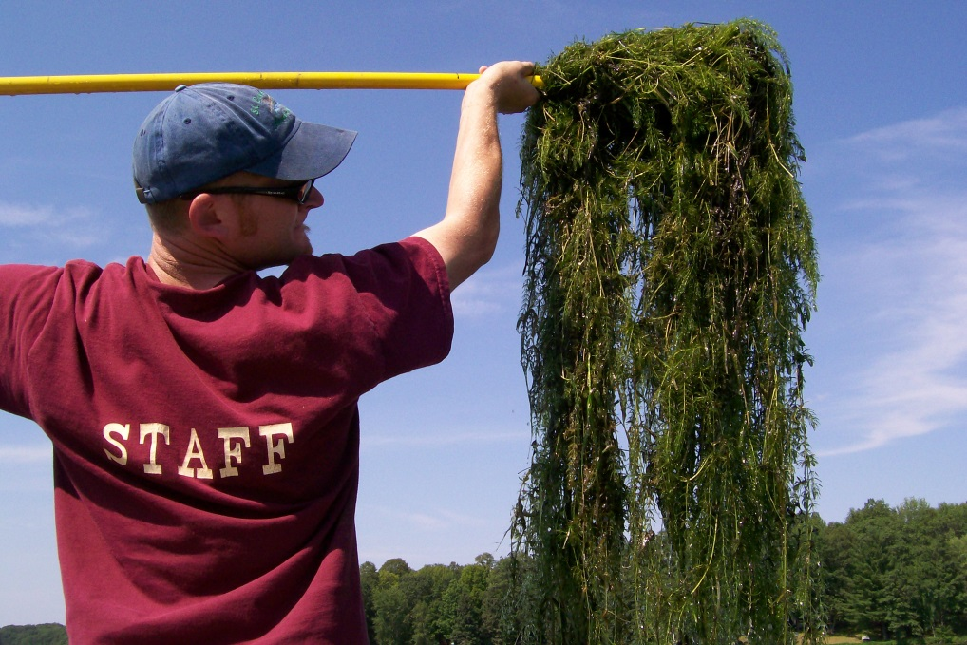
Concerns for Big Blake Lake
High or Medium Concern
By 75% of respondents
Low or No Concern
By 60% of respondents
New invasive species entering the lake
*Expansion of curly leaf pondweed
*Excessive aquatic plant growth
Excessive algae blooms
Lack of water clarity or quality
Increased nutrient pollution
Decrease in overall lake health
Excessive noise level on the lake
Decreased wildlife populations

Slide 9
Current Conditions on Big Blake Lake
Water level:
too low (81%)
Water quality:
fair (54%) or good (26%)
Change in water quality:
graph
Months algae is a problem:
July (66%) and August (88%)
Aquatic plants:
too many (69%) and healthy amount (29%)
Months aquatic plants are a problem:
June (46%), July (74%), and August (67%)

Slide 10
Uses Impaired by Algae and Aquatic Plants

Slide 11
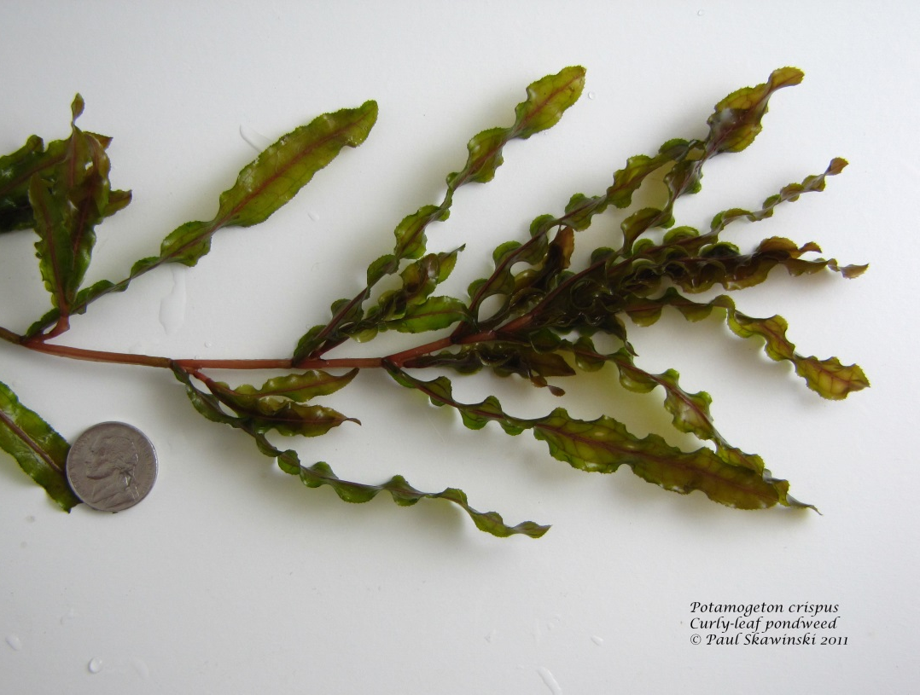
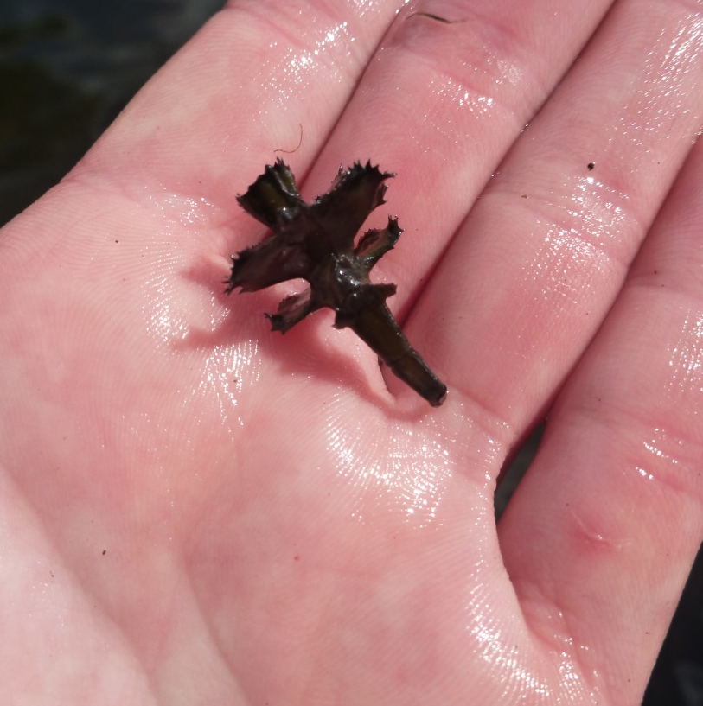
Curly Leaf Pondweed (CLP)
Half of respondents can definitely recognize curly leaf pondweed and another 20% probably can
Paul Skawinski, UW-Extension Lakes

Slide 12
Aquatic Plant Management Program
Is the current program effectively controlling nuisance aquatic plant growth?
How satisfied are property owners with the aquatic plant harvesting program?

Slide 13
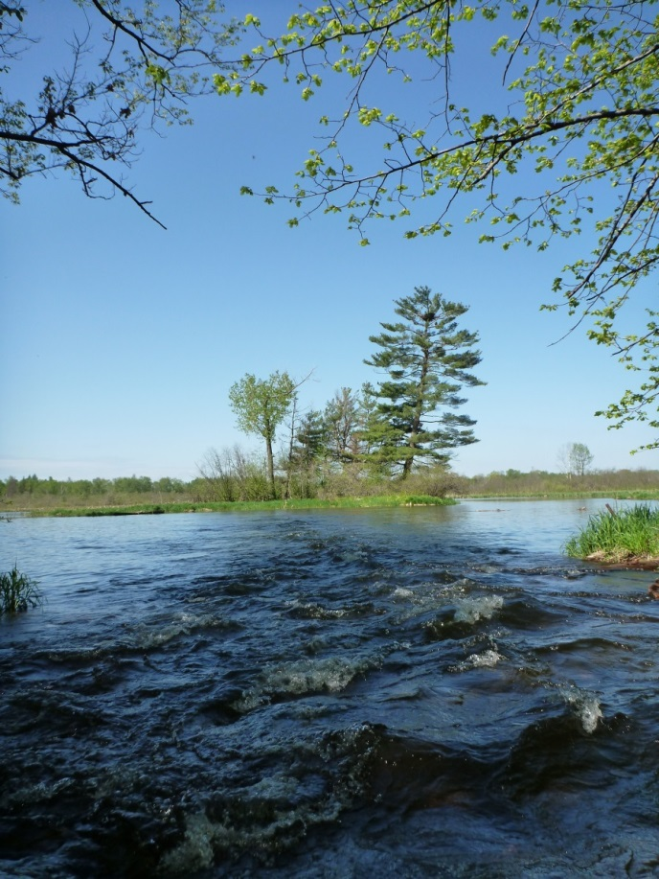
Actions to Manage Big Blake Lake
Ranked by priority
Bring the dam up to code: 91%
Programs to prevent and monitor AIS: 89%
Enhance fisheries: 78%
Upgrade non-conforming septic systems: 71%
Install shoreline buffers/rain gardens: 61%
Install farmland conservation practices: 54%
Lake fairs and workshops: 44%
Enforce slow no wake zones: 44%

Slide 14
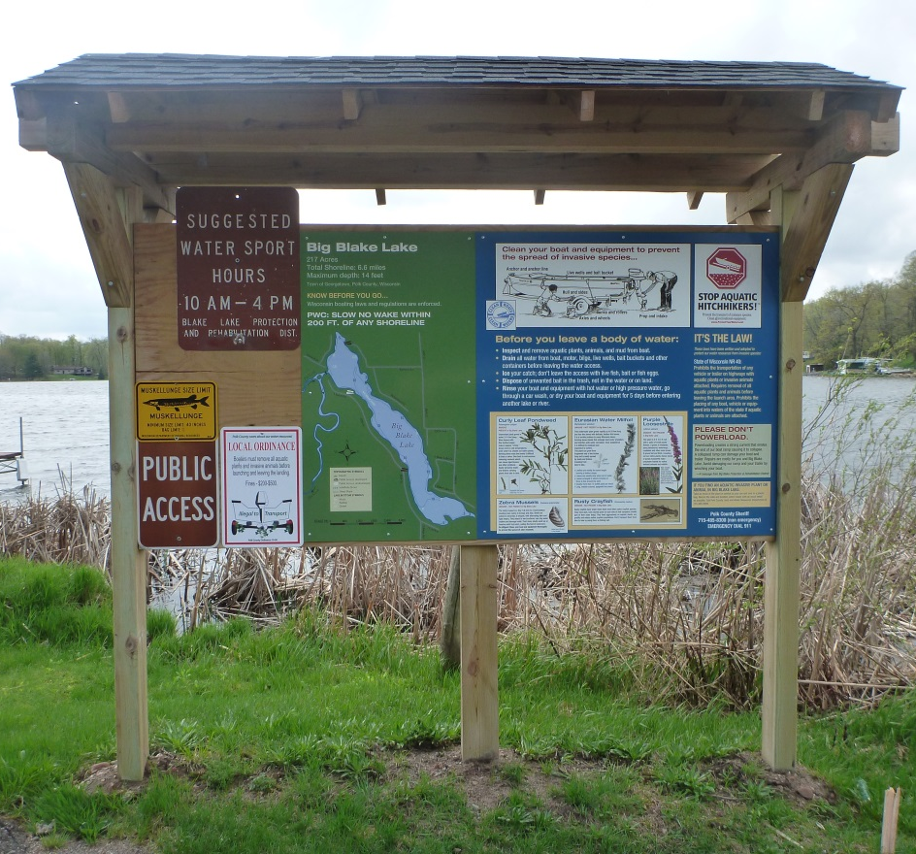
Actions to Manage Aquatic Invasive Species (AIS)
Ranked by priority
Harvesting CLP: 90%
Monitoring to detect new AIS: 89%
Clean Boats, Clean Waters: 86%
Educational programs: 72%
Trainings to identify and manage AIS: 69%
Herbicide control of CLP: 54%
Boat landing cameras: 37%
Boat wash stations: 35%

Slide 15
Communication
Half of property owners were unaware of the Facebook page and another third have never visited the page.

Slide 16
Grant Update

Slide 17
2015 is the last year of a three year grant!
Projects completed include:
In-lake monitoring for chemistry, algae, zooplankton, plants, and CLP turions
Lake resident survey
Education efforts including: The Landing Blitz, Citizen Lake Monitoring, Drain Campaign and Clean Boats, Clean Waters
Projects yet to be completed include:
Pontoon Classroom: Saturday, June 13th from 12-2 pm at the North Boat Landing
Development of a Lake Management Plan

